Slide 1
The UK Gaia Data Mining Platform
Nigel Hambly (IfA Edinburgh & Gaia DPAC)
National Astronomy Meeting, Hull 2024

Slide 2
DR3: ‟A release of superlatives…”
… yet it represents
only 27% of the likely end-of-mission observation time-line
∼1% of the likely end-of-mission data release volume
DR1 (Q3 2016; 15 m)
DR2 (Q2 2018; 22 m)
EDR3 (Q4 2020 34 m)
DR3 (Q2 2022; 34 m)
DR4 (not before mid 2026; 66m)
DR5 (not before end 2030 TBC; ≥ 10 yr up to end-of-mission)
EOM:
Early 2025
Mission timeline
July 2014
May 2017
Jan 2020
July 2024

Slide 3
Gaia DR3 bulk data volume
Bulk download of DR3 products is provisioned via a Content Delivery Network
8.9 TB of gzipped eCSV (text) files; 25 TB uncompressed
Single thread download/decompress the lot in roughly a few days
Largest single data sets are (eCSV)
XP mean spectra: 8 TB (12% of catalogue sources)
MCMC posterior PDF samples output from Apsis General Stellar Parameterization from Photometry: 7 TB (0.1% of catalogued sources)
DRs 4 (& 5) detailed contents being generated now (DR5 still under discussion) but ≈60x (DR4) to 100s (DR5) times bigger than DR3
More spectra, epoch-resolved data, raw and/or intermediate data, …

Slide 4
Relational systems beginning to groan…
TAP/ADQL provides limited access to bulk data via VO Datalink
Relational DBs don’t handle array types easily (i.e. time series, spectra, sampled PDFs, …)
Even straight tabular data is becoming challenging
Mitigate in the short term via e.g. column subset “gaiadr3.gaia_source_lite” in Gaia archive
No facility for end-user programmability
e.g. ADQL has only very basic statistical aggregates
ADQL is not a programming language!
👈

Slide 5
Advanced, scale-out usage scenarios
Community requirements gathered by DPAC via GREAT network and documented in Brown+ (2012)
Higher order, robust statistical aggregates (e.g. GDAS-OA-03)
Analysis of per-CCD photometry for short timescale variability (e.g. GDAS-ST-19)
Searches in Fourier-analysed time domain data (e.g. GDAS-ST-12)
Wholesale dataset trawls (e.g. GDAS-ST-11)
e.g. Spectral twins
Pattern queries (e.g. GDAS-ST-08)
increasingly requiring Machine Learning techniques
General CPU-intensive analysis (e.g. GDAS-OA-01)
Efficient searching for pairs (or higher multiples) of associated objects, e.g.
Lensed QSOs
Wide binaries
Searches in time-resolved astrometric data, e.g. detect plane gravitational wave(s) or primordial stochastic GW background
Requires local plane coordinate residuals from epoch astrometry

Slide 6
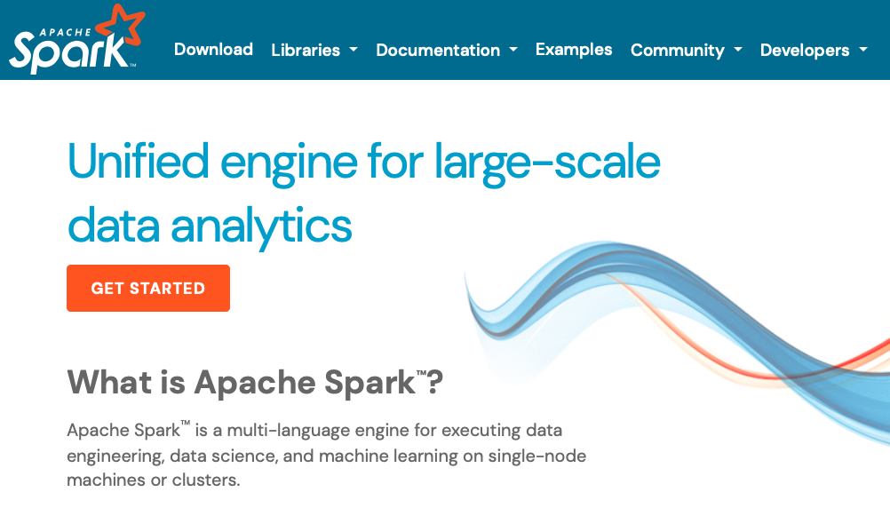
Introducing the UK Gaia Data Mining Platform
The (obvious) solution: code-to-data platforms
Bring end-user code to lots of CPU co-located with the data
Employ distributed computing to mitigate increases in data volume and scale of processing
cf. Rubin Science Platform for LSST, STScI/MAST TIKE, ESA Datalabs, …
The UK Gaia DMP
Deployed on the STFC IRIS Cloud
Flexibility and scalability
Employs Apache Spark ecosystem
Python notebook interface
Friendly APIs to access distributed processing
Familiar libraries for vectorized operations
Machine Learning and many other libraries

Slide 7
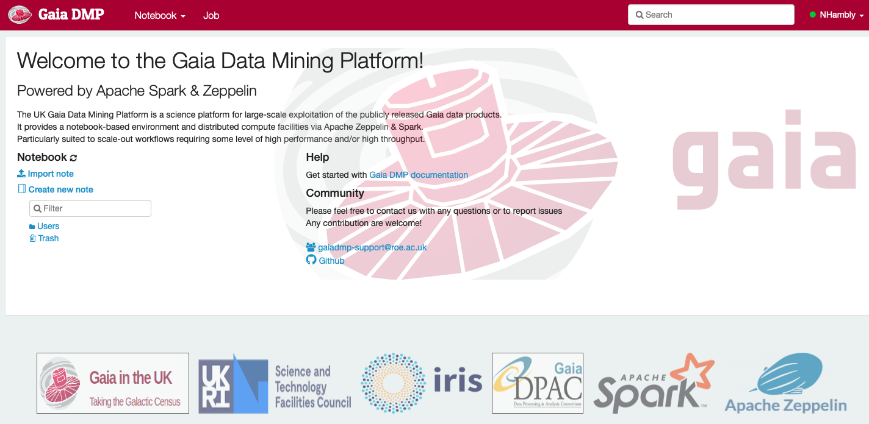
https://dmp.gaia.ac.uk/

Slide 8
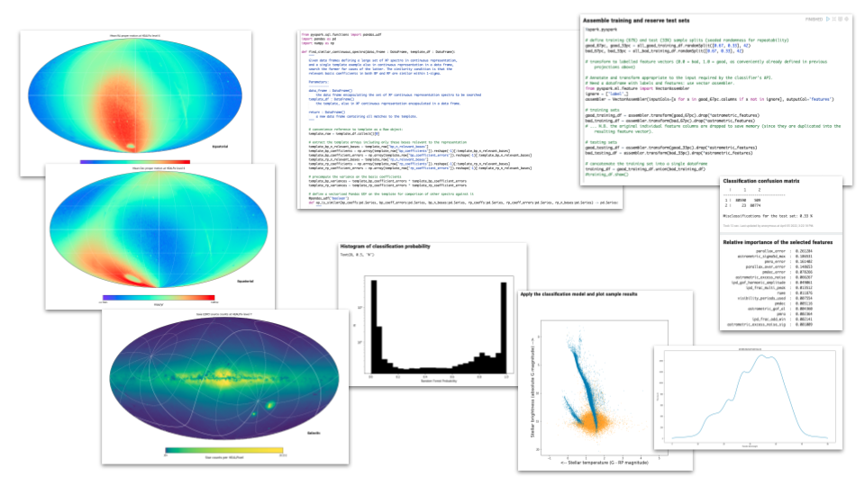
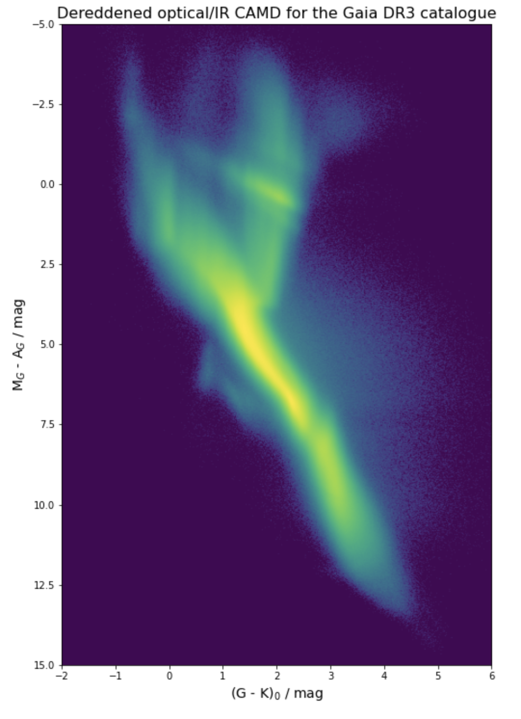
https://dmp.gaia.ac.uk/

Slide 9
A detailed example: searching 2x10⁸ spectra
DR3 has 220 million blue + red spectra in basis-set representation
N basis coefficients
N coefficient uncertainties
N(N-1)/2 correlation coefficients
where N = 55 in each passband
2.7TB in compact (Parquet) binary format
Simple use case: given one example template, find similar spectra …

Slide 10
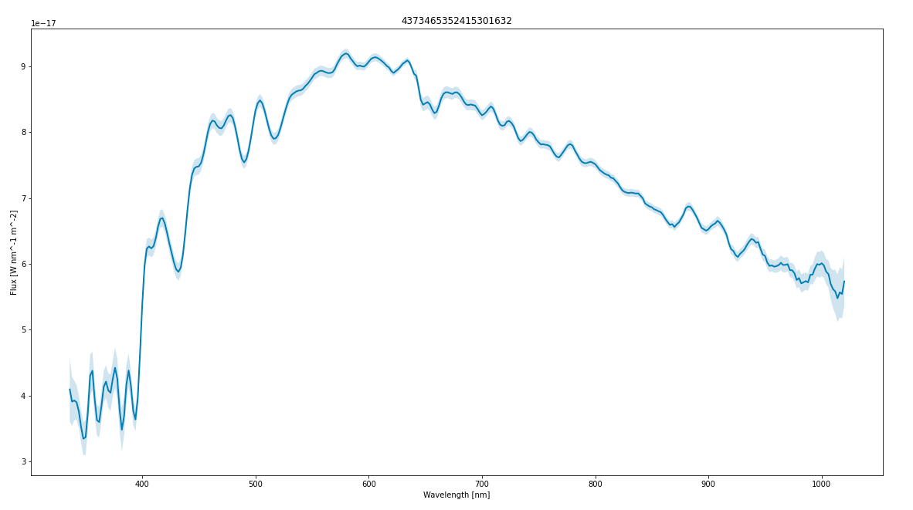
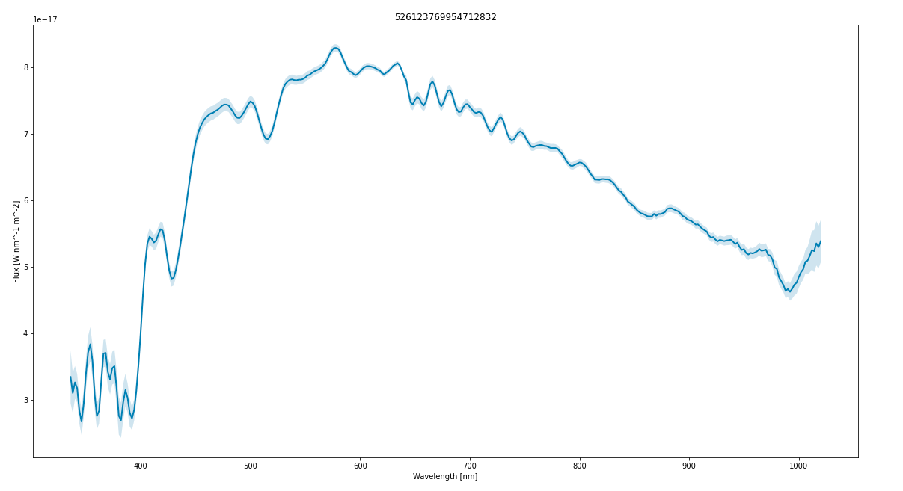
… for example, a Solar (G-) type star
Statistical rigour: compute the Mahalanobis distance (e.g. De Angeli et al. 2022) between the template and all others
In each case reconstruct the full 2d covariance matrix from the (flattened, 1d) correlation matrix and uncertainties vector
matrix & vector multiplications implemented as a “Pandas” (vectorized) User Defined Function for execution on Spark cluster worker nodes
Example matches at similar S/N in a couple of hours
Modest level of parallelism in (virtual) Spark cluster
I/O bound (CPU wait time typically 50%)

Slide 11
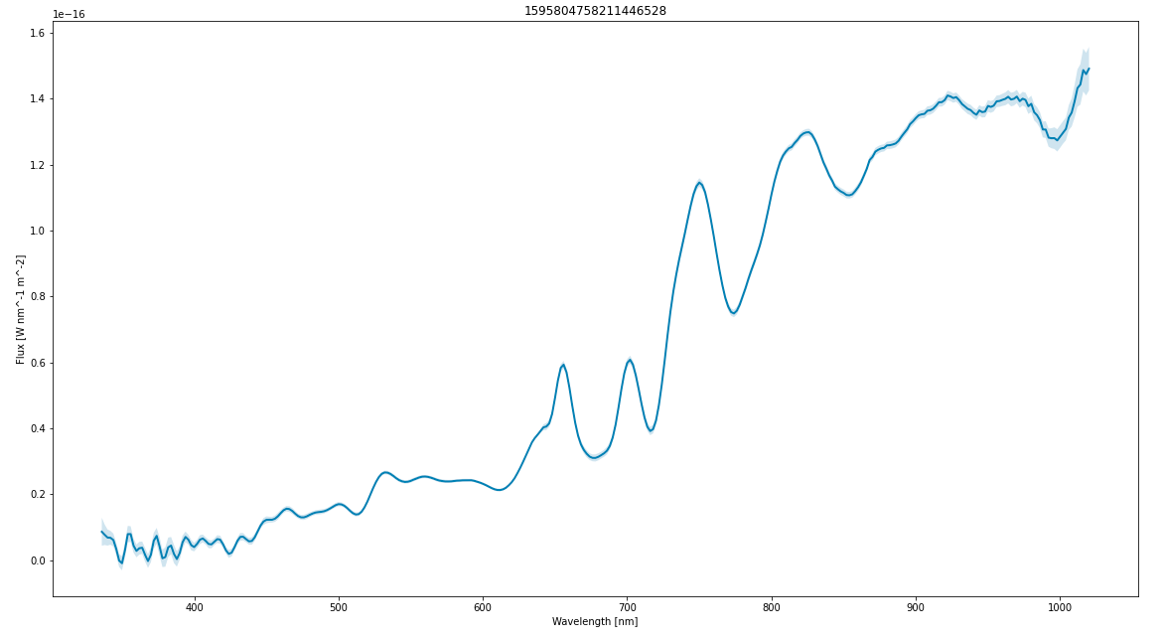
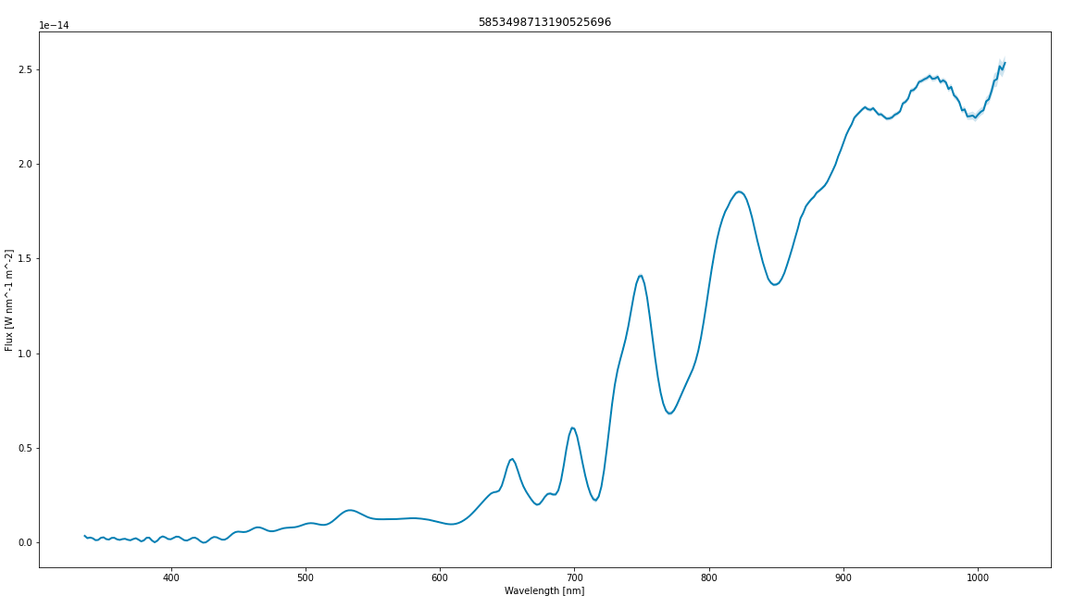
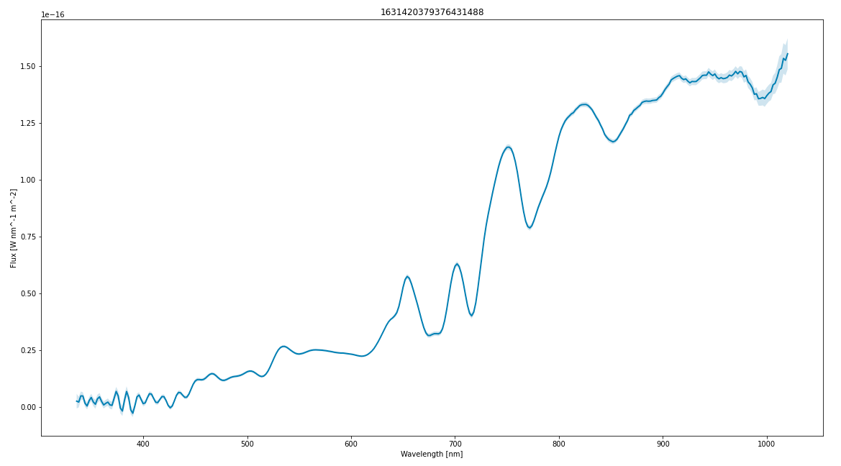
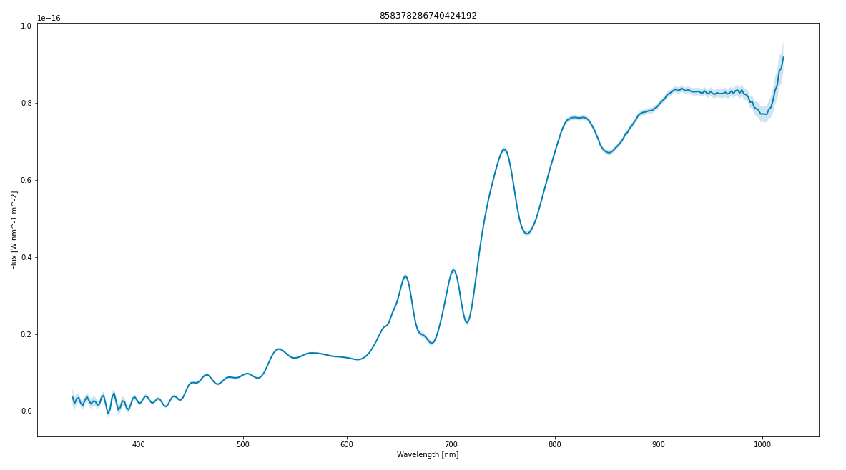
Another example: Proxima Cen look-alikes

Slide 12
Further information
If you …
… find your Gaia science hobbled by the existing archive access, and / or
… are interested in Data Mining / Machine Learning in Gaia astronomy, and / or
… wish to learn more about industry-standard “big data” technology
then please get in touch (speak to me today at NAM 2024 and see live demos!)
Email: gaiadmp-support@roe.ac.uk
for an account and further information.

