Slide 1

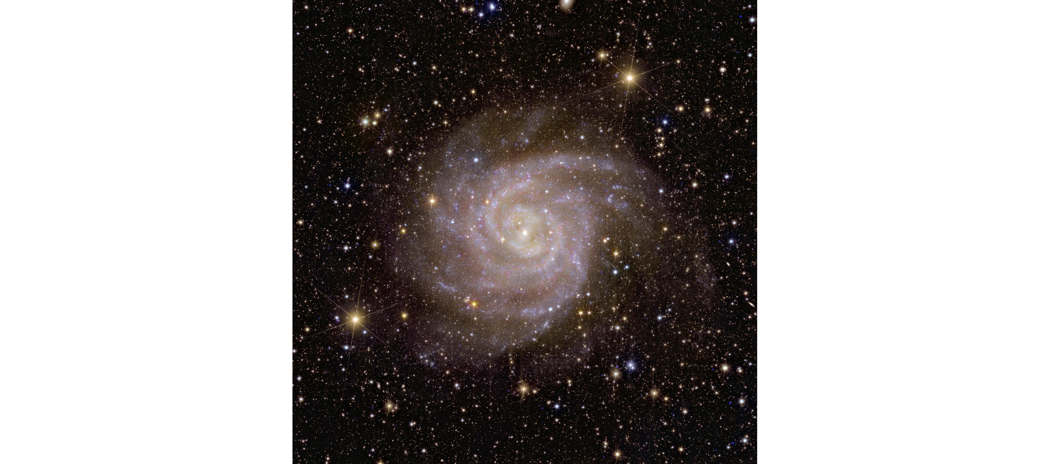

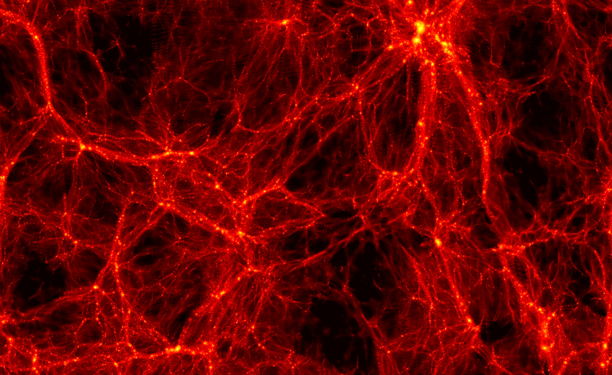

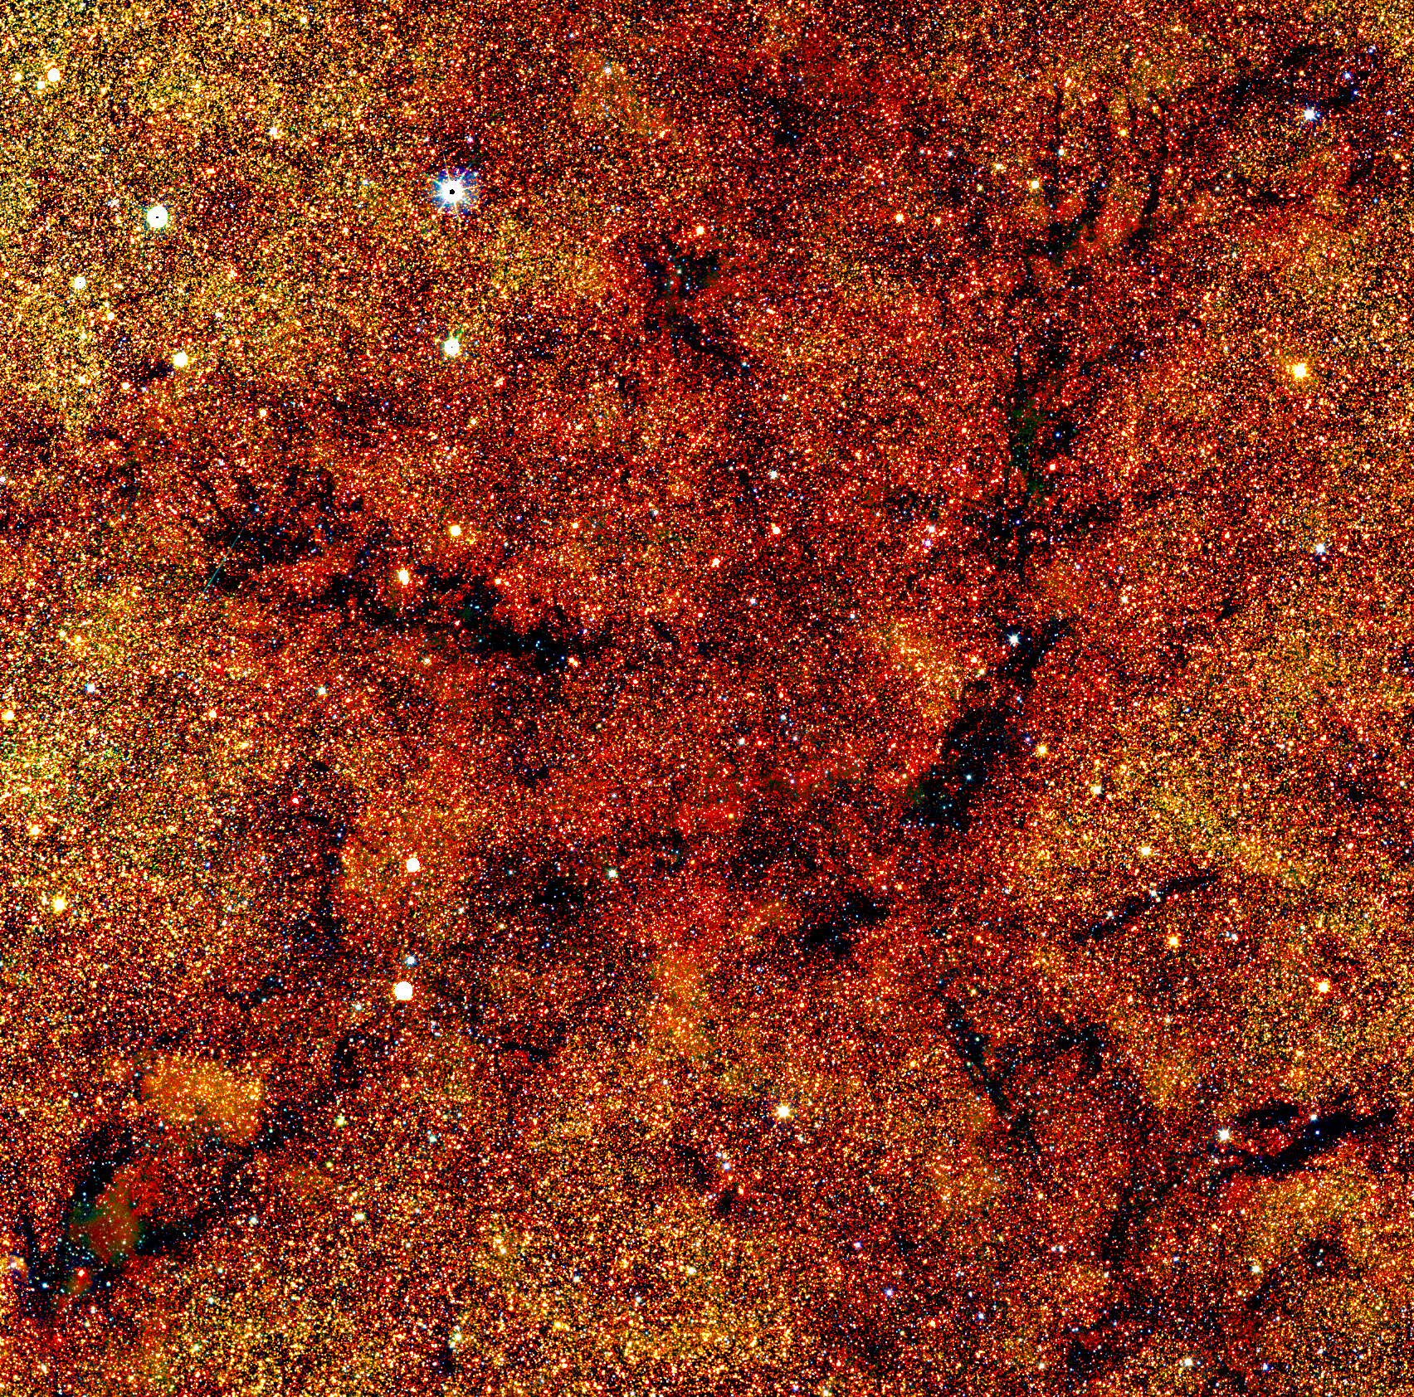

Euclid Data Processing on Distributed Cloud Wide Field Astronomy unit institute for Astronomy university of Edinburgh
Presented by: Mark Holliman WFAU Head of IT Services
The Wide Field Astronomy Unit (WFAU) processes and archives data from space and earth-based observatories, curating science ready data products for the world’s astronomy research community.
Euclid is an ESA mission to explore the nature of dark matter and dark energy. WFAU processes Euclid data using a mix of dedicated hardware and distributed cloud infrastructure.

Slide 2
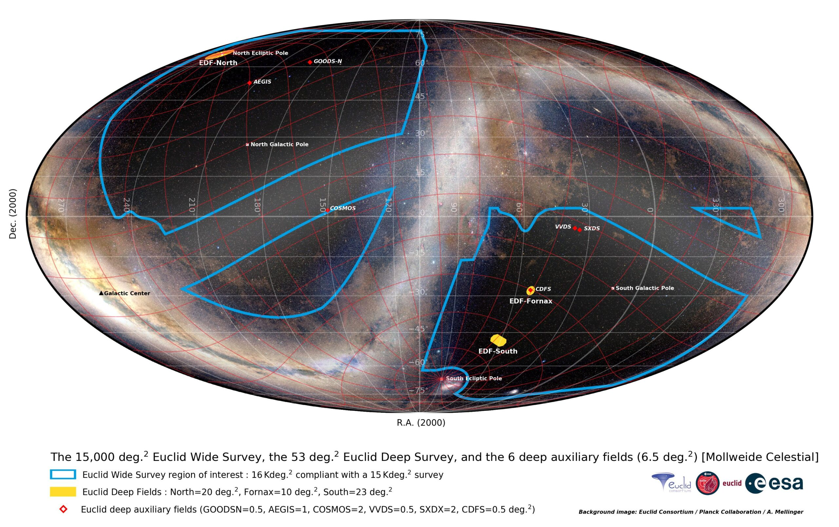


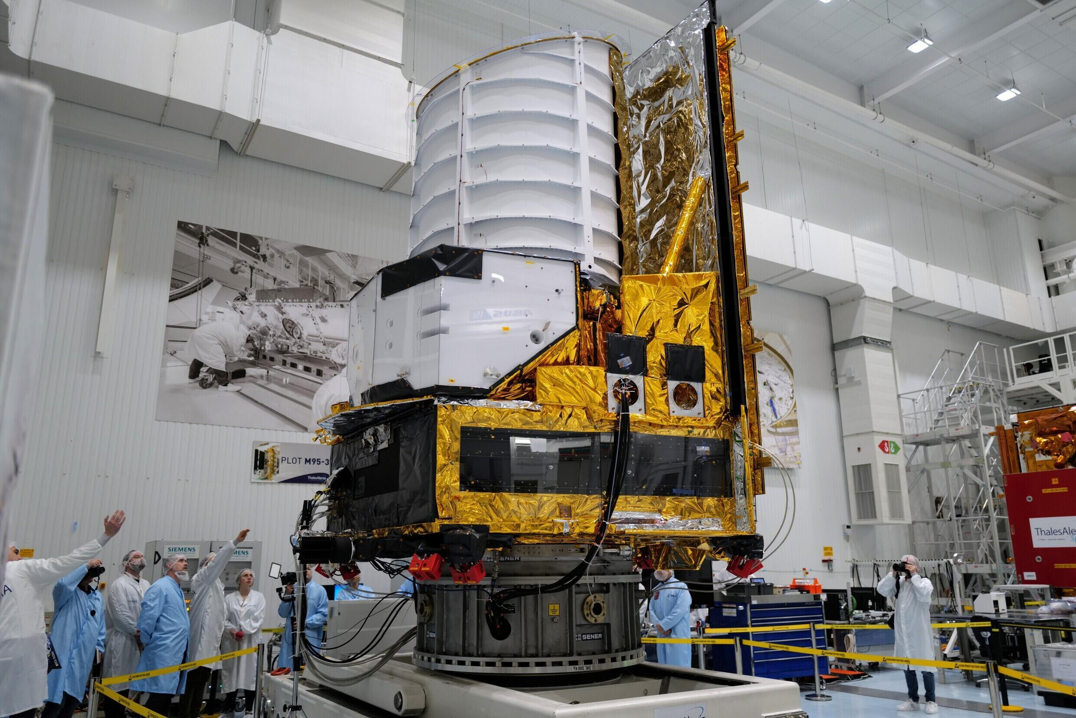
Euclid
Euclid is the European Space Agency’s satellite telescope tasked with surveying a third of the heavens to explore the nature of dark matter and dark energy. It uses a wide angle telescope with two instruments primarily designed for extra-galactic science:
VIS: Visible Spectrum camera
NISP: Near-Infrared Spectrometer and Photometer
The UK is a major contributor at every level of the mission, from building the VIS camera all the way through to leading the main science goal of analysing the gravitational lensing of distant galaxies to build a map of dark matter in the universe.

Slide 3

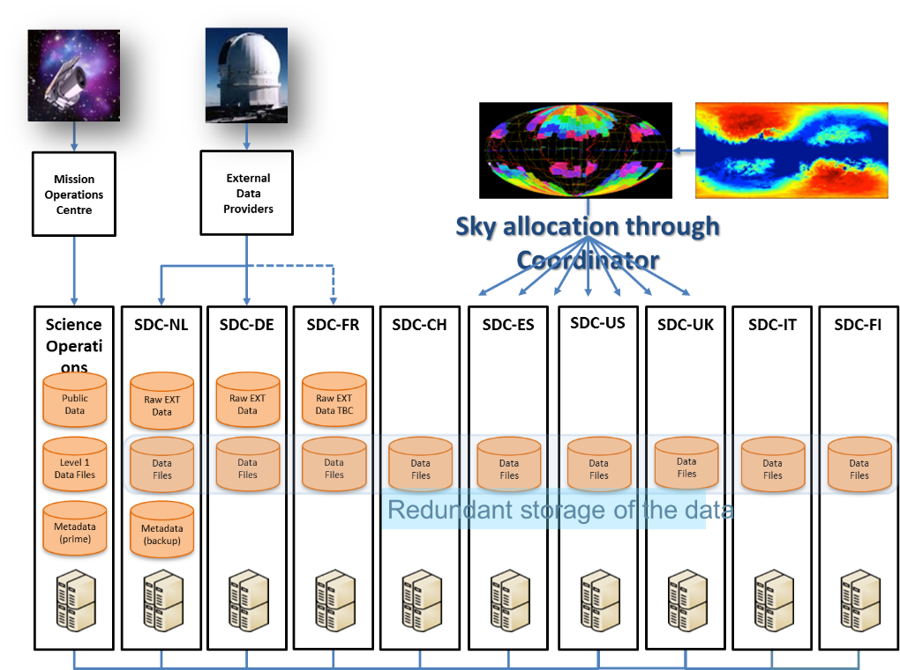
The Data Flow
Satellite to data centres
The Euclid data flow follows these steps:
Images are collected by the satellite and transferred to the Mission Operations Centre at ESAC. Here they undergo Level 1 processing (metadata insertion, image artifact correction).
Complementary data (called EXT) from external sources (ground based surveys) is processed at select data centres.
Euclid data and matching EXT data is transferred to the 9 Science Data Centres (SDCs) based on a sky allocation map.
Science Data Centres run Level 2 processing to create primary science ready data products. These are stored locally in a distributed archive system.

Slide 4



Data Processing
Level 2 Pipeline
11 Processing Functions (PFs) developed by international teams. Early data products often feed into multiple PFs later making it infeasible to run each PF separately at designated SDCs.
Large data volumes make it infeasible to transfer intermediate data into/out of object stores when running the pipeline end-to-end.
All PFs run end-to-end at all SDCs on their assigned sky allocations.
PF subtasks have a wide variance in resource profiles, some HTC-like (1 core, 2GB), others HPC-like (32 core, 512GB).
All PFs use a shared filesystem for workflow management. Euclid job controller uses it for staging efficient execution of PFs in order, caching files known to be used in subsequent steps. PF workdirs can range from 200GB->15TB.
LE1
VIS
SHE
EXT
MER
PHZ
LE3
NIR
SIM
SIR
SPE

Slide 5





The Computing
Science Data Centres
Euclid Processing Services
9 different Science Data Centres each with different funding, different infrastructure, and different service models
Mix of shared and dedicated clusters
Node sizes vary
Shared filesystem is required for data flow management (different shared file system technologies at different sites)
CVMFS mounts for pipeline code access
No use of MPI or GPUs (can’t be guaranteed at all SDCs)
All code must run at all sites
Euclid job manager (IAL)(runs at each SDC)
Fetches processing orders from archive
Submits pilot jobs to batch queues
Assembles work directories for pipeline runs
Manages pipeline payload jobs
Ingests all new data products into the archive
Euclid Archive System (EAS)
Central archive database containing metadata and processing control information
Distributed data storage nodes at each SDC, with files registered in central database

Slide 6
Data Centre View
Input data copied from
local archive to workdir
on shared filesystem, then
output is copied back to
archive when job finishes
SDC UK
EAS
EAS serves file metadata
DSS stores files
Archive
Cluster
Processing
Orders
IAL submits
pilot jobs
DRM Server
PPO
PPO
File Store
IAL retrieves
orders from EAS
DDO
DDO
IAL
Pilot 1
Cluster Node
Pilot List
Pilot gets
Payload
jobs
Pilot 1
Pilot 2
...
CVMFS
pipelines
Payload Queue
Job 1
Job 2
...
Pipeline codes
and Pilot scripts
distributed
Job 1
Workdir
Job 2
Workdir
Pilot scripts
Shared Filesystem
CernFS Proxy
Pipeline codes and Pilot scripts mounted on nodes

Slide 7



SDC UK
Workloads
Clusters
Mission Data Processing
UK is responsible for processing ~10% of all mission data (~3PB of final data products)
There are 3 official Data Releases planned, each one requiring a complete (re)processing of all collected data
SHE Pipeline Development
UK leads the Shear Lensing science goal, and is responsible for developing the shear measurement pipeline
Code development involves running large numbers of simulations, performance testing the SHE PF at scale, and analysing algorithm sensitivity to various instrumental and code-based factors
Science Exploitation/Analysis
UK Astronomers using Euclid data for their science projects request compute and storage through SDC-UK
Dev Cluster
Hardware cluster with ~300 cores, 50TB shared disk, 1.5PB archive/backup storage
Used by SHE team for small code tests and storage/archiving of simulation results
Used by Euclid Operations team for scaled testing of Euclid Processing Services (job controller, archive)
Production Cluster
Hardware cluster with ~2000 cores, 180TB SSD shared disk, 3PB archive storage
Used for processing mission data
Cloud Cluster
Software cluster with ~8,000 cores, 200TB shared disk
Used by SHE team for large simulations, code tests, etc
Used for processing mission data during reprocessing campaigns (burst processing when production cluster is saturated)
Used by UK Astronomers for running scientific analysis routines and simulations

Slide 8



IRIS Cloud
Clouds for STFC Science Activities
IRIS is a cooperative federated community creating digital research infrastructure to support STFC science. IRIS helps fund multiple compute cloud sites in the UK, which allocate compute resources to STFC science projects.
Infrastructure Details:
OpenStack Clouds
Most using the Scientific OpenStack standard: https://www.hpc.cam.ac.uk/scientific-openstack
Joined-up authentication through IRIS IAM
Cloud resources differ by site:
Flavor and node sizes vary significantly between sites
Most offer Ceph block store, CephFS (through Manila), and some include SSD backed CephFS. Object store (Swift/S3) is offered at some sites
Hypervisors with NVMe SSDs served via PCI passthrough are available at limited sites
High speed interconnect at both LAN and WAN level (100/200Gbps from clouds to JANET backbone interconnect)
Sites include: STFC Cloud, Cambridge Arcus, Imperial Cloud, Somerville Cloud

Slide 9

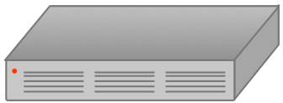
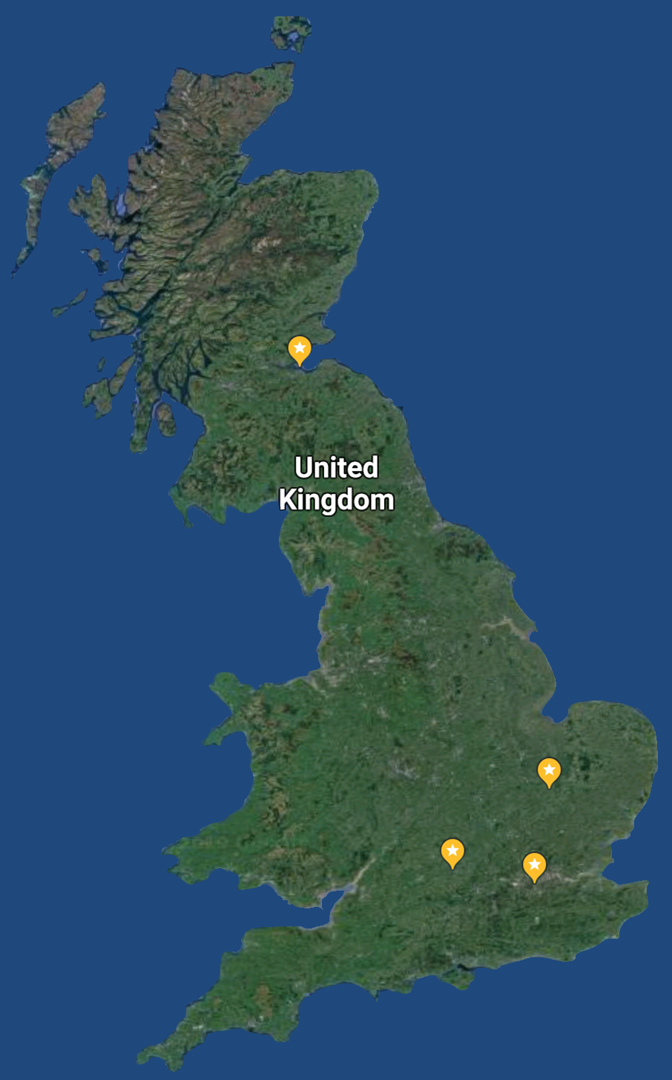
Euclid UK Cloud Cluster
Euclid UK have operated an IRIS backed Cloud Cluster since 2019
Looks and operates like a “typical” Slurm cluster
Deployed across three clouds (Cambridge, Imperial, RAL). The size and capabilities of the cluster have changed (and will continue to change) according to resource allocations and availability.
Separate Slurm partitions on each cloud site with a central head node in Edinburgh where users login and submit jobs.
Separate shared file systems at each site, provisioned by OpenStack Manila. Mounted on head node using NFS.
Sites interconnected through an OpenVPN mesh, with nodes at each site used to route traffic as though on a LAN.
ROE, Edinburgh
Head node, VPN Gateway, long-term storage
Cambridge ARCUS
VPN gateway, workers
RAL Cloud
VPN gateway, workers
Imperial Cloud
VPN gateway, workers

Slide 10

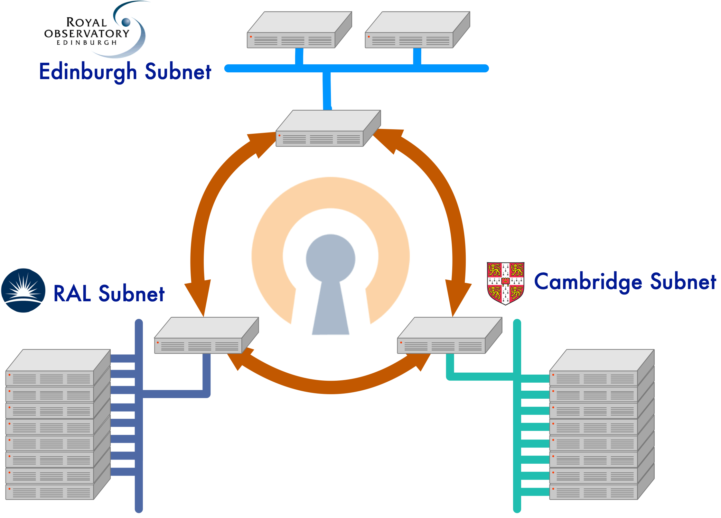
OpenVPN Mesh
The Illusion of Proximity
The cluster is interconnected using an OpenVPN mesh:
Gateway instances deployed on each cloud
Connected via public floating IP, and cloud LAN(s)
Runs OpenVPN daemons with tunnels connecting to other sites
Allows routing of packets through the tunnels
Separate subnets for each site to simplify routing
Worker nodes have routing tables set to direct specified subnets through the gateway server’s tunnel interface

Slide 11

Cloud Cluster Deployment
Original Method (2019-2021)
Current Method
Software-Defined Infrastructure
Define “cluster” as node groups in Ansible YAML
Define different node types for different jobs: VPN gateways, IAL nodes, CVMFS proxies, cluster workers, etc…
Launch nodes on OpenStack using Heat APIs
Create an inventory of everything created
Use Ansible playbooks to configure the nodes
Installs all packages, sets up users and system mounts, populates configuration files from inventory (i.e. slurm.conf)
Advantages: System build is fully documented, deployment easily repeatable, expansion (theoretically) simple
Disadvantages: Playbooks are long and failures result in wasted time, Heat failures are often silent and hard to diagnose (differ by site), playbook maintenance/troubleshooting effort doesn’t always scale
2-tiers of Ansible Playbooks
Cluster-bootstrap - separate playbooks run from head node for:
OpenVPN deployment and testing
CVMFS Proxy deployment and testing
Slurm head node install and configuration
Node deployment and maintenance – site specific playbooks for:
Deploying worker nodes, setting up VPN routing, installing base packages, mounting shared filesystem, creating user accounts
Installing and configuring Slurm

Slide 12

Cloud Cluster Optimization
Optimize for latency, Reliability
Deploy for performance
OpenVPN mesh:
Inter-site connections are inherently high latency, traffic tends to be bursty, and tunnels need to be optimized accordingly
# Increase TX Buffer txqueuelen 4000 # Increase the MTU size tun-mtu 6000 # Disable max segment size mssfix 0
Slurm config:
Reduce chatter, increase timeouts, limit health checks:
SlurmctldTimeout=200 SlurmdTimeout=500 MessageTimeout=120 HealthCheckInterval=300
Warn users that tasks requiring >48hr runtime are liable to fail and need to be checkpointed
Avoid centralized account IAA. Use Ansible playbooks to manage user accounts locally on machines. Otherwise network outages can result in failed jobs/IO.
Use Big Nodes: lower node counts mean less network chatter, fewer health checks
Build/transfer machines: Shared filesystem mounts on head node are inherently slow, as are inter-site transfers through the VPN. We provide a build/transfer node at each site with public IP, allows users direct “local” access to filesystem, and direct SCP from site to site.

Slide 13
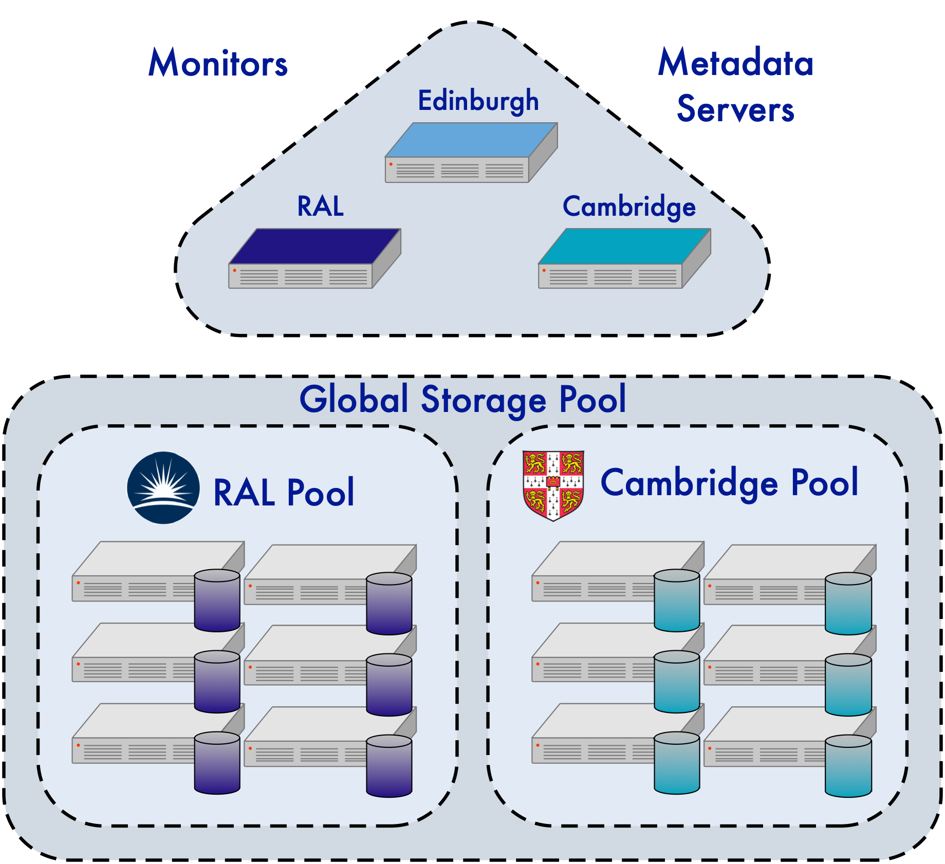
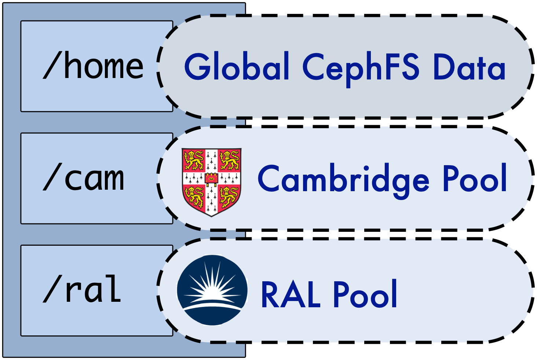
Multi-site Ceph (retired)
Federated Shared storage
From 2018-2021*, none of the IRIS clouds offered shared filesystems to cloud clients. To overcome this, we built a federated Ceph cluster across our instances using ephemeral storage as the backend.
Deployed with Ceph Ansible https://github.com/ceph/ceph-ansible
Compute nodes provide storage by serving ephemeral disk or volumes as OSDs
Each site runs monitors and metadata servers. MDS subtree pinning used to keep metadata calls local
Storage pool across entire deployment – 2-way replication for global data (home space)
Storage pool per site uses CRUSH rules to “localize” shared work spaces
POSIX extended attributes set the backend pool per file or directory
Compute nodes all mount CephFS
*This system was retired when Manila shares became available, due to the latter’s better performance and resilience.

Slide 14
Cloud Cluster Scale
Resources by Year
IRIS Resource Allocation
Year | CPU | CephFS | GPU
2018 | 1500 | 20TB*
2019 | 2000 | 40TB*
2020 | 4600 | 45TB*
2021 | 6000 | 100TB
2022 | 6000 | 100TB
2023 | 4500 | 130TB | 2
2024 | 4500 | 200TB | 4
2025 | 8000 | 300TB | 8
Cluster size varies year by year
Euclid UK operates a resource allocation exercise annually, calculating needs for mission data processing, PF development and simulations, and science analysis. The total figures are submitted to IRIS
IRIS RSAP determines total resource allocated, and informs us where they will be provided
We resize the cluster accordingly, increasing/decreasing the deployments at the cloud sites as needed
* Use of multi-site Ceph

Slide 15

Cloud and WAN
Current issues
Possible Solution?
High latency – Slurm, node health checks, other services all need to be tuned to minimize traffic and account for long response times
Slow transfers – moving data between the shared filesystems is slow (<20MBps) making it difficult to move workloads in response to cloud outages
Instabilities – WAN disruptions regularly lead to nodes dropping into DRAIN state or jobs failing (when they complete during a network hiccup)
All together, the above issues preclude use of the multi-site Ceph, despite user requests for the utility it offers (for certain purposes)
Hardware assisted networking between cloud sites?
Inter-site VPN deployed at cloud level?

Slide 16
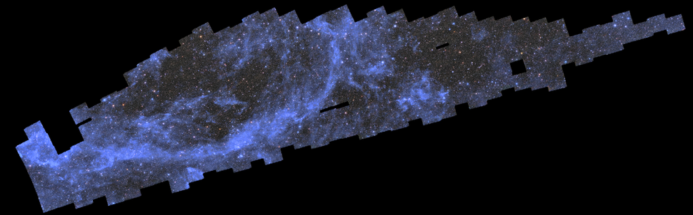
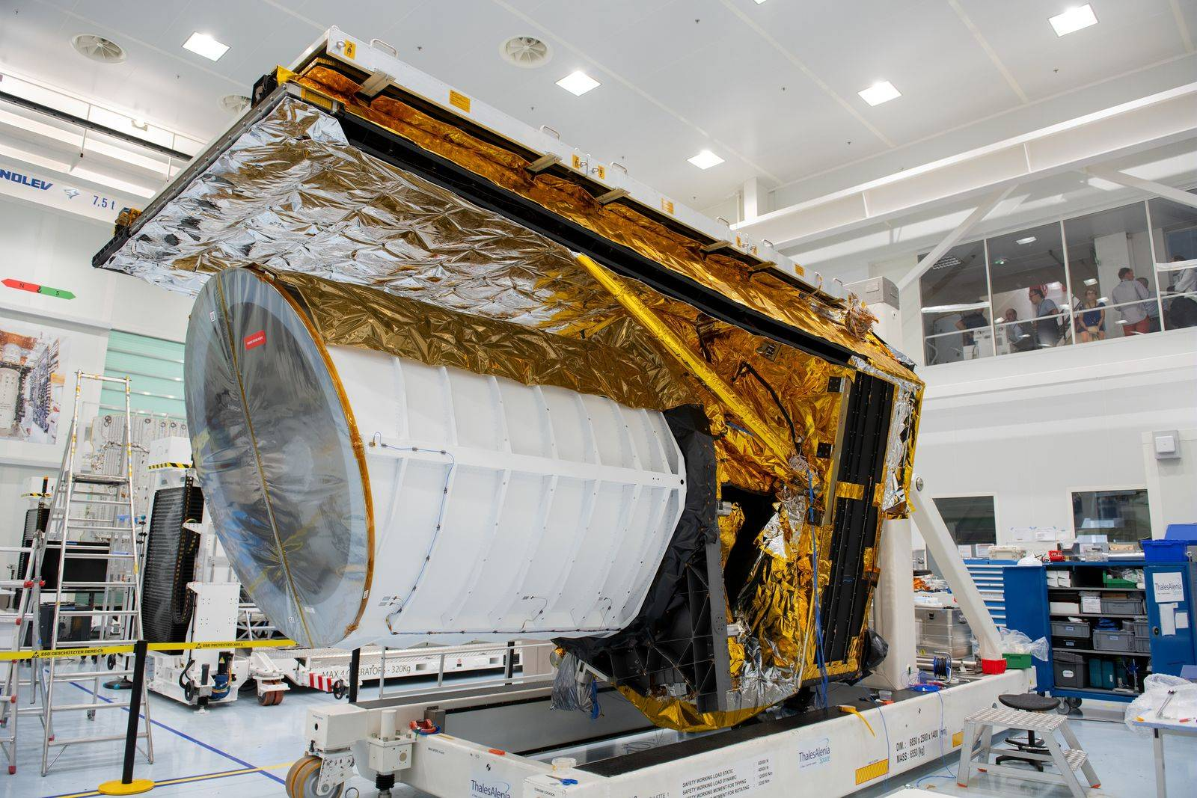

Euclid
Photos taken from ESA

Slide 17

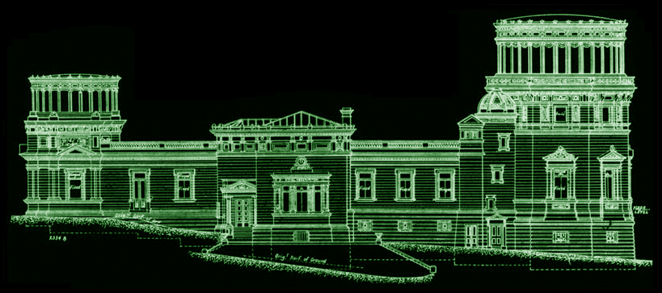
Mark Holliman msh@roe.ac.uk Head of IT Services Wide Field Astronomy Unit Institute for Astronomy University of Edinburgh

