Slide 1

The Science & Technology Organization
Enabling Future Innovation and Capabilities
Presentation to
SSA Workshop
Colonel Monty Greer
Collaboration Support Office
Operations & Coordination Director

Slide 2
Why Collaborative S&T in NATO
NATO’s Security Situation is more complex and not assured:
COUNTRIES | ORGANIZATION(S) | TECHNOLOGIES | HUMANS
Russia, China, Iran, Syria, North Korea | Daesh Shadow Brokers | Cyber & Electronic Warfare, Space, Integrated Air Defense | Mass Migration, Urbanization…
Changes in the International Technology Sphere:
Increase Use of Commercial Items → Loss of Government Leadership in Tech
Very much shortened timelines to develop technologies
Implies that NATO needs to go faster and expand technology development
options leading to capabilities.
Convergence of Factors Enhances Need to Collaborate

Slide 3

The Science and Technology Organisation
1 Board: Science and Technology Board
2 Business Models
3 Executive Bodies
Conducts the NATO collaborative S&T Program
Science and Technology
Board
Provides NATO HQ
Scientific Advice
Collaboration Support Office
Office of the Chief Scientist
Centre for
Maritime Research
Conducts the NATO
In-House S&T Program

Slide 4

The CSO
“The Production Engine of S&T in NATO”
Maintain Active Network of about 4,500
Manage > 250 Collaborative S&T Activities per annum
R&D PERSONNEL (FTE)
R&D INVESTMENTS (M US-$)
5,500,000 (2)*
Leveraging NATO/EU & Global Partners Resources
1,100,000 (4)*
INFLUENCE
ACCESS
670,000 (1)*
329,000 (3)*
(3) Total Government Budget Appropriations for R&D (GBAORD)
(4) Gross Domestic Expenditure on R&D (GERD)
* Source: OECD, Main Science and Technology Indicators database (2015)
ACCESS
LEVERAGE
(1) Government R&D Personnel
(2) Total R&D Personnel
* Source: OECD, Main Science and Technology Indicators database (2015)
STO: 4,500
ACTIVE
INVESTMENT
STO CPoW: 500
CSO: 49
CSO: 5.5

Slide 5
The STO Panels/Group
AVT Applied Vehicle Technology
HFM Human Factors and Medicine
IST Information Systems Technology
SAS System Analysis & Studies
SCI Systems Concepts & Integration
SET Sensors & Electronics Technology
MSG Modelling and Simulation Group
Notes:
11
14
11

Slide 6
Collaborative S&T Environment
Toolbox:
Task Group
Technology Demos happen here!
(study group, 3 years)
Specialists’ Team
(quick reaction)
Specialists’ Meeting
(<100 people, 2-3 days )
Workshop
(selected participation, 2-3 days)
Lecture Series
(junior and mid-level scientists)
Technical Course
Symposia
(>100 people, 3-4 days)
Exploratory Team
National
Interests
250 Activities Per Year
NATO
Success
Partnerships
Collaboration
Exploitation
Knowledge
Generation

Slide 7
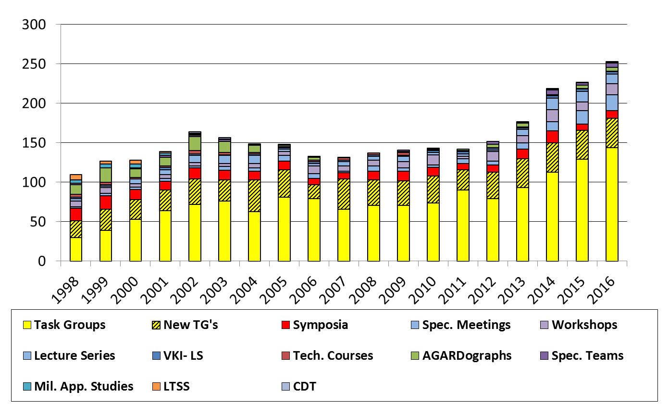
Total Number of Activities per Year
All Panels/Group Combined
Plus about 75 Exploratory Teams, 50 of which
are mature enough to become an activity—about
80% become Task Groups / other
Notes:
7

Slide 8
NATO Nations Participation in CPoW
(activities per nation)

Slide 9

SCI-ET-036: Collaborative Space Domain Awareness Data Collection and Fusion Experiment
Team Leaders | USA
Active | DEU, FRA, ITA, NLD, ROU, TUR, USA,
Willing
Desired | NCIA, ACT, ACO, JAPCC, JToES, SET, SAS
Duration | Jan 17 – Jan 18
Related Activity | SCI-279
Objectives:
The exploratory team will determine the type of SDA information can pragmatically be collected, shared and fused within the member nations participating Topics/themes:
Space Object Tracking
Satellite RF Interference
Space environment (weather) conditions affecting spacecraft
Data fusion algorithms
Decision Support communication concepts, tools and methods for communicating changes in the space domain
Impact and Exploitation:
A detailed proposal and plan for a task group activity (or activities) in one or more of the three space domain awareness focus areas (space environment, radio frequency interference and space object tracking).
Notes:
9
The objective of this exploratory team is to determine a mutually agreed-upon activity that involves the collaborative collection and fusion experimentation of space domain awareness data and information. The exploratory team will determine the type of SDA information can pragmatically be collected, shared and fused within the member nations participating (e.g., space environment, space object flight metric information and radio frequency interference of space services and space system command and control). The objective of the exploratory team is to provide a technically and institutionally justifiable plan for a new program of work appropriate for a multi-year task group (s).
TOPICS TO BE COVERED:
The following topics will be addressed by the exploratory team:
Space object tracking (including satellites, debris, rocket bodies, etc.)
Satellite radio frequency interference (to space communication services and satellite command and control)
Space environment (weather) conditions affecting spacecraft and space operations and services.
Data fusion algorithms and other concepts relevant to space domain awareness data and information
Decision support communication concepts, tools and methods for communicating changes in the space domain relevant to NATO operations, satellite operations and the providing of space services.
A detailed proposal and plan for a task group activity (or activities) in one or more of the three space domain awareness focus areas (space environment, radio frequency interference and space object tracking). To include specification of NATO members and other approved nations with a strong expressed interest in participation and accommodation of the institutional challenges that such a task group may encounter.

Slide 10
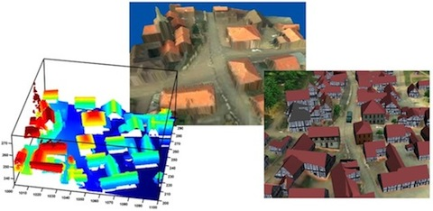
SET-241 RSY 9th NATO Military Sensing Symposium | Chair: Mr. Bruno GILBERT (CAN) Members: BEL, CAN, HRV, DEU, ITA, NLD, NOR, POL, SVK, TUR, GBR, USA Partners: AUS, FIN, SWE Duration: Jan 2016 – May 2017 Cooperation: SCI Related Activities: None
Objectives: The symposium aims at bringing together government and industry experts from the NATO countries in the area of military sensing. It enables the sharing of current information on sensors and how they are being used in operation. The emphasis will be on military sensor technology at the system and subsystem level. Keywords: novel sensing technologies, sensor systems, advancements in EO/IR, THz, radar and acoustic sensing, autonomy, sensing from space, sensing phenomenology, sensor exploitation, spectrum management | Deliverables: DOTMLPFI Meeting Proceedings. Exploitation: The symposium will allow to identify outstanding challenges in the area of military sensing to support ongoing industrial development of new products and orient research activities to better answer the needs. The symposium will also inform the military community on the benefits and challenges associated with novel sensing technologies to promote interoperability, foster mutual reliance for future development activities and ultimately enhance the quality of the next generation of military sensors.
May 31 to June 02, 2017
Quebec, CAN
Notes:
II. Objective(s):
The symposium aims at bringing together government and industry experts from the NATO countries in the area of military
sensing. It enables the sharing of current information on sensors and how they are being used in operation. It is expected that
valuable comparisons and technical critique will foster interoperability within NATO, stimulate joint programs and
agreements, and improve the quality of national programs related to military sensing. The emphasis will be on military sensor
technology at the system and subsystem level.
III. Topic To Be Covered:
The symposium covers all military sensing technologies, comprising electro-optics/infrared, radar, seismic and acoustic which
includes topics such as: novel sensing technologies (quantum, biomimetic, nanomaterials, …), sensor systems (digitization of
night vision systems, cognitive systems, distributed sensors, networked sensors, on-board processing, in-memory processing,
from data to information …), advancements in EO/IR, THz, radar (mmw phased arrays, MIMO, noise radar, …) and acoustic
sensing, autonomy (autonomous sensing, sensing for autonomy, …), sensing from space, sensing phenomenology, sensor
exploitation, spectrum management, etc.
The focus of the application of these technologies could be related to themes such as countering UxVs, countering directed
energy, the Alliance Future Surveillance and Control Capability (AFSCC), human performance optimization, etc.

Slide 11
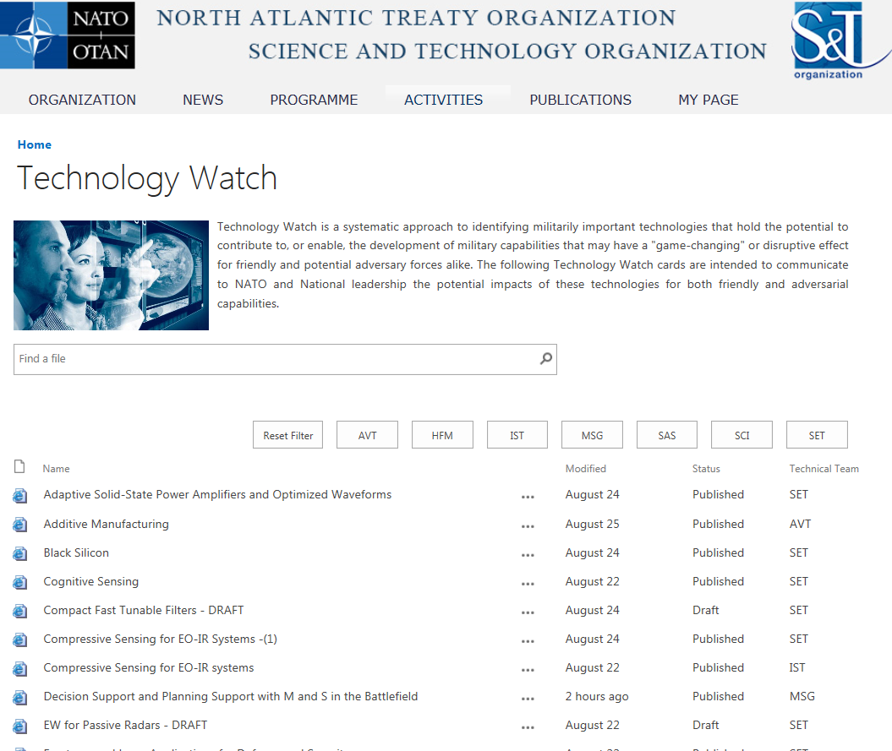
Technology Watch
Growth in Tech Watch Cards – From 42 to 70 over last year
Making Accessible
Through a Tech Watch Wiki
Available to NATO Members
via S&T Organization Website
  Access Activities, after login
  Separate TAB for Tech Watch
  Wiki is searchable
  Content added by CSO
https://www.sto.nato.int/publications/techwatch

Slide 12
Notable Events
Autonomy Workshop – May 2017:
  Keynotes from Dr. Greg Zacharias & Mr. Alan Shaffer
  23-25 May 2016 - Oslo Norway
Cooperative Demonstration of Technology:
  Characterization of Munitions Contamination on Military Training Ranges
  3-7 Oct 2016 - Cranfield University, United Kingdom
Aerospace Medicine Technical Course:
  Aerospace Medecine from the Ground Up
  March 2017 - Ramstein AB Germany
Sensing Symposium
  9th NATO Military Sensing Symposium
  31 May – 2 June 2017 - Quebec, Canada

Slide 13
Questions?
STO Website: https://www.sto.nato.int
Col Monty Greer
  James.Greer@cso.nato.int
  +33673998230 (mobile)

