Slide 1

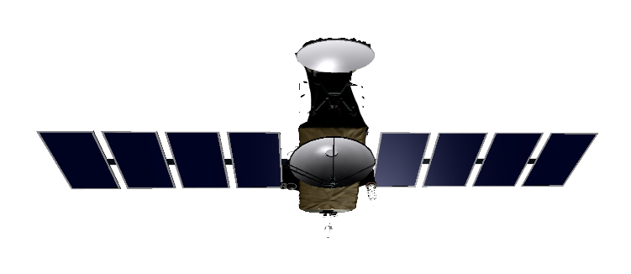
Non-gravitational Forces on Satellites at GEO:
Advances, Techniques and Challenges
Professor Marek Ziebart
Chair, IGS Satellite Vehicle Orbit Dynamics Working Group
NATO SCI-279 Task Group
Director, Space Geodesy and Navigation Laboratory
University College London
EOARD SSA Workshop, Ruislip, United Kingdom December 7th, 2016

Slide 2
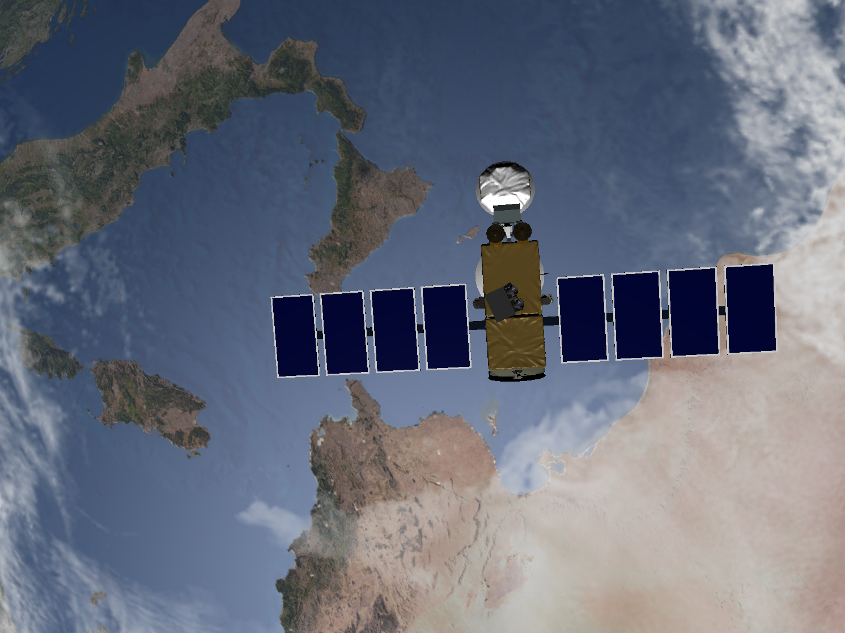

SV state and track custody: Problem Elements
State/track uncertainty
Dynamics
Integrator
Estimator
Measurements,
Measurement models
Reference frame
Notes:
Track custody: the ability to establish and maintain unique space object identification. Absolute track custody implies eliminating the possibility of mistaken identification and always knowing where the space object is and will be over operationally relevant time scales.

Slide 3
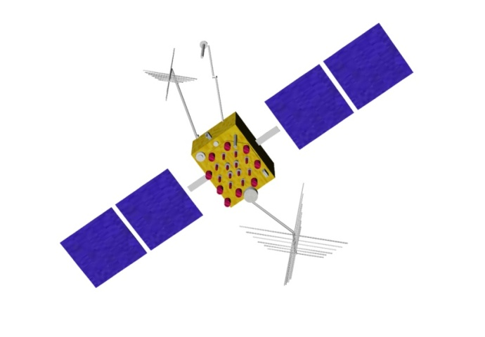



Forces acting on an orbiter
Antenna thrust
(AT)
Out-gassing
Lorentz forcing
planetary gravity
general relativistic
effects
Thermal forcing
(TRR)
Particulates drag,
Solar wind
Solar radiation pressure (SRP)
Lunar gravity
Earth gravity
Solar gravity
Tidal effects
PRP
(planetary radiation
pressure)
Notes:
3
For the GNSS altitude we conventionally assume that the conservative gravitational effects are very well known – particularly since the launch and analysis of dedicated gravity field missions like GRACE and GOCE. The radiation pressure effects are perceived as more problematic and simplified, empirical approaches are adopted.

Slide 4
We can categorize these forces using four fields:
Gravitational potential
Electro-magnetic radiation
Particulate matter
Geomagnetic

Slide 5
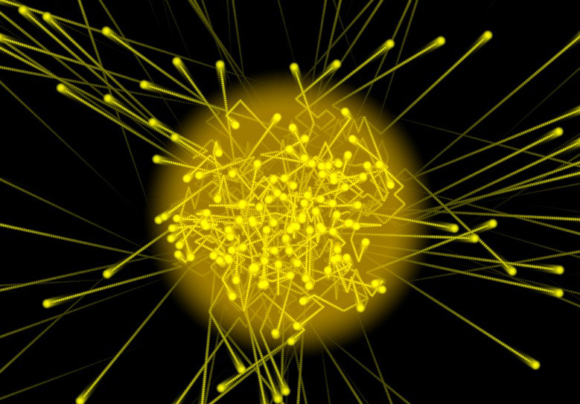
Photons and Radiation Pressure

Slide 6

Everyone knows….......
Radiation Pressure
For Photons:
ρ=E/c
Momentum = Energy/speed of light
Momentum!
Notes:
Special relativity says e = m c squared – but Einstein went further than that energy is related to mass and momentum. Photons have a zero rest mass so we rearrange the equation and see that photons carry momentum. When they hit something – it moves!

Slide 7
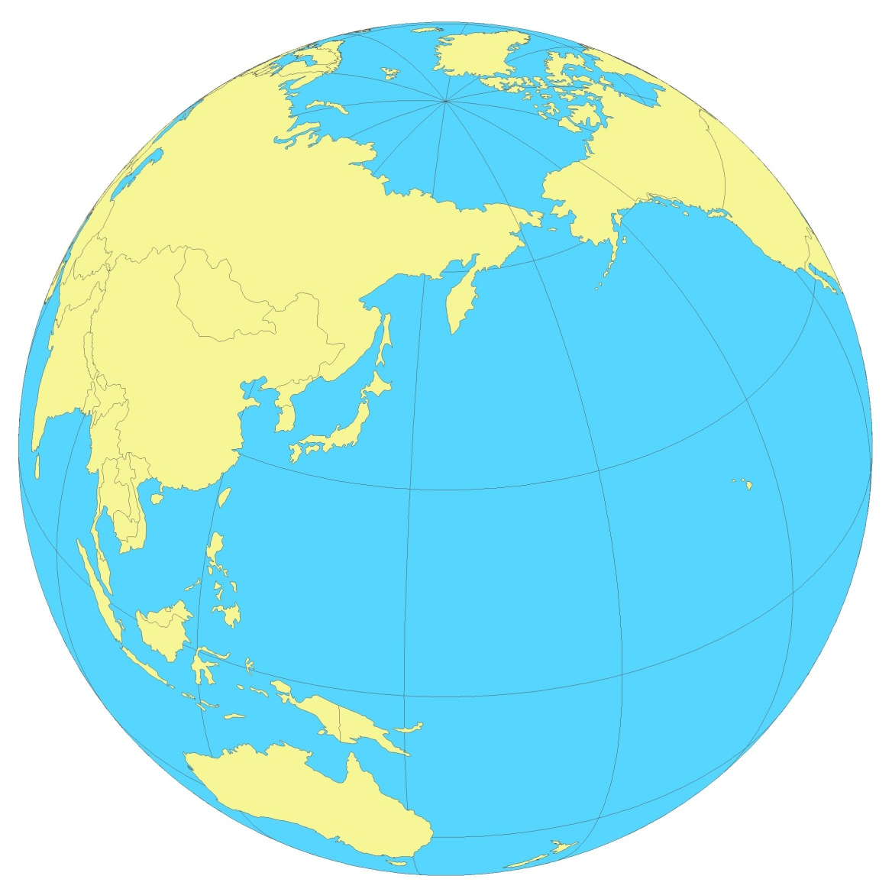
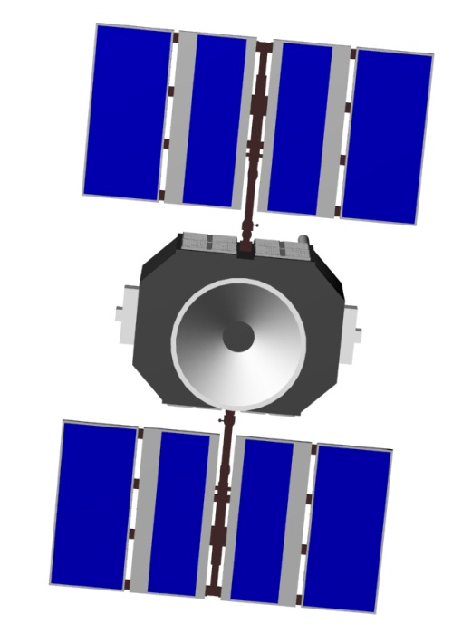
Radiation Pressure
Resultant force
Notes:
All this science in some way depends on knowing where the spacecraft is in space…….. And that is what we are going to consider

Slide 8
Modelling philosophy
Utilise all available physical and engineering data about the space vehicle and the space environment to build force models
Embrace the complexity of the processes
Develop models that capture the complexity, but that run fast in implementation
Heritage established through nearly 20 years of mission experience (JPL, GSFC, USAF, ESA)
UCL models used as operational standards for several NASA missions and for all science grade GPS orbit products

Slide 9
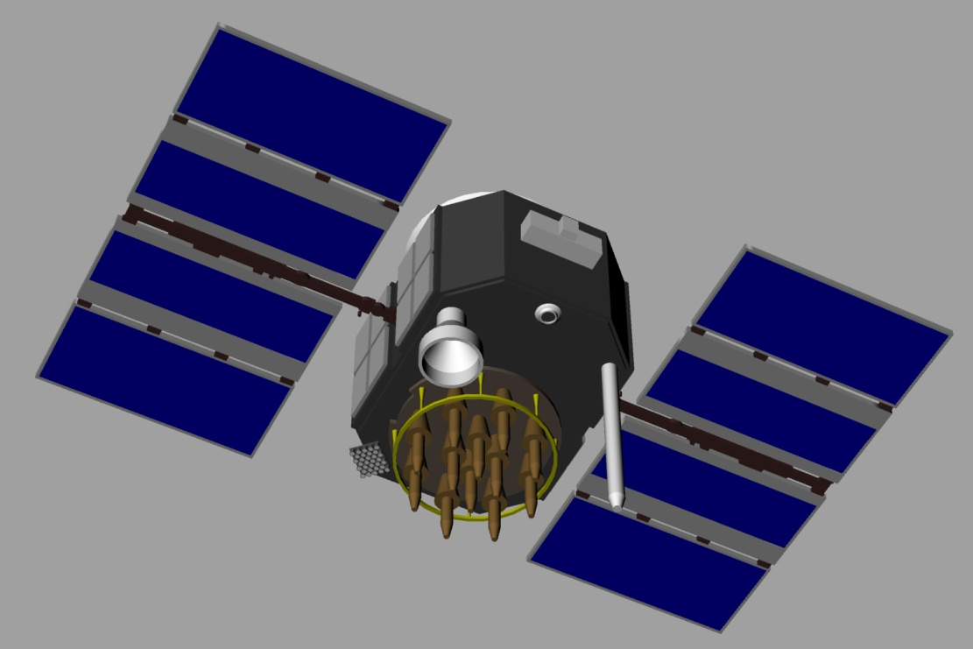
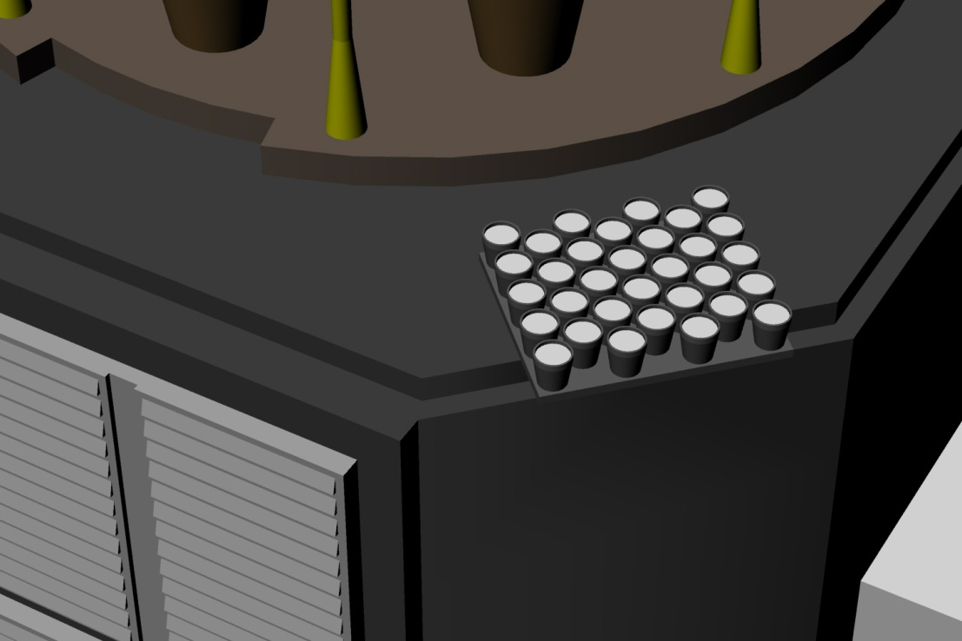
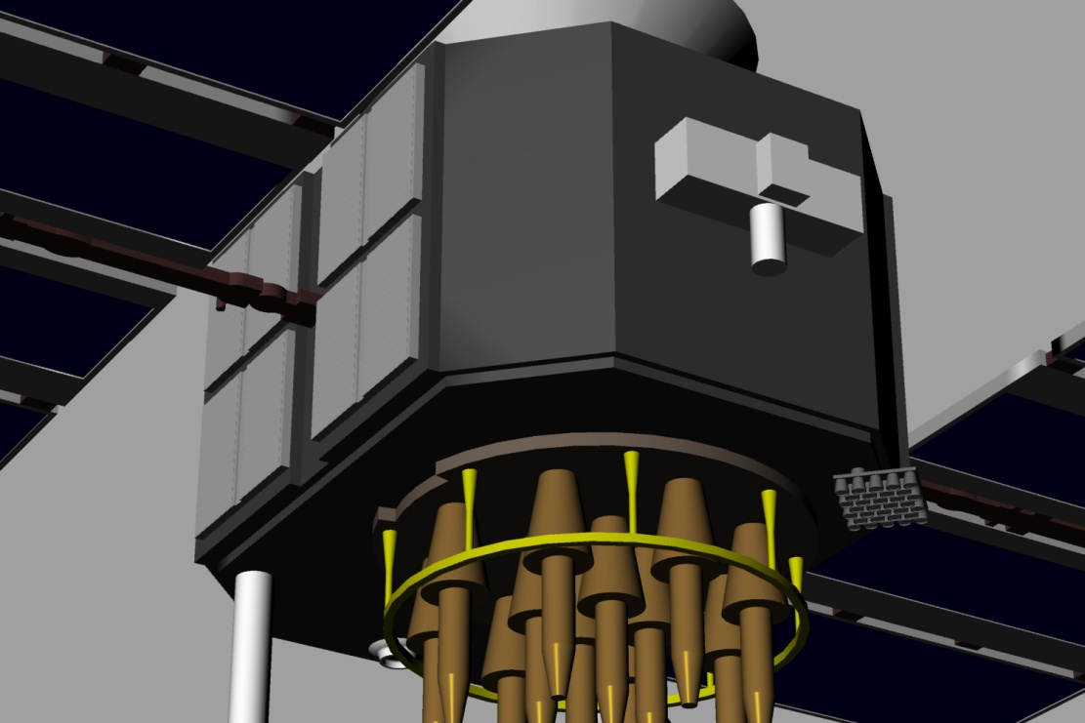
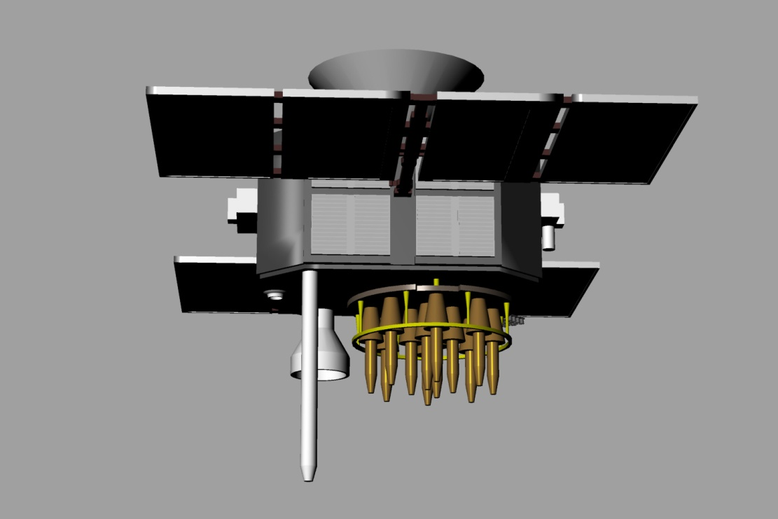
We develop a detailed structural computer model of the spacecraft

Slide 10
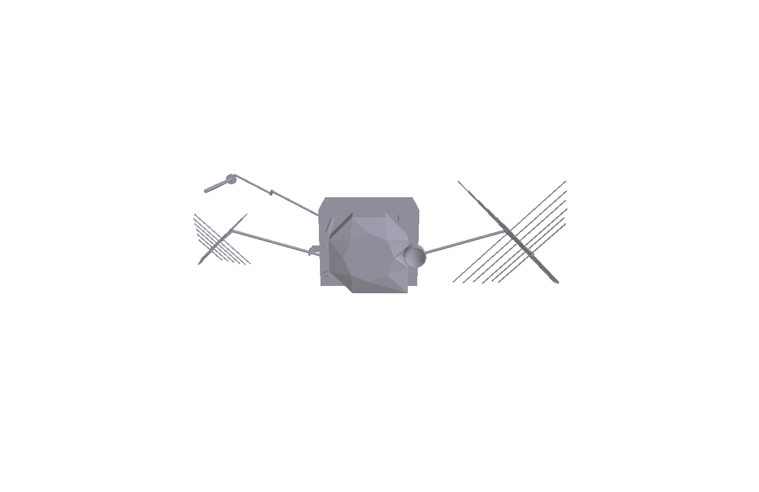
Ray Tracing - 1
Geometry
Material types
Optical and thermal properties
Spacecraft model represented in the SV body frame
Notes:
Spacecraft bus, we generally separate out the solar panels as hey can be treated as flat plates analytically

Slide 11
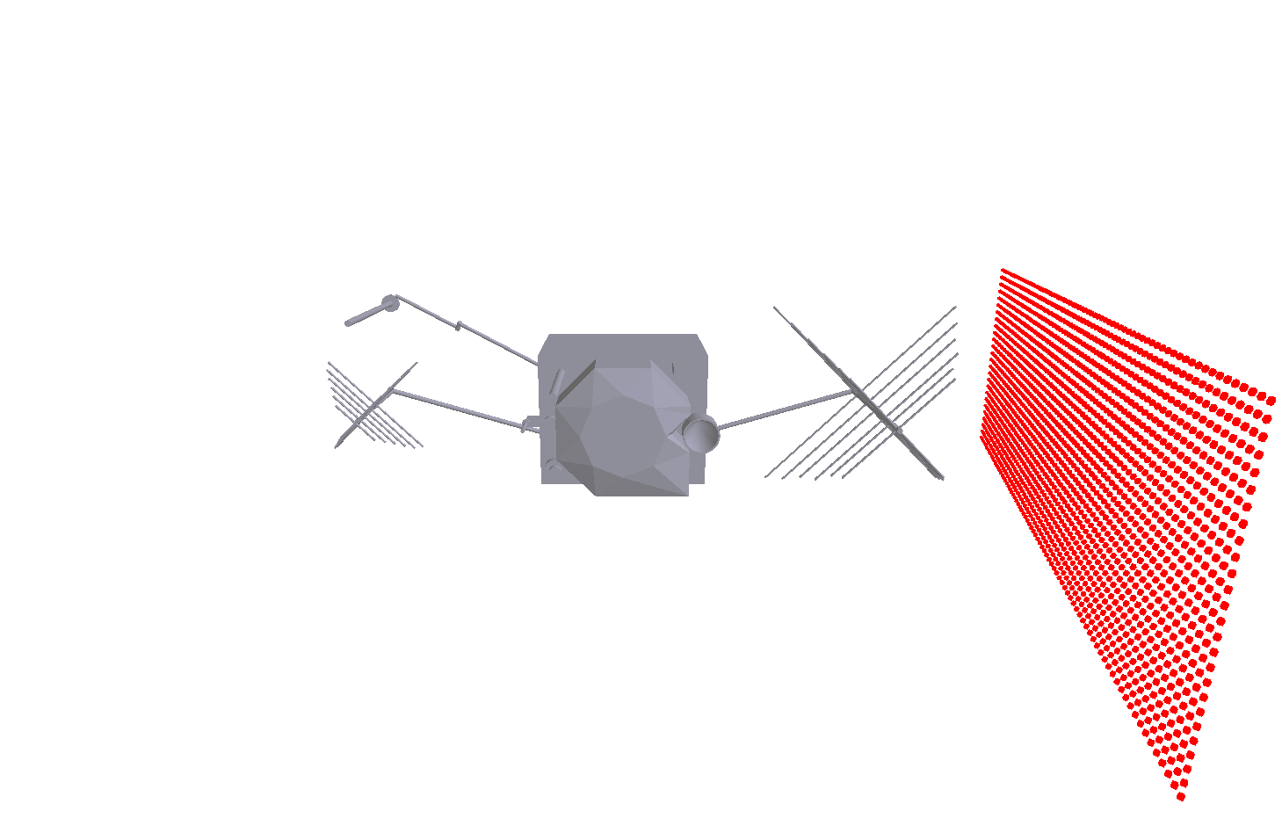
Ray Tracing - 2
An array of flux origin points is created
Dependent on the incoming flux direction
Notes:
So we choose a incoming flux direction
Align a grid of points in a plane perpendicular to this direction

Slide 12
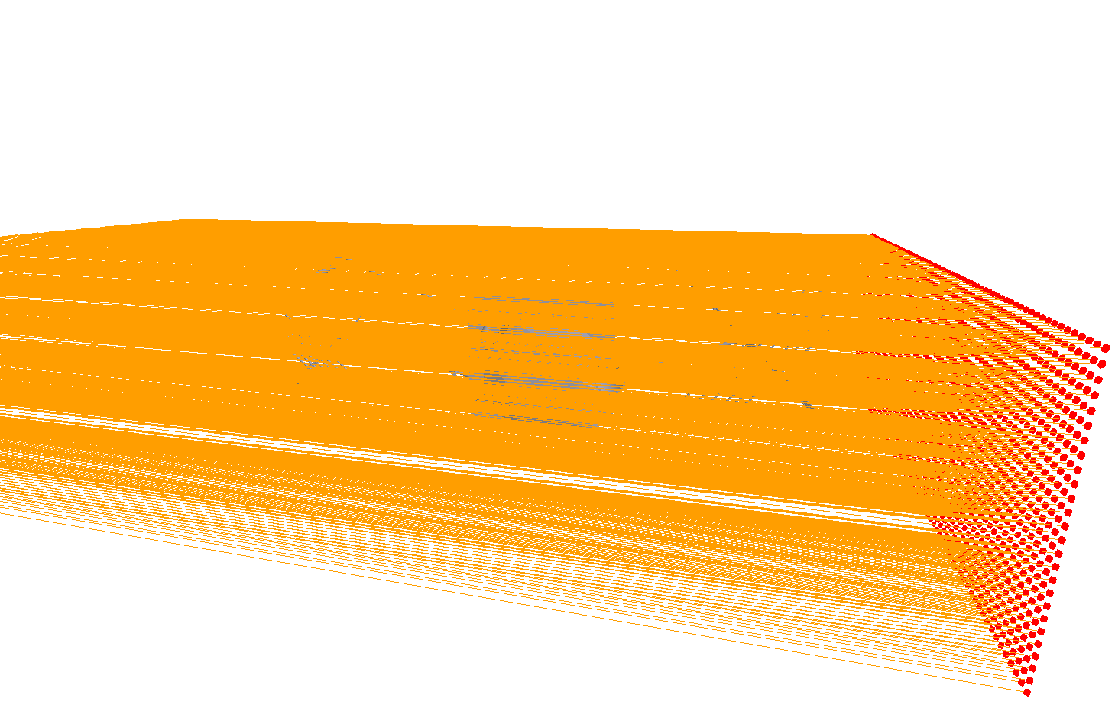
Ray Tracing - 3
Rays are generated from each of these points
Notes:
Propagated towards the spacecraft

Slide 13
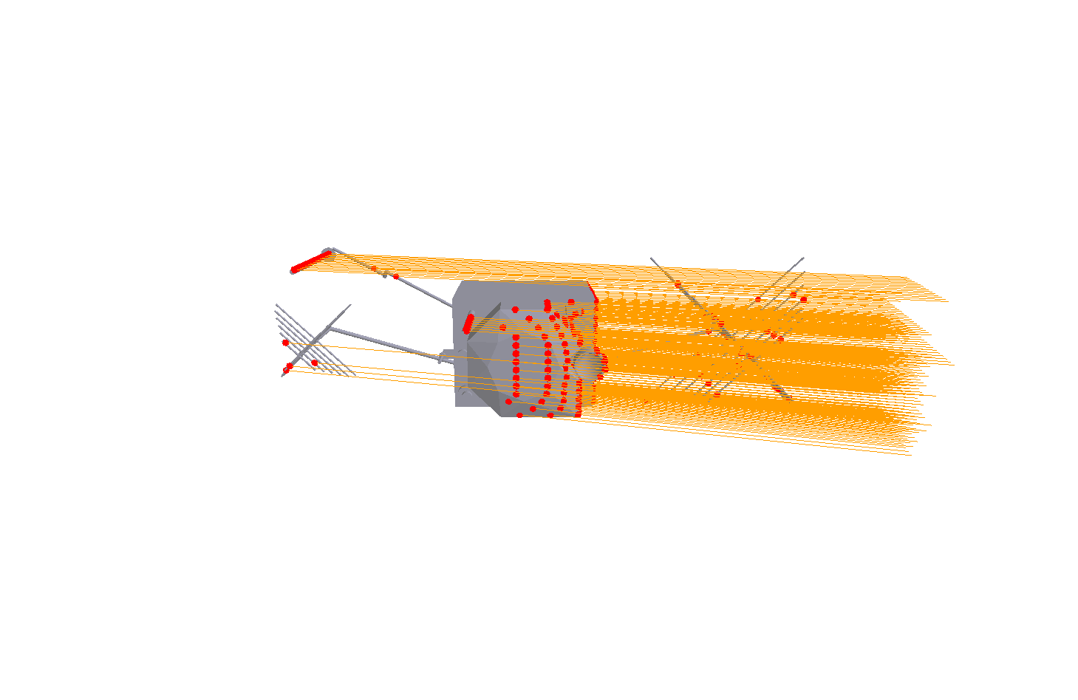
Ray Tracing - 4
The intersection between each ray and the spacecraft is computed

Slide 14
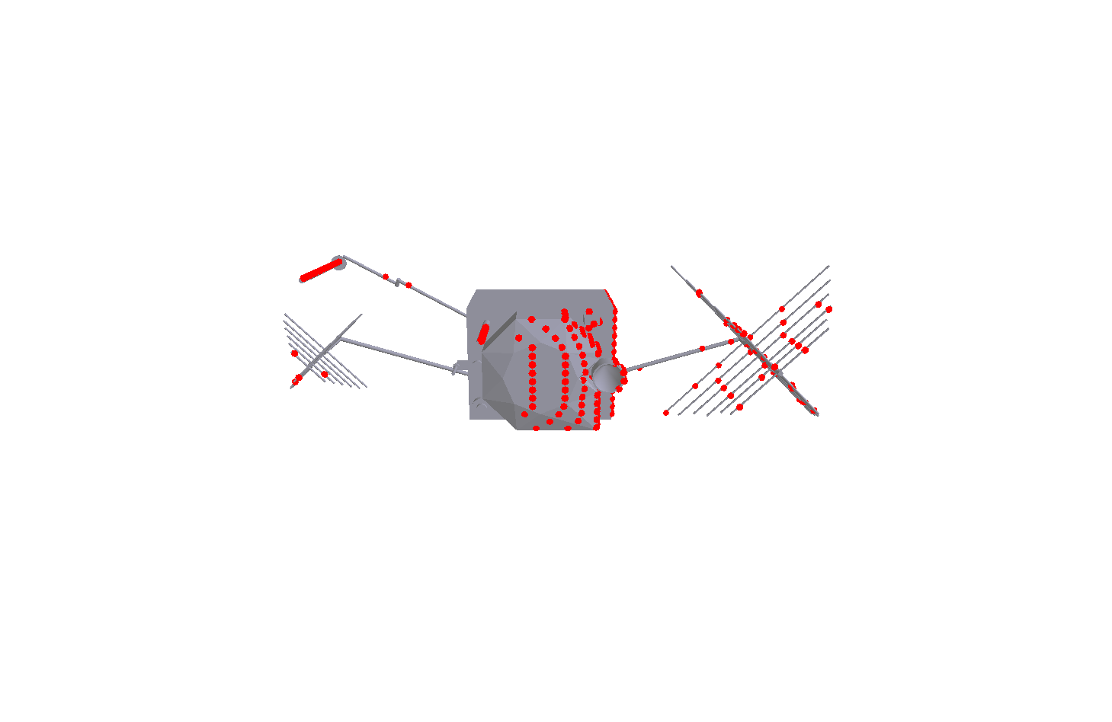
Ray Tracing - 5
The material properties of the surface are known at each of these points

Slide 15
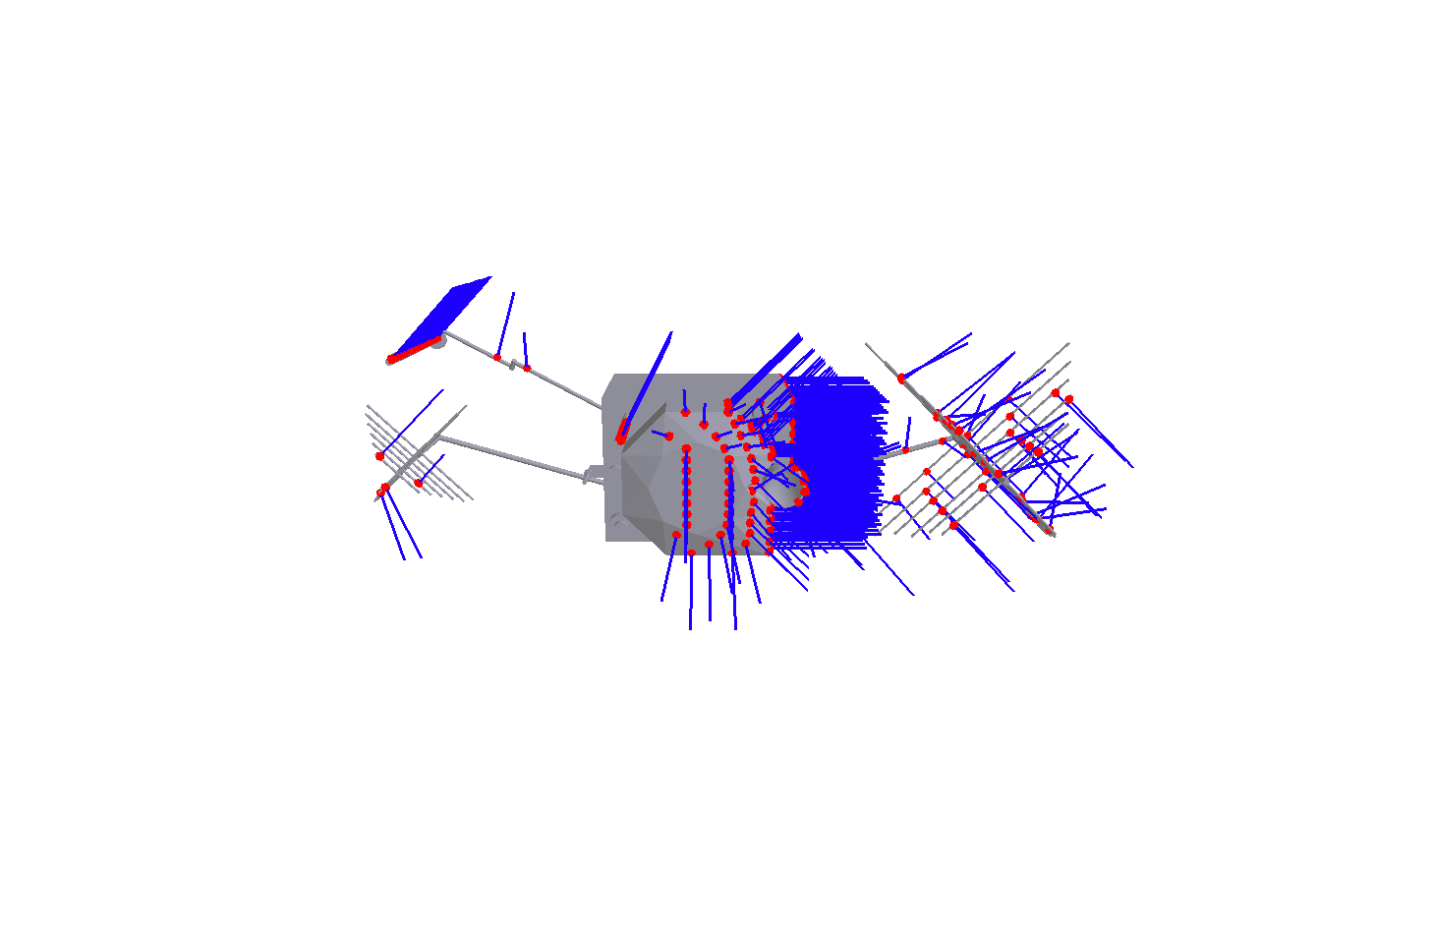
Ray Tracing - 6
The surface normal is calculated at each of these points for planar or curved surfaces
Notes:
Mention Curved Surfaces

Slide 16
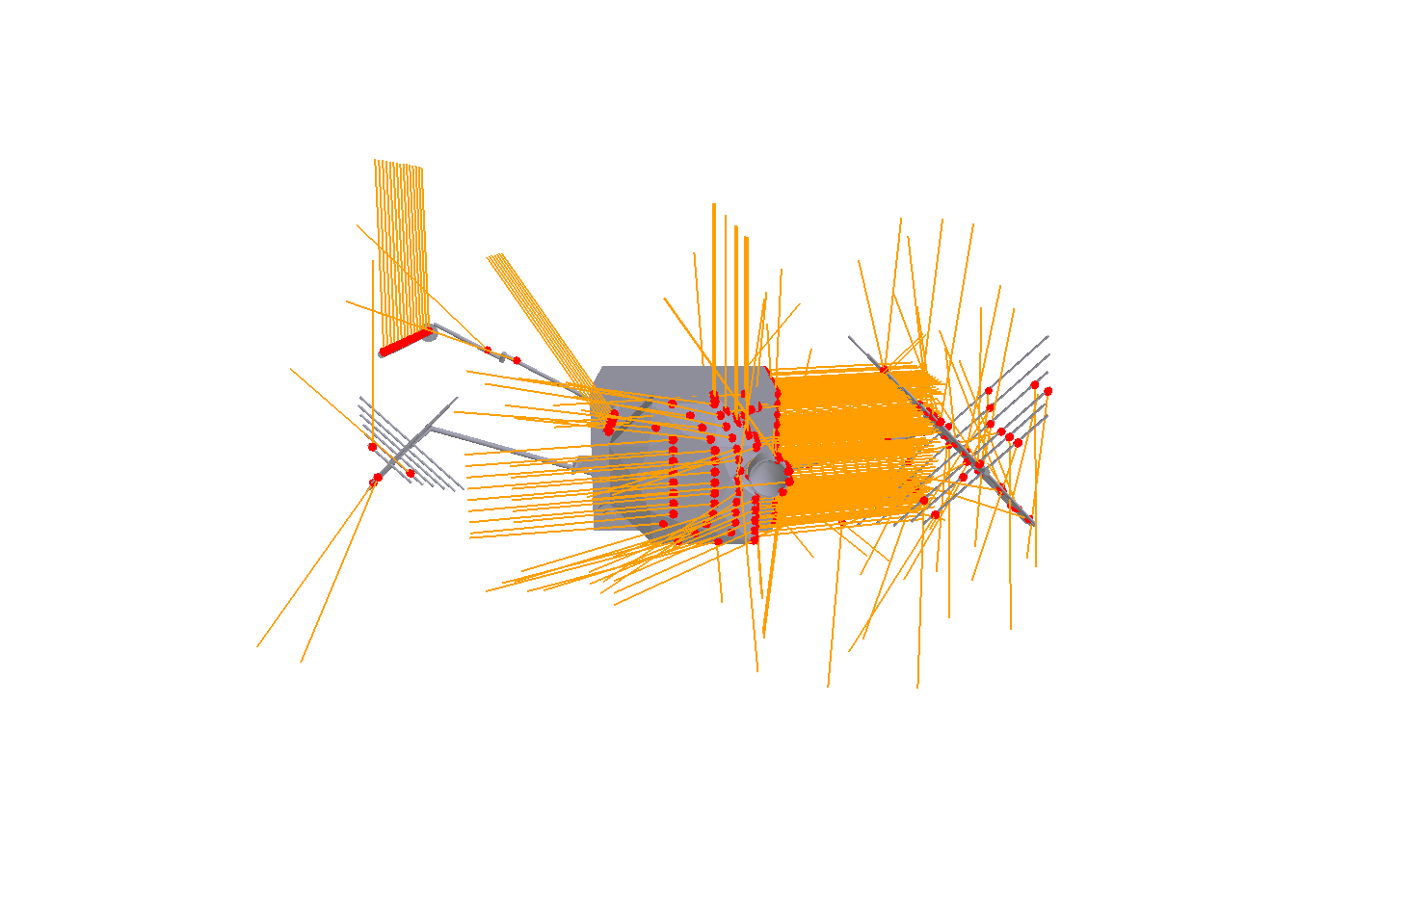
Ray Tracing - 7
New rays are generated for each reflection and the intersection and reflection step repeated:
Secondary intersections

Slide 17
Ray Tracing - 8
The acceleration data for all rays (primary and secondary) is collected:
Resultant acceleration computed for that radiation source direction

Slide 18
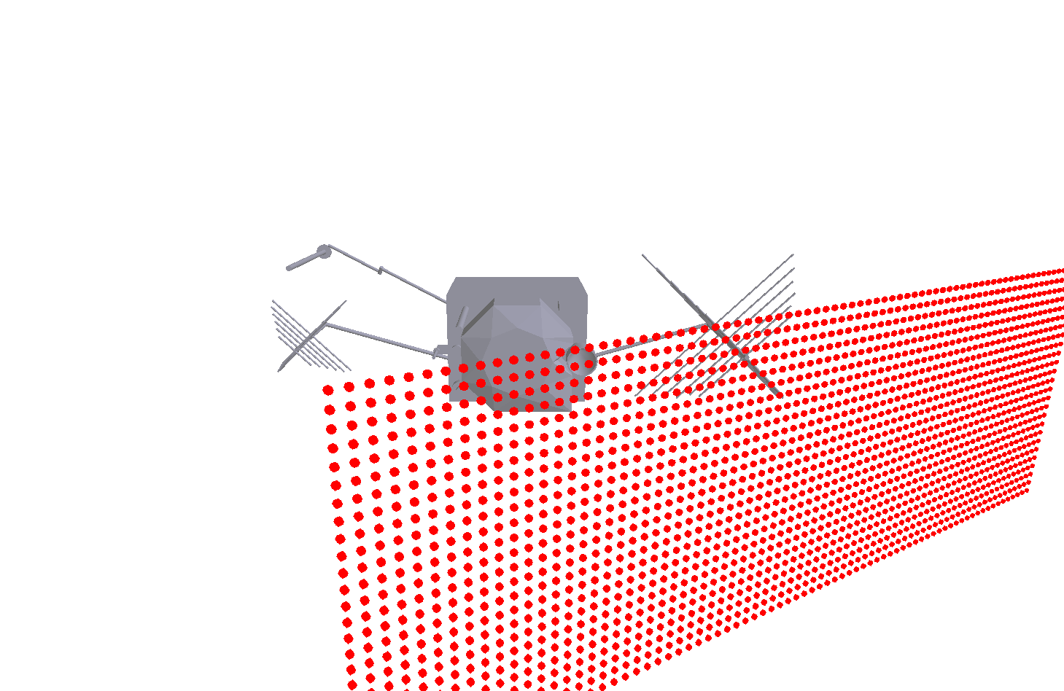
Process is repeated for other incoming flux directions

Slide 19
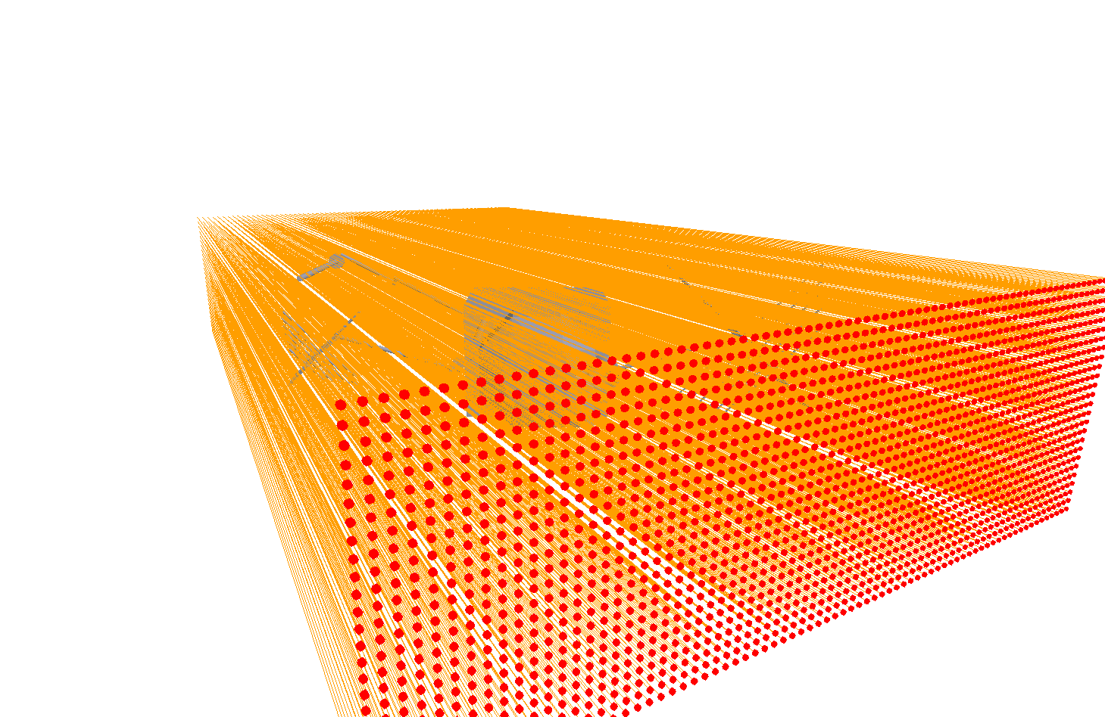

Slide 20
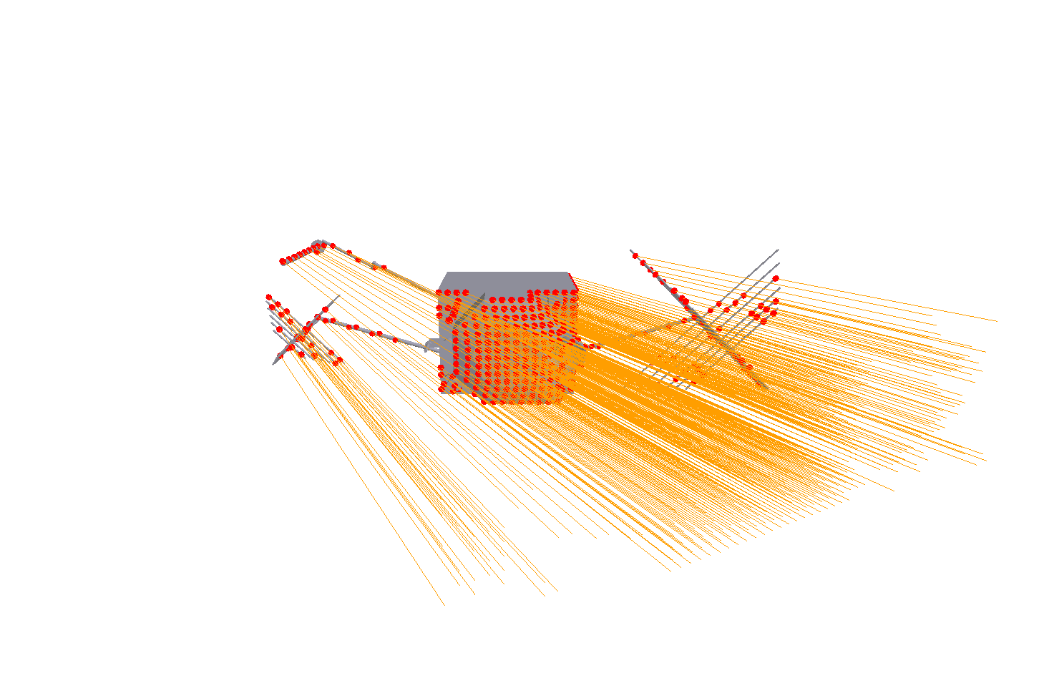

Slide 21
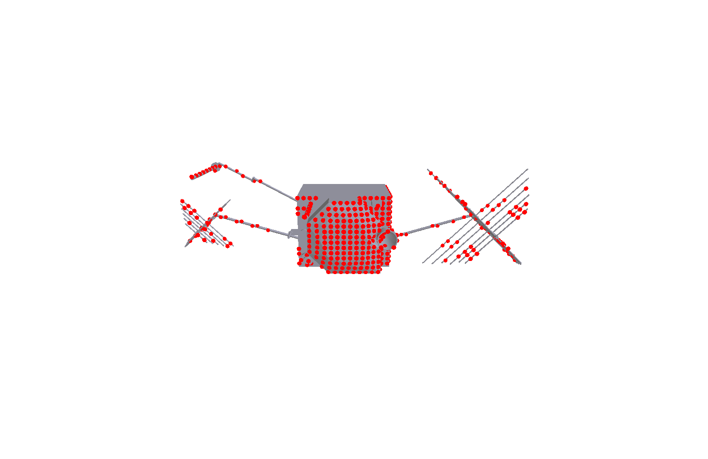

Slide 22
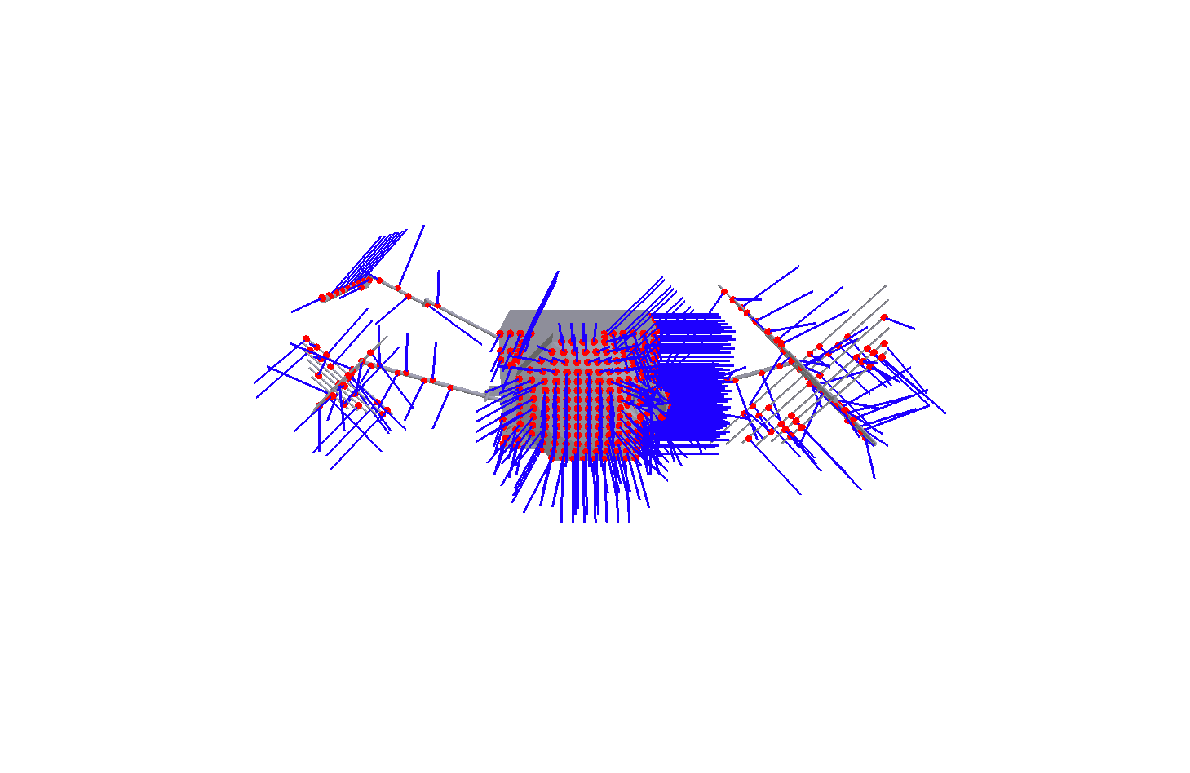

Slide 23
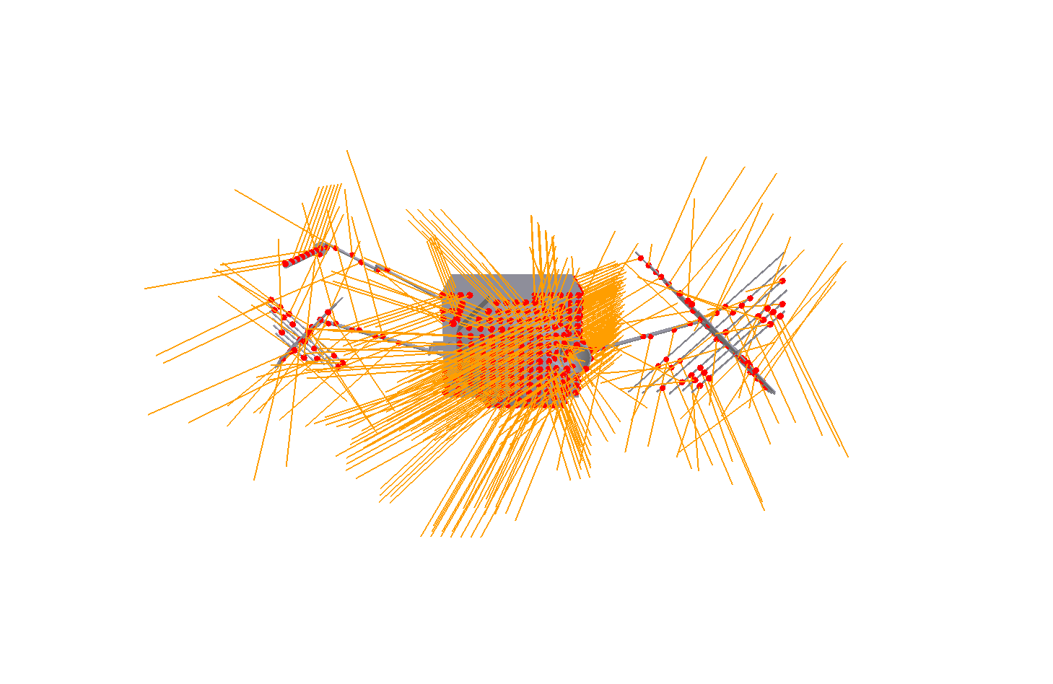

Slide 24
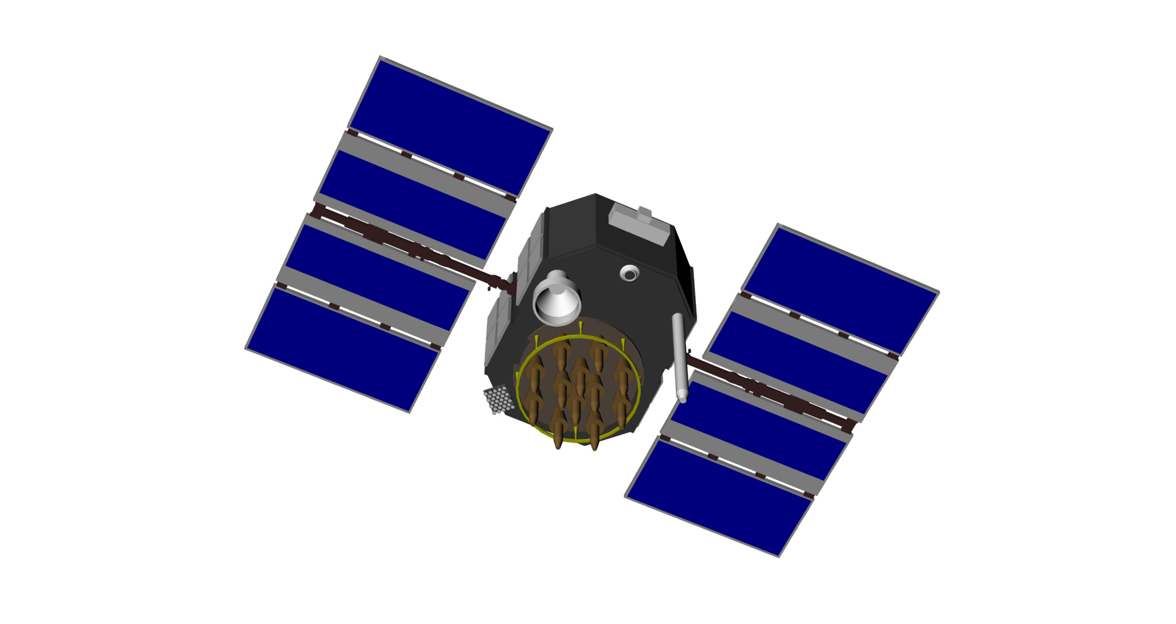
Summary of modelling techniques
Photon pressure modelling of complex forms through ray tracing
Flux models (solar, Earth radiation)
SV thermal effects (MLI, solar panel thermal gradient, radiator output)
Antenna thrust
Mass history modelling
Surface charge analysis via photo-electric effect*
Lorentz forcing*
Torque analysis*
* Research topics – everything else has flight heritage

Slide 25
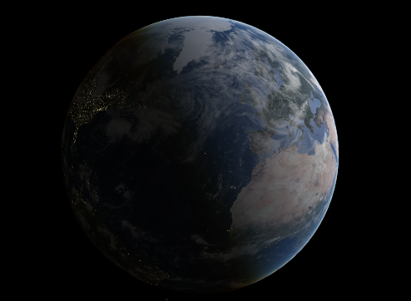
How well do these ideas work? Do they make any difference?:
Predicting a GPS satellite orbit over a 173,000 km trajectory

Slide 26
Along-track orbit prediction errors over 12 hours for one GPS IIR satellite with different photon-based force models
10
Solar radiation pressure (SRP) only
8
SRP + Thermal force (TRR)
SRP + TRR + Antenna Thrust (AT)
6
8 metre
orbit error
SRP + TRR + AT + Planetary Radiation Pressure
Orbit Prediction Error (m)
4
2
0
-2
0
1
2
3
4
5
6
7
8
9
10
11
12
Time (hours)
Notes:
Animate the build up of sophistication

Slide 27
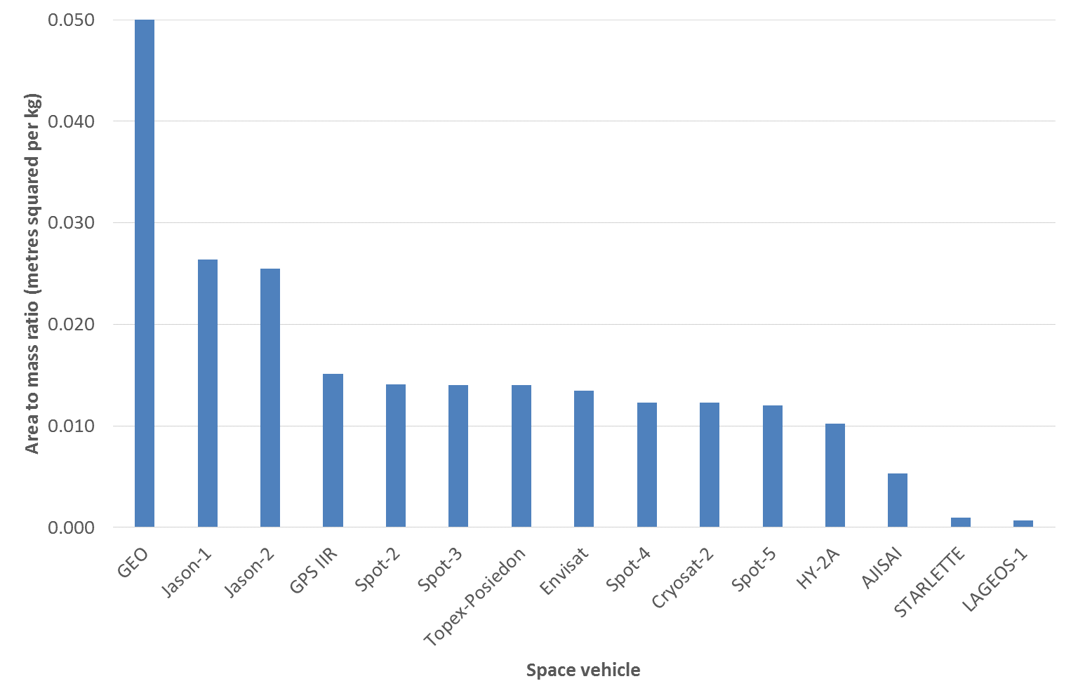
Sensitivity to surface forces: Area to mass ratio

Slide 28
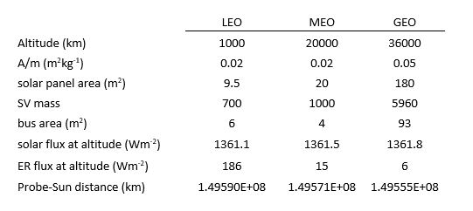
Typical space vehicle characteristics

Slide 29
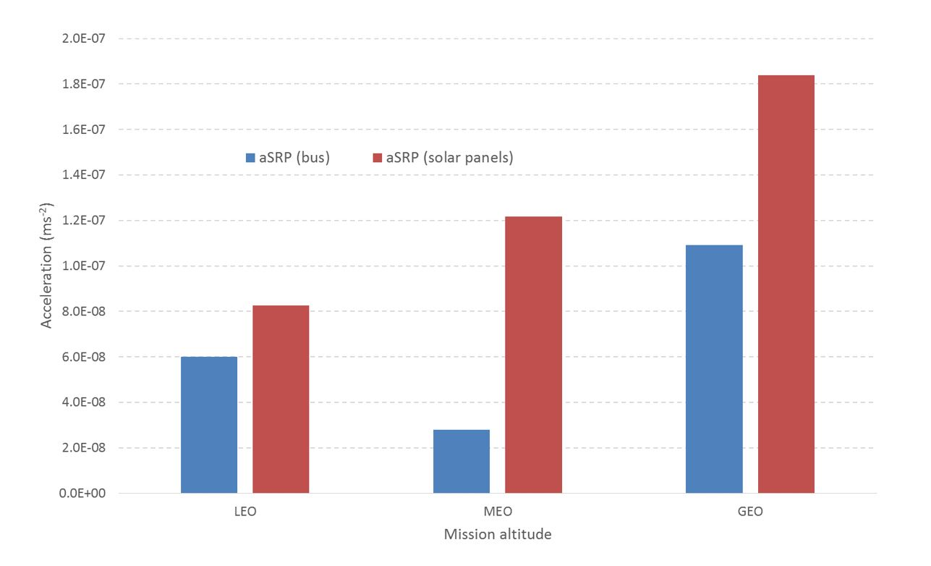
Characteristic Solar Pressure Accelerations for LEO, MEO and GEO satellites

Slide 30
Key Point 1:
GEO Satellites are highly sensitive to surface force effects compared to LEO/MEO satellites
Double Whammy: gravity weak, surface forces strong

Slide 31
Key Point 2:
Precision surface force modelling techniques developed for MEO/LEO missions have not been applied to GEO space vehicles as yet

Slide 32
Lorentz Force Effects
B (magnetic flux density)
An object in orbit carrying a net electrostatic charge (Q), will be influenced by an interaction with the local electromagnetic field, due to the Lorentz force.
v
Q
magnetic flux tube
F = QvxB
Notes:
The magnetic component of the Lorentz force, the vxB, is always orthogonal to the instantaneous velocity vector.

Slide 33
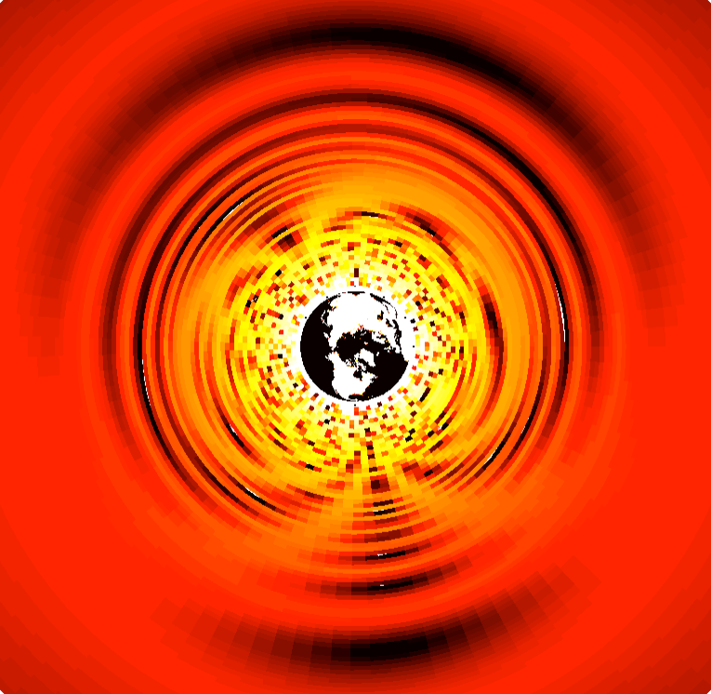

Magnitudes of the standard case GLA (equatorial plane: z = 0),
17 July 2013
in ms⁻²
5
Geostationary
Orbit
The standard case:
m = 1 kg
q = 1 Coulomb
Thus, q/m = 1 C/kg
Circular orbit
Inclination = 0
2000 km – ~36,000 km
y/R_{E}
0
y
sample
velocity vector
x
z
-5
R_{E} is the
mean Earth radius
-5
0
5
x/R_{E}
Notes:
We’ve developed a way of studying the Lorentz force effects by examining vxB maps.
For an object in orbit, the geomagnetic Lorentz force would be scaled by the Q(r,v,t).
These are standard Lorentz force maps.
Circular orbits.
Mass 1kg
Carrying 1 coulomb charge.
The force/accelerations are stronger closer to the Earth. However, there are distinct feature, and non-zero accelerations up to GEO.

Slide 34
Lorentz force at GEO
SVs co-rotating with the Earth have minimal velocity with respect to field
In super-GEO or geo-synchronous effects could be more pronounced (graveyard effects)
Key parameter is Q/m (charge to mass ratio)
Knowledge of charging is limited (currently)
Effect would be systematic (e.g. an issue for graveyard orbits)
It leads to another interesting question: solar wind and the plasma environment

Slide 35
Thoughts/Questions over the GEO Environment
Particulate radiation environment is difficult to predict a priori – take measurements?
Solar wind modelling and prediction – ingest predictive, space weather data from L2?
Engage with the space weather community for the purposes of dynamics modelling?
Commercial satellite operators (via NATO SCI TG) are willing to host instruments ‘on the wings’
A useful resource is the experience of existing satellite operators
Consider using a GEO satellite exploiting GPS side lobes for positioning

Slide 36
Conclusions
Non-gravitational orbital dynamics at GEO are unique and relatively unexplored (radiation pressure, solar wind, Lorentz)
GEO satellites have very high area-to-mass ratios compared to LEO/MEO SVs: sensitive to surface force effects
Mature modelling techniques (LEO/MEO) not yet applied to GEO
Environmental effects (plasma fields, solar wind forcing, charging, Lorentz) are poorly understood – may require sensor development on orbit
It would be useful to carry out a study on GEO orbital dynamics to quantify just what ‘natural motion’ comprises and to ingest new sensor information
This could provide the basis for track custody developments – identification and trajectory prediction

Slide 37
Back up slides

Slide 38
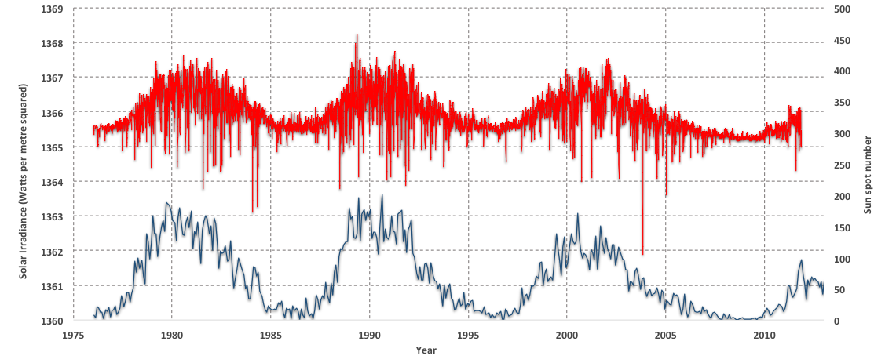
Total solar irradiance and sunspot number

Slide 39
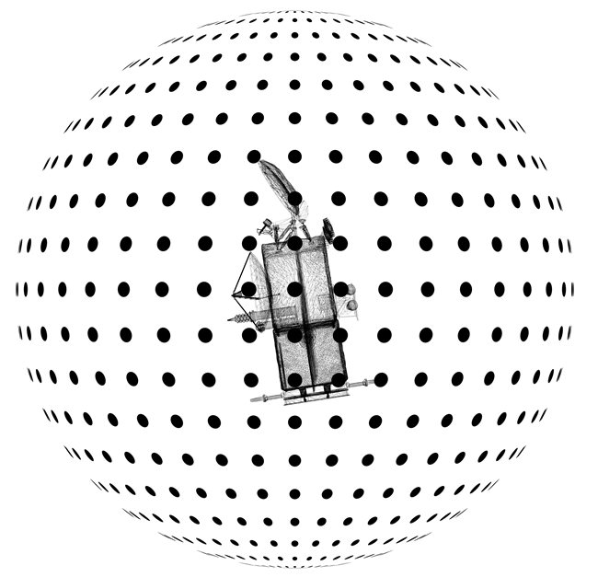
Spiral points computation
10,000 pixel arrays distributed evenly over a sphere centred on the S/C bus
1mm pixel resolution
Each pixel array position yields a resultant radiation force vector in body-frame components
Primary data set from which the grid file calculation is derived
The grid file allows for interpolation to create a continuous acceleration surface, modelled in the S/C body frame

Slide 40
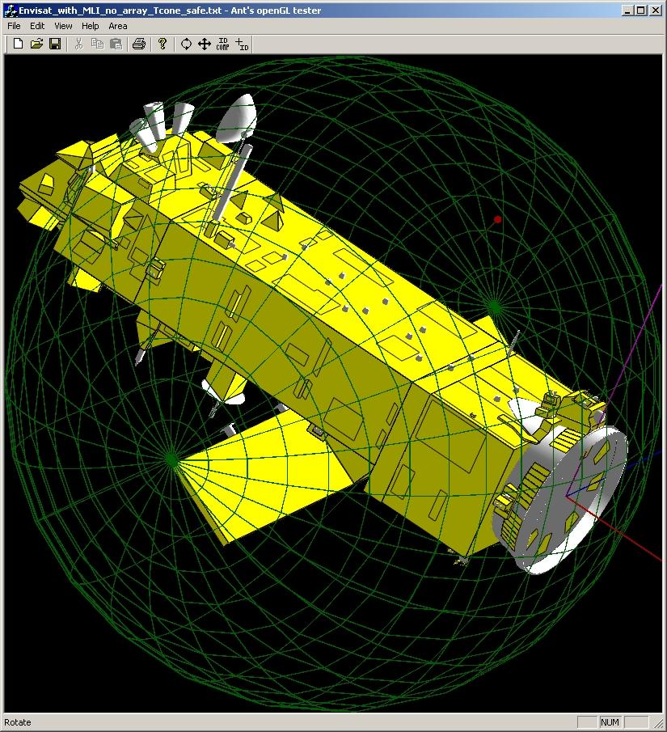
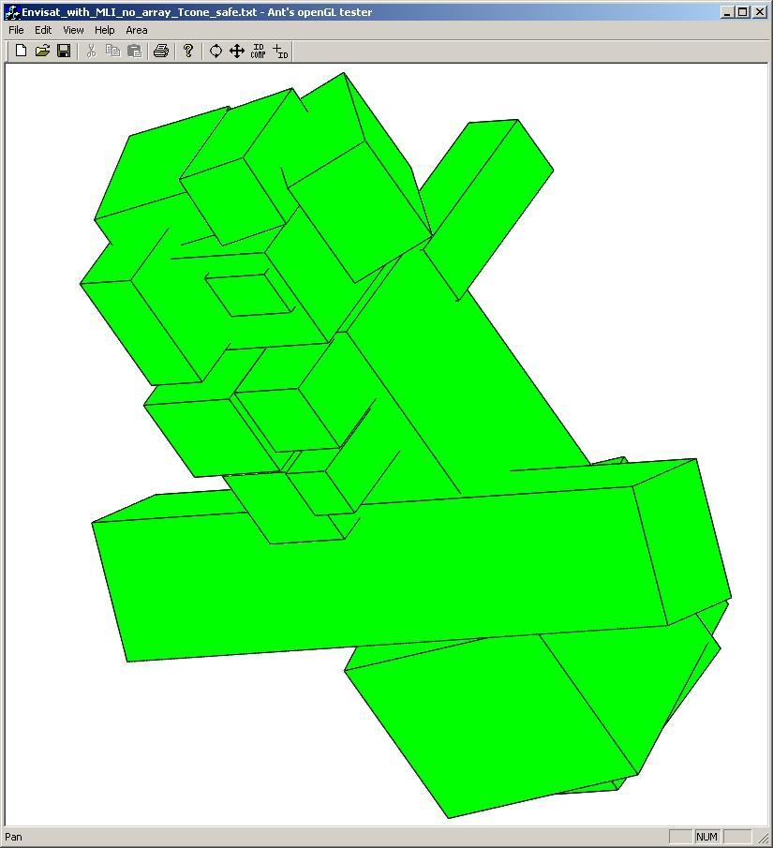
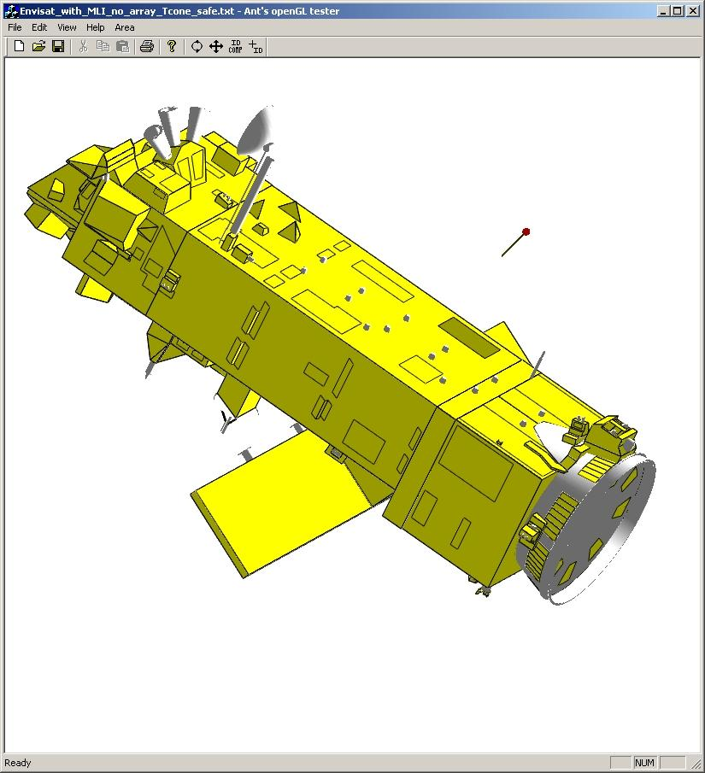
UCL Computational Efficiency & Quality Control

Slide 41
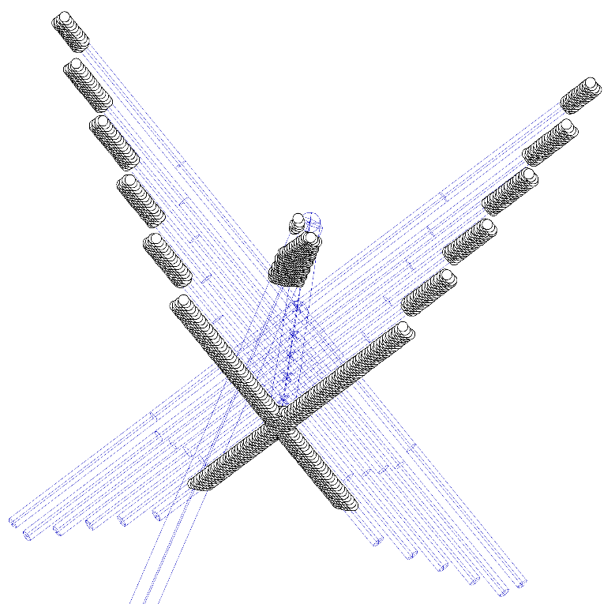
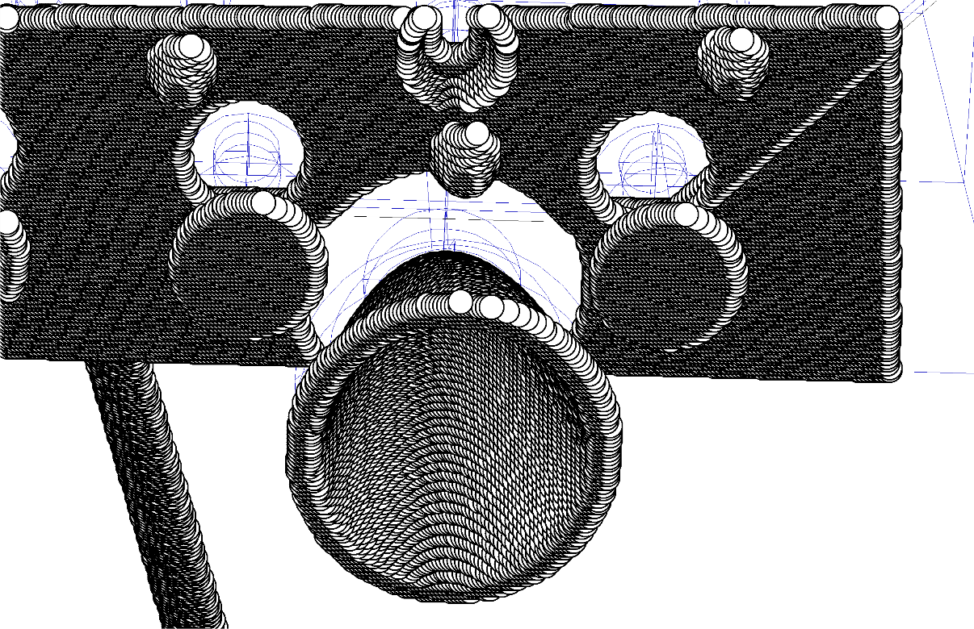
UCL Computational Efficiency & Quality Control

Slide 42
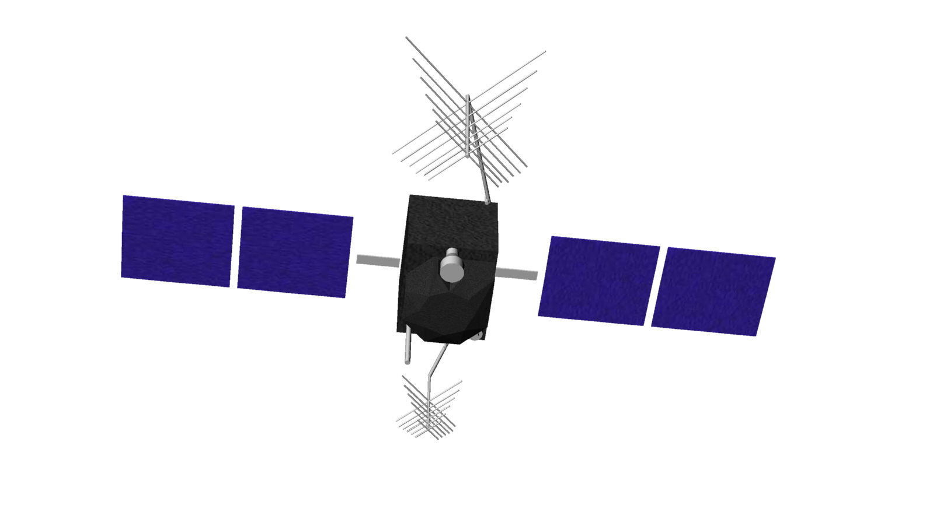
Thermal modelling:
Anisotropic thermal emission from spacecraft results in a net acceleration
Derive recoil force
recoil
recoil
recoil
recoil
heat
heat
heat
heat
Determine temperature distribution

Slide 43
Multilayer Insulation (MLI)
Pixel array algorithm determines insolation of MLI
Energy balance:
Incoming
radiation (W) absorbed
‘Effective emissivity’ (ε_{eff}) parameter governs heat transfer to bus
MLI blackened, α=0.94 ⇒ large thermal force
θ
Thermally
stabilised
bus, T_{sc}
Emitted
radiation
To s/c
Notes:
This is to try to keep spacecraft thermally stable.
MLI is designed to transport very little heat through to spacecraft
Effetive emissivity derived experimentally

Slide 44
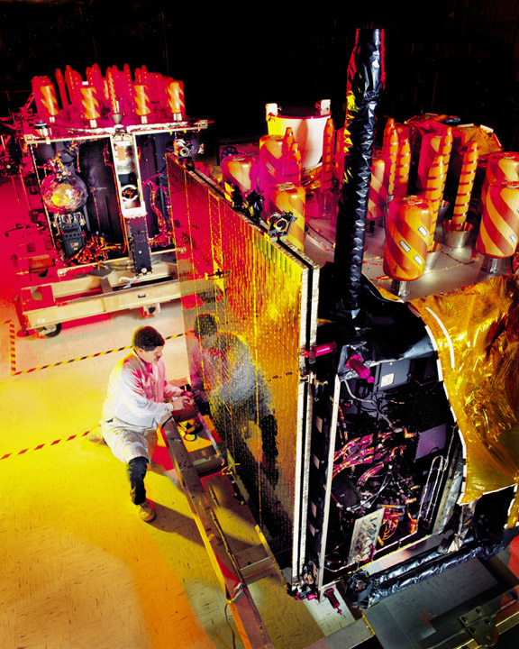
Solar Panel Thermal Analysis
Steady state and transient models (during eclipse) developed to yield temperatures and forces
Input data : thicknesses and conductivities of panel composite layers, surface emissivities and absorptivities, power draw
Model verification by comparison with telemetered surface temperatures

Slide 45
Solar panel thermal gradient force: system
K₁
K₂
…..
K_{n}
Conductivities
Power draw
Incoming radiation
(solar, Earth IR)
Incoming radiation
(Earth IR)
Absorptivity (α_{b})
Emissivity (ε_{b})
Emitted heat (front face)
Emitted heat (rear face)
Δx (slab thicknesses)
Absorptivity (α_{f})
Emissivity (ε_{f})
T_{f}
T₁
T₂
…..
T_{n}
T_{b}
Temperatures

Slide 46
Solar panel thermal gradient force:
Inputs and outputs
Inputs:
Outputs:
Incident radiation fluxes
Panel attitude in inertial space
Absorptivity and emissivity (front and back)
Slab thicknesses and conductivities
Power draw
Intermediate:
  Temperatures at slab interfaces
  Net thermal gradient
Final:
  Accelerations due to thermal emission (front and back)

Slide 47
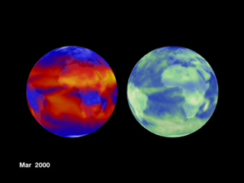
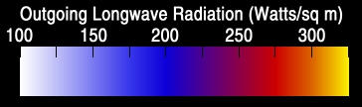
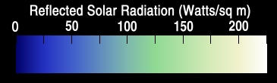
Earth radiation:
Emitted (LW) and reflected (SW) radiation

Slide 48
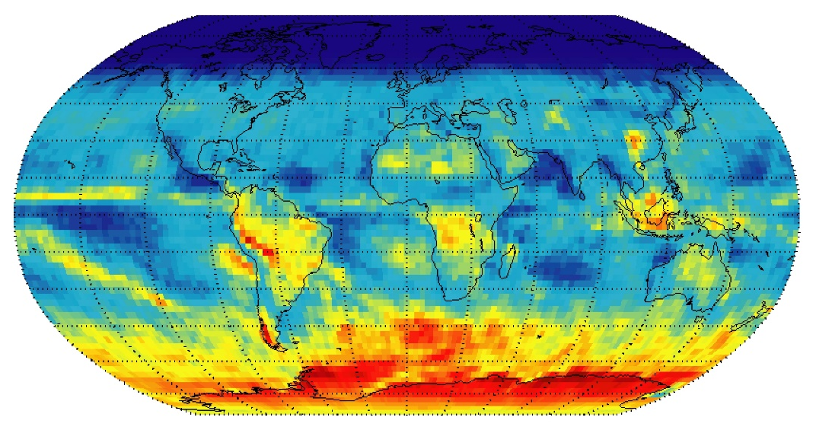
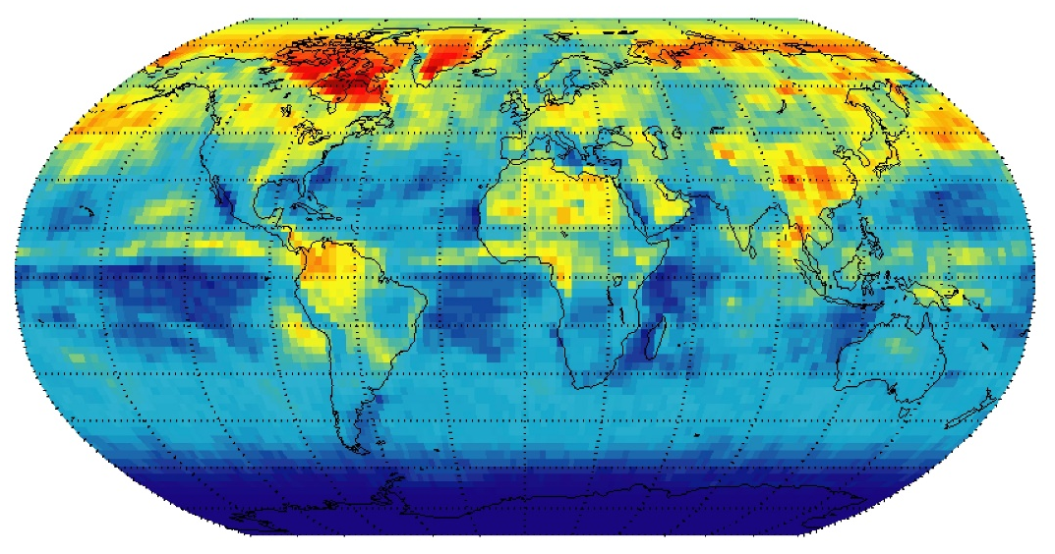
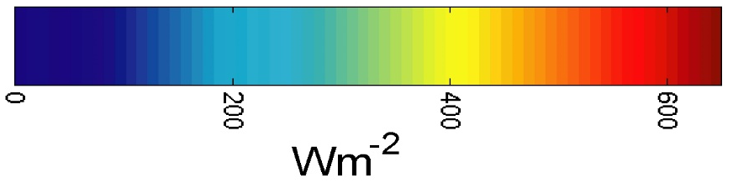

Planetary Radiation Pressure (PRP)
SW Radiation Complexity – strong seasonal signals
Maximum SW flux: Dec 2003
Maximum SW flux: May 2004
0
200
400
600

Slide 49
Modelling Earth radiation pressure step 1:
Visibility of Satellite to Grid Cells
GPS SVN 44 at one epoch on 1st July 2001

Slide 50
Modelling Earth radiation pressure step 2:
Compute reduction in flux as a function of satellite-cell elevation and satellite-cell distance

Slide 51
Planetary radiation pressure HCL accelerations, GPS satellite SVN 41
H = Height C = Cross track L = aLong Track

Slide 52
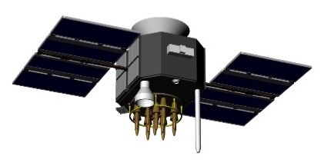
Orbit accuracy tests: Satellite Laser Ranging (SLR)
Range measurement from time of flight
Accuracy:
generally sub-centimetre
Laser pulse of photons
Ranging requires retro-reflectors

Slide 53
GPS satellites carrying retro-reflectors
2 Block IIA spacecraft
PRN05, PRN06
Retro-reflector array

Slide 54


The GPS-SLR Orbit Anomaly
Estimated orbit (e.g. IGS)
(from pseudo-range
and phase)
Mean bias
~ 5 cm
Estimated orbit is
consistently
too high
True trajectory
(tracked by SLR)
5cm range error => [gravity] acceleration error of: ~2.3x10⁻⁹ ms⁻²
Small number, big effect : along track error of ~2.11m (12 hrs)

Slide 55
Mean Orbit Differences
5 cm
3.3 cm
2.9 cm
IGS combined
JPL nom PRP
JPL UCL PRP
SLR
Combined Earth radiation pressure and antenna thrust model reduces SLR bias by 21 mm

Slide 56
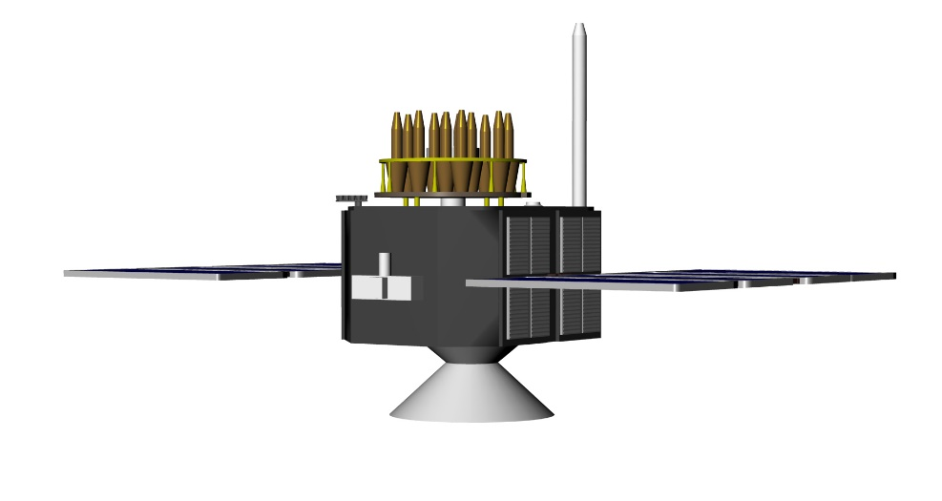

Laser Retro-reflector Array (LRA) offset
LRA position in s/c body frame required for analysis of laser ranging
New data suggests LRA offset further from centre of mass than previously understood
Shim corrections: +11 mm (PRN05), +13 mm (PRN06)
shim

Slide 57
IGS experiments, analysis, standards
This research leads to IGS standards – applied by all analysis groups within the organization. Ideas are tested by large-scale data processing experiments spanning many years and huge networks of data. The recent REPRO2 exercise re-computed orbit, clock, station positions and earth orientation parameters using over twenty years of daily data from the entire network. Such operations give insight into system and planet scale behaviors.
Earth radiation forcing and antenna thrust methods changed IGS orbit accuracy from 5 cm to 2.5 cm (radial)

Slide 58
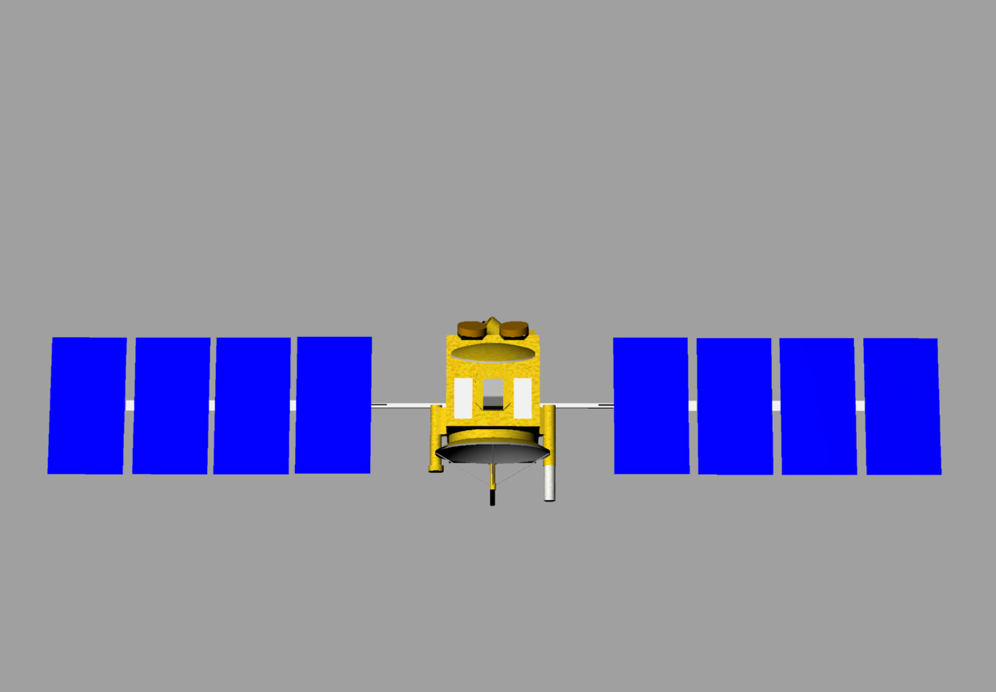
Phase centre variation method: Jason-1&2
Utilise many months of GPS observations
Stack phase residuals by bins as a function of latitude and longitude in antenna frame
Create look up table of phase observation corrections

Slide 59
What do we need to do this, and to push the envelope of what is possible:
SV mass and mass history
Structural details (primarily surface geometry)
Material types (absorptivity, reflectivity, specularity)
Specific thermal information (MLI characteristics, power draw, thermal emissions, solar panel construction)
Satellite attitude (both eclipsing and non-eclipsing, non-nominal attitude, yaw flips, noon day and midnight turns)
Satellite phase centre (phase centre offset, phase centre variations)
Laser retro-reflector array position, corner cube phase centre

Slide 60
Emerging Technology and Challenges
Many GNSS satellites carrying retro-reflectors (Galileo; GPS III, Beidou, GLONASS)
Galileo orbit and clock performance – a new benchmark?
Next generation understanding of the space environment (radiation fluxes, Lorentz forcing)
New paradigms in atmospheric density modelling
Accurate space vehicle phase centre information
Utilising telemetry in the OD/prediction process
Using measured attitude instead of attitude laws

Slide 61
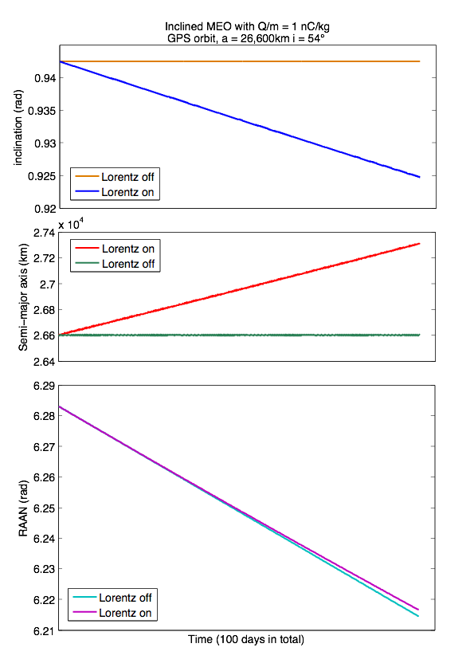
MEO:
Dynamics
Monopole
J2
Lorentz
~1.02 degrees
708 km
~1.14 degrees

Slide 62
GPS 2.5cm orbit accuracy: summary
Careful calibration of receiver and satellite phase centres
Well defined reference frame and Earth orientation parameters
Sophisticated troposphere mapping functions and horizontal troposphere gradient parameters
Precise knowledge of retro-reflector array position
Dynamics modelling: antenna thrust
Dynamics modelling: Earth radiation forcing

Slide 63
1cm accuracy Jason-class orbit: summary
Careful calibration of GPS receiver phase centres and phase centre variations
Detailed modelling of solar radiation pressure and thermal re-radiation effects
Use of measured attitude (quaternions) over the attitude laws
High accuracy GPS orbits

Slide 64
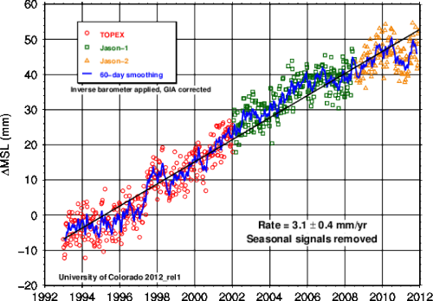
Why we need a 1cm orbit for Jason-class satellites:
Global sea level rise measured by satellite altimetry

Slide 65
Conclusions
Non-gravitational orbital dynamics at GEO are unique and relatively unexplored
GEO satellites have very high area-to-mass ratios compared to LEO/MEO SVs, making them particularly sensitive to surface force effects
Some environmental effects (plasma fields, solar wind forcing) are poorly understood – may require sensor development on orbit
It would be useful to carry out a study on GEO orbital dynamics to quantify just what ‘natural motion’ comprises
This would provide the basis for discrimination techniques

Slide 66
Modelled Earth Radiation pressure (SVN35, UCL ADM model
}
Height
Cross track
accelerations
Along track
Eclipse
Eclipse
Acceleration (ms⁻²)
Time (hours of day)

Slide 67
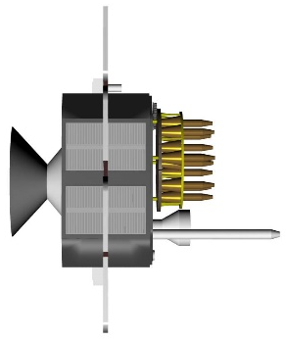

Thermal

Slide 68

Thermal

Slide 69

Thermal
Albedo

Slide 70

Albedo
Thermal

Slide 71

Thermal
Albedo

Slide 72



Slide 73

Explanation
‘SLR orbit’
Symmetric thermal thrust
Assymetric ‘Albedo’ thrust
Orbit estimated using
using phase/pseudorange
(without modelling PRP)
Solar panel

Slide 74
Maximum Y-acceleration
due to star sensors
Effect reduces as
profile changes
Star sensor
Becomes
visible
Opposing faces
cancel effect

Slide 76


Slide 77


Slide 78


