Slide 1
Space Situational Awareness (SSA)
Project Overview and Background
Andy Ash - SSA Project Technical Authority
UK OFFICIAL

Slide 2
Contents
Context
MOD CSA Space Situational Awareness Research
  EU SST
Specific deep space interest areas
UK OFFICIAL

Slide 3
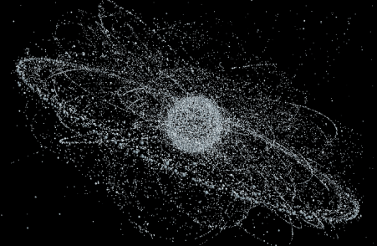
Space… but not as we know it..?
The domain is continuing to evolve; more congested, competitive and contested
UK OFFICIAL

Slide 4
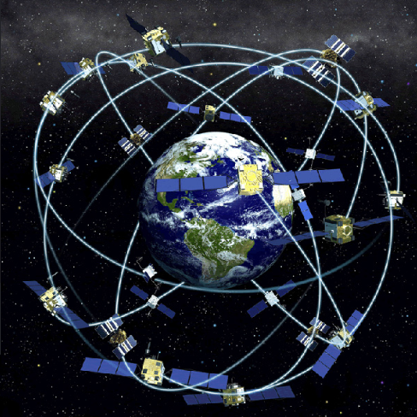
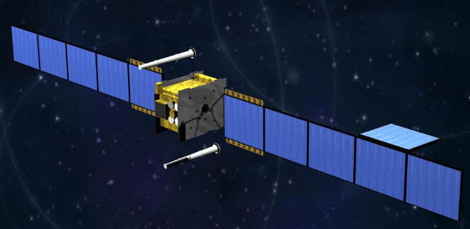
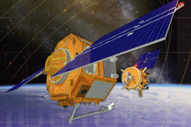
Context: Civ/ Mil SSA
Space inherently ‘Dual-Use’
Hostile/ adverse action impacts UK government-wide & internationally → inherently a global problem
One (passive) response: SSA
2025 vision: Civ/military SSA hub at UK Space Operations Centre (UK SpOC)
UK OFFICIAL

Slide 5
Technical (and wider) Challenges
Ever increasing problem (more targets and more data)
  An enhanced UK footprint in space (MOD ISR, use of EU GNSS, next-gen sat comms, Civil space tourism etc.) will generate more requirements
  Ever growing reliance on space-derived capabilities
Immaturity of science within existing operational processes
  Re-entry prediction, astrodynamics, orbit prediction and propagation, space environment forecasting etc.
Global Problem: need global solutions
  Bi-laterals, NATO, UN, EU SST, CSPO etc.
  Need to develop robust system to enable flexibility as options are investigated
  FAA/ Civil space and Space Traffic Management concepts
UK OFFICIAL

Slide 6
Dstl SSA project

Slide 7
Top-level UK Direction
2014 National Space and Security Policy (NSSP);
  Growing reliance of UK on space-based capabilities
  MOD has a key role to ensuring continued access to these capabilities
  UK requirement for indigenous SSA capabilities to augment and contribute to allied networks
2015 SDSR:
  “UK is reliant on access to space for our security, […] and military capabilities. But near-Earth orbits are becoming increasingly congested and competitive, with more countries and private actors pursuing space programmes”
  Enhance UK SSA capabilities; and work with within CSPO and EU SST
  Investment in UK SSA mission systems
  Enhance Space Weather forecasting to mitigate against natural threats
UK OFFICIAL

Slide 8
Top-level SoSp Activities
R&D to enable development of UK SpOC
  Develop tools and techniques to support data processing
  Identify gaps and potential solutions
Promote underpinning UK S&T to support UK SpOC
  Leverage external investment to benefit of MOD
R&D targeted at address future SSA mission needs
Identify and assess UK options for SSA sensors
Conduct SSA experiments to develop and test prototype SSA solutions;
  Within international SSA initiatives including CSPO
Data exploitation and fundamental SSA science
Wider data sources and practical demonstration
UK OFFICIAL

Slide 9
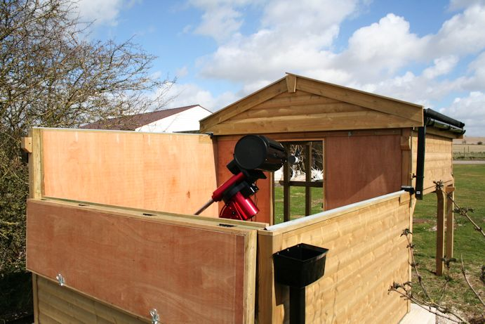
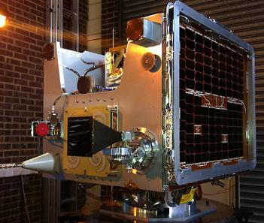
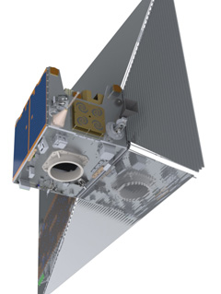
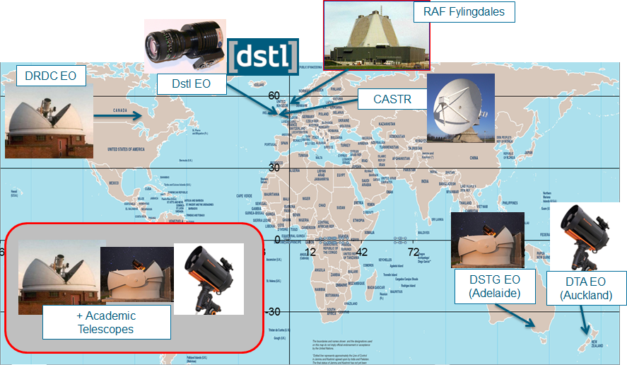
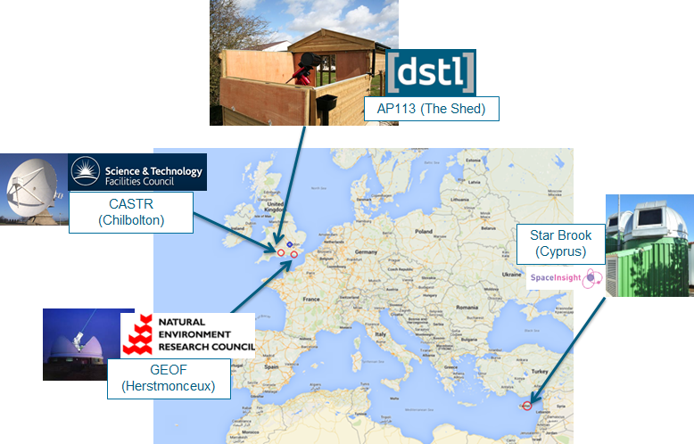
Specific Experimentation Activities
Polarmetric Imaging for object characterisation
Daedalus – De-orbit sail observation
Inform future HQ Air SSA requirements for data processing techniques, C2 etc.
CSPO Launch & commissioning experiment (initial planning underway)
UK OFFICIAL

Slide 10
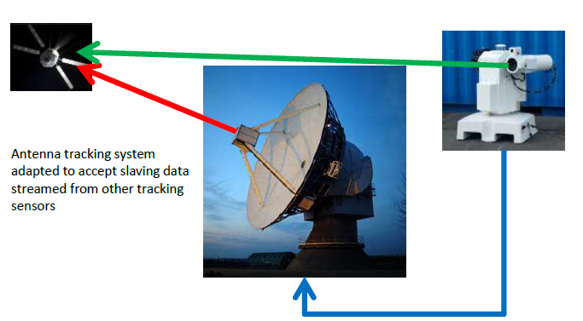

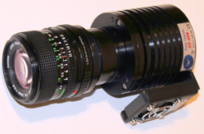
Sensors Investigation
AP113 – understand utility of COTS EO technology. Maturing automated data processing to support UK SpOC/ HQ Air Cmd option generation
CASTR-CL2 (-Hx): EMR to develop automated cueing and data transfer system between UK SSA assets for real-time operation
Inform HQ Air SSA sensor options
Low Cost deployable EO investigation
UK OFFICIAL

Slide 11
EU SST

Slide 12
Overview
5-Nation consortium: UK, DE, FR, IT, ES (+ EU SatCen)
Provide SST services to users:
  Conjunction Analysis & Warning
  Re-Entry Analysis & Information
  Fragmentation Analysis
Initial Phase: January 2016 to July 2017
UK Participants:
  UKSA, MOD/HQ Air, Dstl, STFC, NERC, SpaceInsight
Initial Services provided from 1st July 2016
UK OFFICIAL

Slide 13

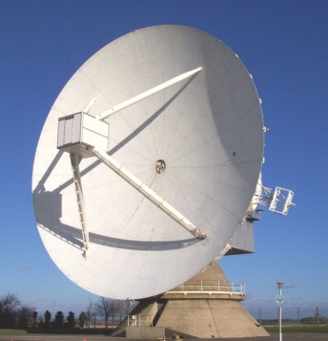
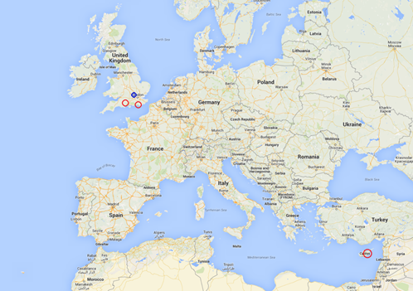


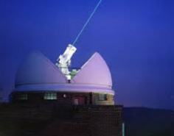

Initial UK Architecture Elements
UK SpOC
(High Wycombe)
CASTR (Chilbolton)
Starbrook (Cyprus)
GEOF (Herstmonceux)
UK OFFICIAL

Slide 14
Status
UKSA/ MOD considering potential UK input to next series of EU SST calls
  Build upon initial architecture work
  Increased focus on S&T versus identified capability gaps
  Funding for sensor operations and analysis support
Possible opportunity for increased UK participation
UK OFFICIAL

Slide 15
Specific Deep Space Challenges

Slide 16
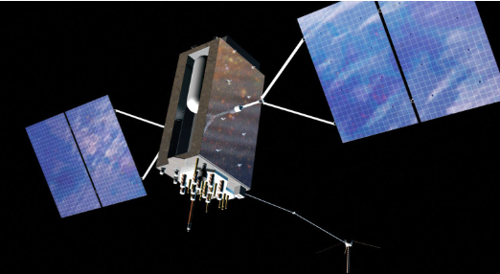
Overview
GEO: small number of high value assets; belt increasing congested
  Clusters, NKO, satellite servicing
MEO: GNSS assets providing critical service to UK
Graveyard: faint targets, difficult to track, population characteristics/ evolution uncertain
UK OFFICIAL

Slide 17
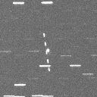
Close Approach 28/04/2016
17125 (SL-12 R/B) and 32294 (SKYNET 5B)
  Predicted close approach 3.4km at 1933 UTC
  Examine procedures for close approach and fragmentation-detection
Starbrook:
  1800 – 2200 UTC: Observations before & after TCA
  2200 UTC: Mini-survey around SKYNET 5B longitude for fragment detection
Herstmonceux:
  Cloud obstruction during most of night, no observations
Based on Observations …
  Space Insight observe ~3 km miss-distance in 2 dimensions (range not known)
UK OFFICIAL

Slide 18
Areas of Interest/ Challenges
Domain evolution
  What will deep space comprise of in T+5, +10, +20 years (and beyond..)
Tasking of sensors
  How to appropriately account for visibility constraints/ weather
  Effective scheduling and task management
EO system design
  Trade off between cost, vis mag limits, FOV, reaction time, etc.
Architecture design
  Best mix of sensors against various missions; how to best mitigate weather dependence; role of RF sensing methods
Data Processing
  How to assess different approaches and test (experiment design)
UK OFFICIAL

