Slide 1
Space Situational Awareness:
Current Relevance and Challenges
17 Sept 2016
Dr. Thomas Cooley, ST
AFRL / RD
Air Force Research Laboratory
This briefing, presentation, or document is for information only. No US Government commitment to sell, loan, lease, co-develop or co-produce defense articles or provide defense services is implied or intended.
DISTRIBUTION STATEMENT A. Approved for public release; distribution is unlimited.

Slide 2
Hazard to Threat Continuum
Space Environment |  | Space Hazards |  | Space Threats
The space environment is hostile and hazardous Electronics upset Materials age Radio waves degrade The space environment affects the dynamic behavior of objects |  | Thousands of space objects Paths only approximately known Space is more crowded today Space objects are hazardous to each other The probability is low, but the consequences are very high |  | Space is contested by adversaries today • The required methods to address the threat are new • The methods cross many phenomenologies and disciplines • Understanding the different types of space threats will minimize vulnerabilities The threat real and growing
The environment needs to be understood and managed |  | Traffic control of space congestion needs to assure safe operations |  | The threat must be detected, understood, and addressed

Slide 3
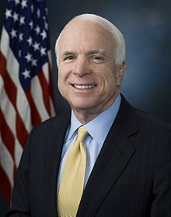
Improving SSA
Becoming A National Priority
“With Russia and China aggressively weaponizing space, we can no longer take for granted the relative peace we have enjoyed in space for nearly sixty years. Both Russia and China are pursing unprecedented counterspace programs and investing robust resources to challenge U.S. superiority in space.
… Russia and China are testing and investing in anti-satellite weapons including direct assent missiles, ground-based lasers, and satellite jammers. To respond to these provocations, the Defense Department is investing $5 billion and reviewing nearly every facet of the way we operate in space and utilize our space-based capabilities.”
Chairman John McCain
House Armed Services Committee, January 27, 2016
Counter-space threats are real -
Improving SSA becoming a national priority

Slide 4
Hazard to Threat Continuum
Space Environment |  | Space Hazards |  | Space Threats
The space environment is hostile and hazardous Electronics upset Materials age Radio waves degrade The space environment affects the dynamic behavior of objects |  | Thousands of space objects Paths only approximately known Space is more crowded today Space objects are hazardous to each other The probability is low, but the consequences are very high |  | Space is contested by adversaries today • The required methods to address the threat are new • The methods cross many phenomenologies and disciplines • Understanding the different types of space threats will minimize vulnerabilities The threat real and growing
The environment needs to be understood and managed |  | Traffic control of space congestion needs to assure safe operations |  | The threat must be detected, understood, and addressed

Slide 5
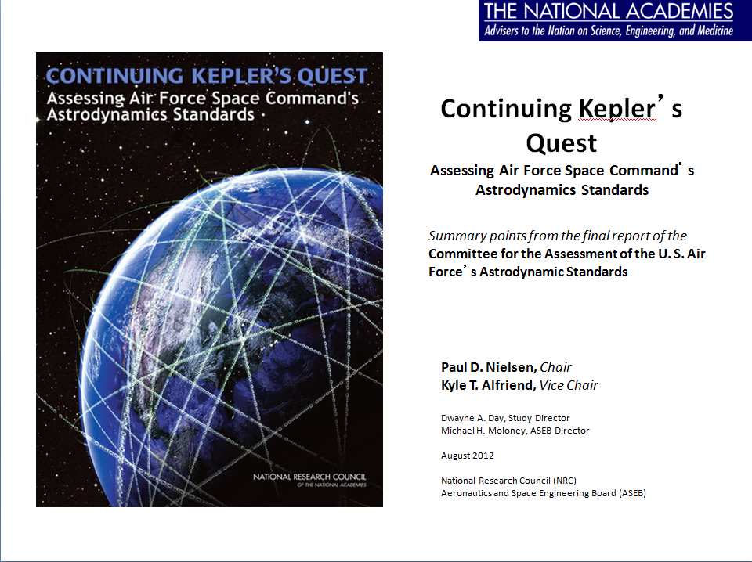
Improved Astrodynamics
Upper atmosphere models
Solar radiation pressure/drag models
Gravitational models
Data association methods for robust catalog maintenance and breakups
Sensor bias models
Uncertainty representation tools
Dynamic systems analysis
Classical analytical techniques
Explore new techniques
  AFRL asked to lead in multiple technical areas

Slide 6
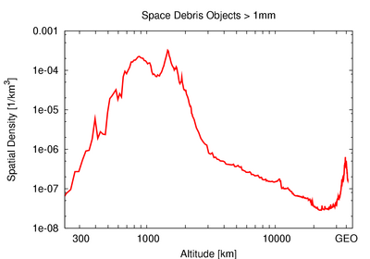
Hazards From Space Objects
Dead and Alive Objects: A growing problem in all regions of space
Before the Iridium-Cosmos collision and the Chinese ASAT test
Spatial Density (1/km³)
~GEO
~LEO
Estimated Altitude Debris Distribution (km)
Sources | Sinks
• New Live objects/satellites • All space object weathering leads to flaking, chipping, erosion • Mission/deployment related debris • Gravity fatigue and torqueing self destruction • Dead objects/debris and explosions • Fretting fatigue causing structural failure | De-orbiting objects: Space environment and/or gravitationally induced perturbations about 1-3 per day
~1200 “Live” objects
~20,000 objects >10cm
~3-600,000 objects >1cm
Space participants are proliferating – 43 countries today

Slide 7
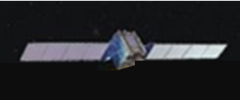
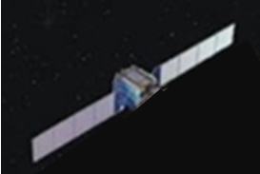

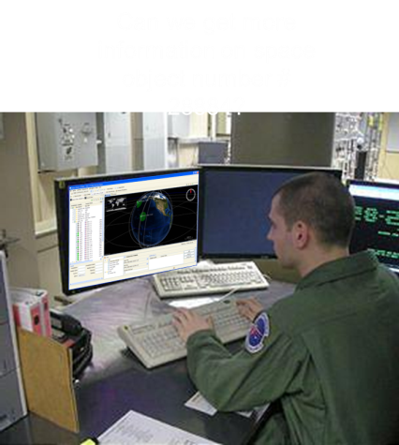
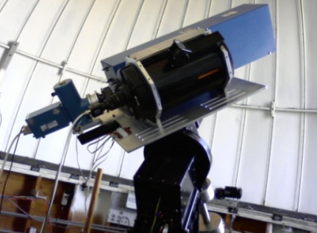
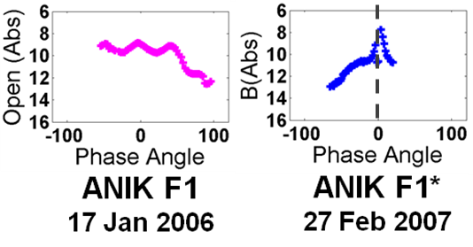
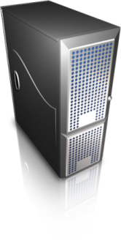
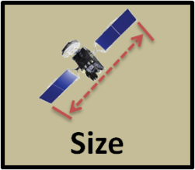
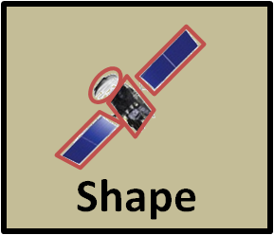
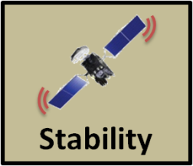
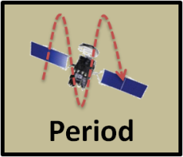
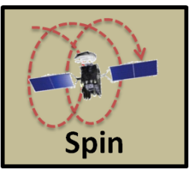
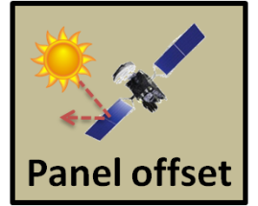
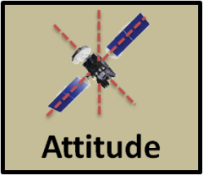
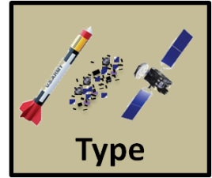
GEO Belt Awareness:
Non-Resolved Signature Exploitation
Ground Telescopes (e.g. Raven)
GEO Satellite Phenomenology
Algorithms and Tools
Analysts
Signature Exploitation
Algorithms
SSA
Information
Sensors
Data
Several characteristics can be inferred from non-resolved satellite measurements
Notes:
7

Slide 8
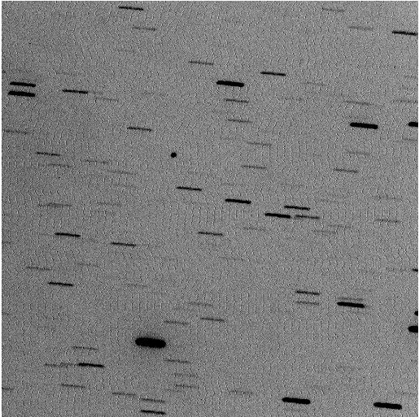
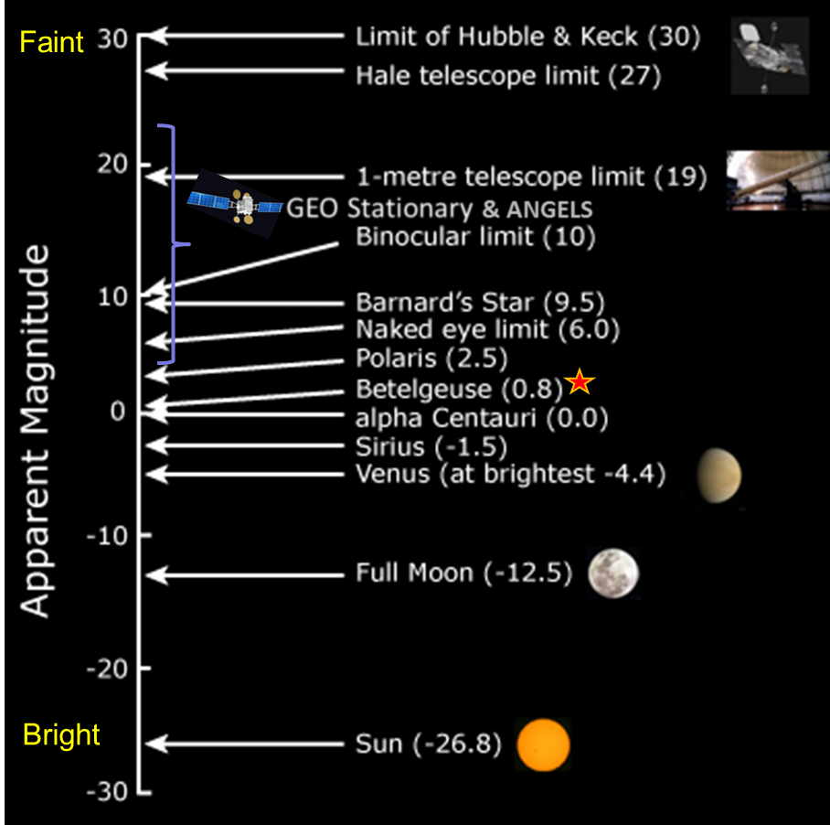
Photometry 101
Tracking Sat
Stars Streak
CCD Image
18” Telescope
Original art planetary-science.org (revised)
Typical data collection
  Sensor observes calibration stars or GEO Belt objects – typical magnitudes ~6th-19th
  Calibrate raw data: remove artifacts convert to physical units, magnitudes M_{v}
  Automated Image Processing star, flaw, catalog correlated satellite
Notes:
Typical values of I0 = 2.75e-12 for open filter
I0=6.95e-12 for B filter
I0=2.254e-12 for R filter
I0=1.196e-12 for I band

Slide 9
Newly-Observed Objects Present Fundamental Challenges
Number of unknown (but detected) objects (red bars) increases with better sensors
Figure from Schildknecht et al (2007)

Slide 10
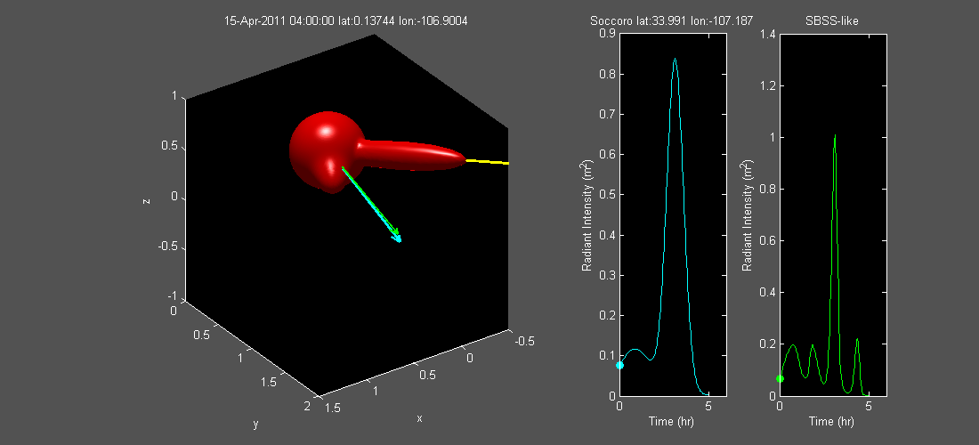
Light-Curve Phenomenology
Socorro, NM
LEOSat
Satellite reflectance function (BRDF)
Time (hr)
Time (hr)
Challenge: Signature changes with time and location of observer

Slide 11
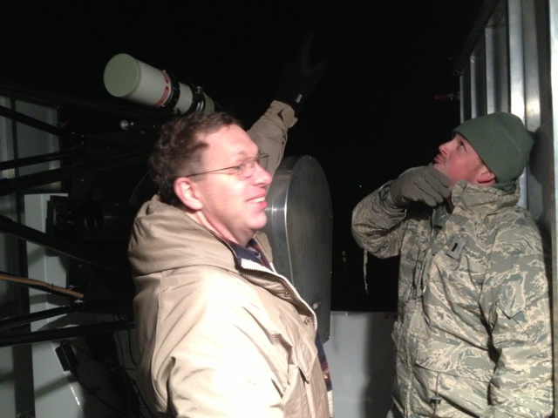
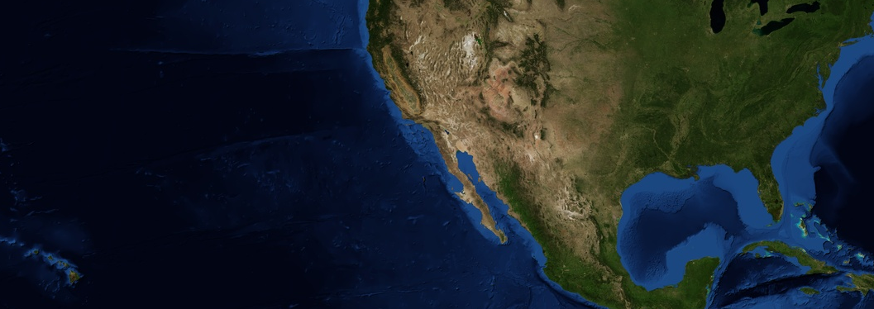

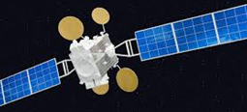
GOLDS Collection Campaigns
Plentywood, MT
USAFA Deployable Telescope
Dayton Telescope
USAFA Telescope
ABQ Raven
Montana, Feb 2013
Maui Ravens
GOLDS – GEO stationary Observations with Latitudinal Diversity, Simultaneously
  GOLDS 1 Feb-Mar 2013
  GOLDS 2 Oct 2014
  GOLDS Bridge Jul 2014- Jul 2015
Key Performers: AFRL RV/RD, USAFA
Collaborators: AFRL/RY & RH, AFIT
S.A. Gregory et al., NI-SOI Workshop, Sept 2013

Slide 12
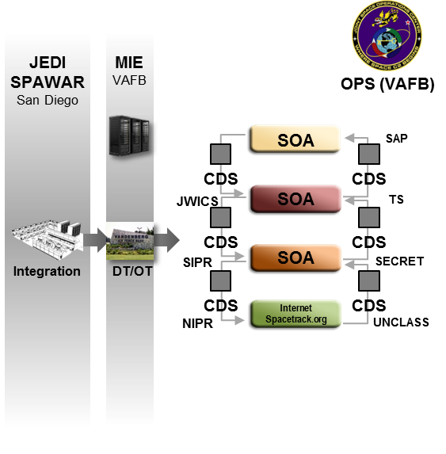


JMS ARCADE Provides Bridge Across the “Valley of Death”
Future Increments will leverage JMS Requirements & Planning Council (R&PC) governance to guide S&T Investment early on and make final acquisition decisions
JMS Program will use ARCADE as a proving ground for prototype capabilities and expose these early to the JSpOC via exercises
ARCADE security infrastructure will protect intellectual property of industry capabilities
Valley of Death
Bull Pen
R&PC
6 Mo.
Cycle
Changes CDD
KSA or OSA
to Promote ARCADE
Application
R&PC
6 Mo.
Cycle
IDs Priorities
For Early Research
Workflows
and Tools
Nominated
applications
Evolving JSpOC
Workflows
Exercises
Exercise
Feedback
Trial
applications
Application
feedback
Algorithm Development
Prototype Application and UDOP Perspective Development
TRL 1
TRL 2
TRL 3
TRL 4
TRL 5
TRL 6
TRL 7
TRL 8
TRL 9
Basic Principles
Observed and
Reported
Tech Concept
and Application
Formulated
Experimental
Critical Functions
Proof of Concept
Component
Validation in
Laboratory Env
Component
Validation in
Relevant Env
Prototype
Demonstration in
Relevant Env
Prototype
Demonstration in
Operational Env
Actual System
Completed
Test Qualified
Actual System
Proven in
Operational Env
Basic Principles
Observed and
Reported
Tech Concept
and Application
Formulated
Algorithms Defined
Exploratory Coding
Coding
Ad Hoc Component
Integration
Architecture Defined
CM/Test Defined
Laboratory Environment
Alpha Version
Relevant Environment
Beta Version
VV&A Complete
Ops System Accredited
DT&E Complete
Installed on
Ops System
OT&E Complete

Slide 13
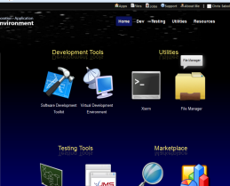
ARCADE Supports a Broad
Spectrum of Users
Acquisition
Agencies
UDOP
Developers
External Data Sources
Preview tech
Tech validation
Develop & test
visualizations
Test interfaces
Develop, test and
validate service
orchestrations
Test interfaces
ARCADE
Data sources
Scenarios
Test cases
Preview tech
Operator feedback
Algorithm
Developers
Algorithm/App Development
Integrate into JMS SOA
Analysts
(U) The JMS ARCADE Provides a JSpOC-Representative Dev’l & Collaboration Environment through a Web-Service Interface
DISTRIBUTION STATEMENT A. Approved for public release; distribution is unlimited.

Slide 14
Hazard to Threat Continuum
Space Environment |  | Space Hazards |  | Space Threats
The space environment is hostile and hazardous Electronics upset Materials age Radio waves degrade The space environment affects the dynamic behavior of objects |  | Thousands of space objects Paths only approximately known Space is more crowded today Space objects are hazardous to each other The probability is low, but the consequences are very high |  | Space is contested by adversaries today • The required methods to address the threat are new • The methods cross many phenomenologies and disciplines • Understanding the different types of space threats will minimize vulnerabilities The threat real and growing
The environment needs to be understood and managed |  | Traffic control of space congestion needs to assure safe operations |  | The threat must be detected, understood, and addressed

Slide 15
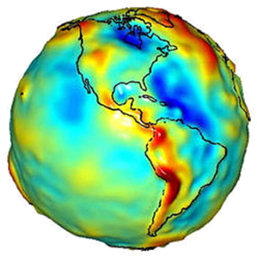
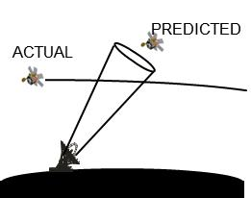
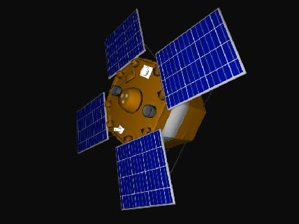

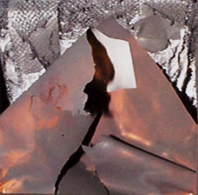

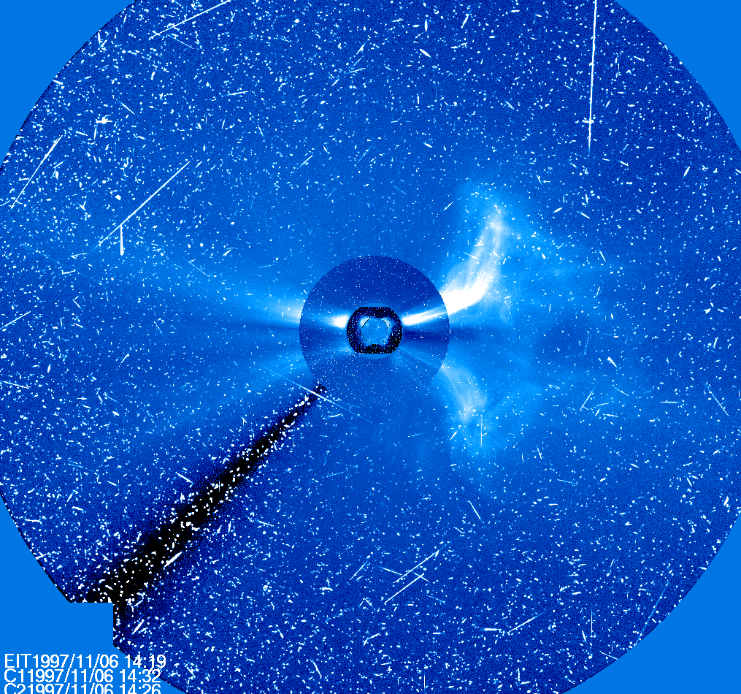
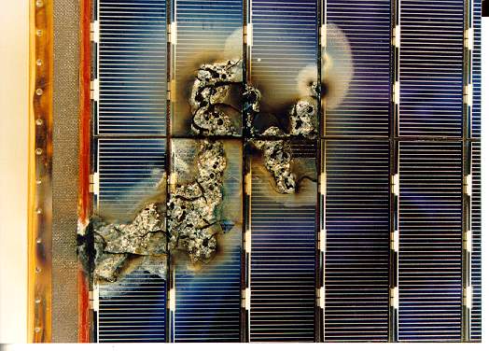
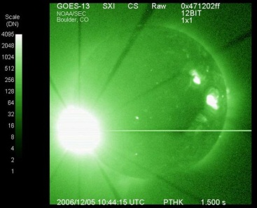
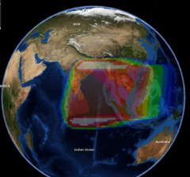
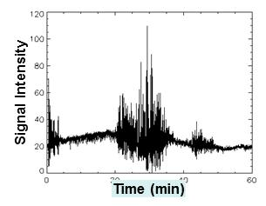
Hazards from the Space Environment
Space environment impacts to systems and services are complex
Vehicle and Payload Anomalies
Sudden solar array power decrease due to radiation event
Solar array arc from surface charging
The Problems
Atmospheric Drag
Microelectronics
bit flips, latch-ups
Non-Uniform Gravity
Material Aging & Damage
Electromagnetic
pulse from
vehicle discharge
Discharge from internal charge accumulation
Space environment imposes
Design constraints
Performance limitations
Knowledge uncertainties
Signal Scintillation
Sensor Noise
Arcing Damage
Solar RFI
We apply time and effort to operate through the space environment impacts. They are a background noise that could conceal real threats

Slide 16
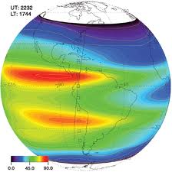
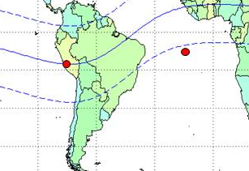
Ionospheric Disturbances
Scintillation phenomena are useful for monitoring the presence of in ionospheric irregularities
  Scintillation also represents a source of degraded performance for some space-based RF systems
Scintillation environment is strongly dependent on the solar cycle and geomagnetic latitude
Much progress has been made recently in specifying and forecasting scintillation occurrence
AFRL PRISM (Parameterized Real-Time Ionospheric Model)
AFRL Legacy SCINDA sites

Slide 17
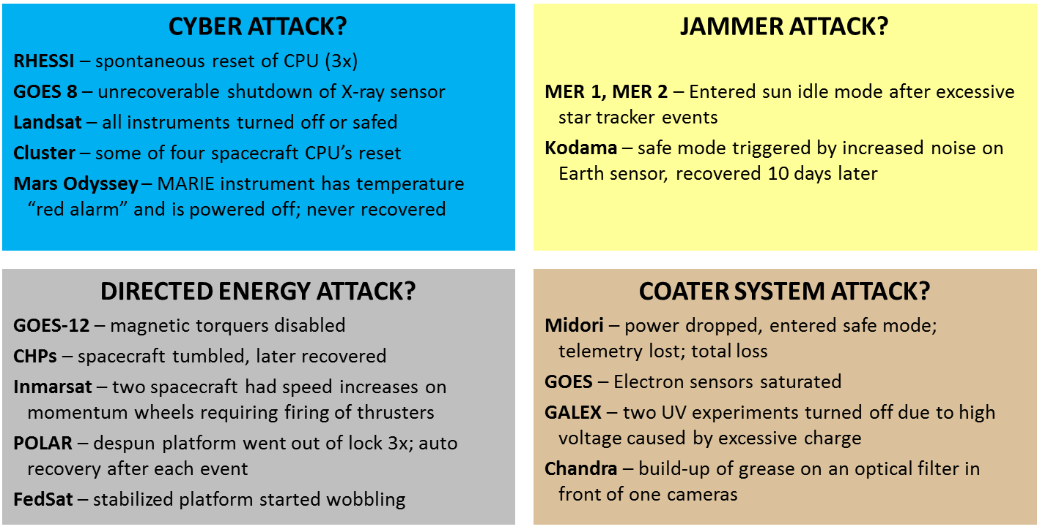
Space Environment Can Mimic Adversary Activity
Halloween 2003 Storms Retrospective Analysis
S. Andrews, “Distributed Threat Warning Study”, MIT/LL Conference
The space environment must quickly be “ruled-in” or “ruled-out” in each case

Slide 18
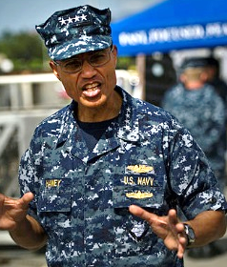
Ensure Space Remains
A Safe Domain for all Legitimate Users
“Our goal is to ensure space remains a safe domain for all legitimate users.
Sharing SSA information and collaborating with other nations and commercial firms promotes safe and responsible space operations, reduces the potential for debris-producing collisions, builds international confidence in U.S. space systems, fosters U.S. space leadership, and improves our own SSA through knowledge of other owner/operator satellite positional data.”
Admiral Cecil Haney, USN Commander, USSTRATCOM
Senate Armed Services Committee Testimony
3/19/2015
Notes:
https://www.stratcom.mil/speeches/2015/130/Senate_Armed_Services_Committee_Testimony/
The U.S. must maintain assured access to space. Our national space capabilities allow us to globally navigate, communicate, and observe natural and man-made events in areas where non-space sensors are either not available or not feasible. Space capabilities are also a key component of strategic deterrence. Our space sensors, command and control systems, and space situational awareness capabilities are critical to supporting both our deployed forces and our national decision making processes.
As articulated in the 2011 National Security Space Strategy, the space domain is contested, congested, and competitive. Our potential adversaries have signaled their ability to conduct hostile operations in space as an extension of the terrestrial battlefield, and consider these operations essential to deny U.S. forces the asymmetric advantages of space. To mitigate this trend, the U.S. continues to partner with responsible nations, international organizations and commercial firms to promote responsible, peaceful and safe use of space. We also strive to maximize the advantages provided by improved space capabilities while reducing vulnerabilities; and seek to prevent, deter, defeat and operate through attacks on our space capabilities.
Foundational to all of these efforts is sufficient Space Situational Awareness (SSA)—the information that allows us to understand what is on orbit, where it is and where it is going, and how it is being used. Our goal is to ensure space remains a safe domain for all legitimate users. Sharing SSA information and collaborating with other nations and commercial firms promotes safe and responsible space operations, reduces the potential for debris-producing collisions, builds international confidence in U.S. space systems, fosters U.S. space leadership, and improves our own SSA through knowledge of other owner/operator satellite positional data.
USSTRATCOM is committed to using the full capabilities of our overhead-persistent infrared systems for all relevant mission areas. We are actively partnering with the Intelligence Community to more effectively manage our intelligence requirements, share data, and ensure all of our assets are effectively working to support national priorities.
In accordance with U.S. law, USSTRATCOM has negotiated SSA Sharing Agreements and Arrangements with 46 commercial entities, two intergovernmental organizations (EUMETSAT and European Space Agency), and eight nations (France, Italy, Japan, Australia, Canada, South Korea, United Kingdom, and Germany) and is in the process of negotiating agreements with additional nations. Through these sharing agreements, USSTRATCOM assists partners with activities such as launch support; maneuver planning; support for on-orbit anomaly resolution, electromagnetic interference reporting and investigation; support for launch anomalies and de-commissioning activities; and on-orbit conjunction assessments.
At the nucleus of USSTRATCOM’s approach to space security is both strategic and tactical mission assurance—ensuring Combatant Commanders have required access to space-based capabilities, achieved through freedom of action in space. USSTRATCOM’s Joint Functional Component Command for Space (JFCC Space), located at Vandenberg Air Force Base in California, leads the efforts to ensure continuous and integrated space operations and routinely track tens of thousands of space objects in orbit around the Earth. This includes more than 1,100 active satellites owned and operated by approximately 60 nations and government consortia, plus hundreds of small commercial and academic satellites. In 2014, this allowed JFCC Space to issue more than 12,000 conjunction alerts, resulting in 121 collision avoidance maneuvers, to include several maneuvers by the International Space Station.
We must sustain judicious and stable investments to preserve the advantages we hold in this dynamic and increasingly complex environment. Examples include the Space Fence program which will greatly expand the capacity of the Space Surveillance Network, investments in modeling and simulation which will increase our understanding of the space environment and adversary capabilities, and funding for satellite communications that are resistant to interference. We must also continue to seek out innovative and cooperative solutions with Allies and partners to ensure the products and services we derive from operating in space remain available, even when threatened by natural events or the actions of a determined adversary. These include both active and passive protection measures for individual systems and constellations and a critical examination of the architectural path we will follow to ensure resilience and affordability in space.
Senate Armed Services Committee Testimony
Admiral Cecil D. Haney
3/19/2015

Slide 19
Questions?

