Slide 1
ACI Meeting 7th and 8th December 2016
Mike Trethewey Control Loop Concepts Ltd (CL2)

Slide 2
Overview
CL2 Capability & Facilities
Networking of Sensors
GEO & MEO Observations
Work is part funded by STFC/DSTL contracts

Slide 3
CL2 at STFC Chilbolton
Satellite IOT since 2005 (Giove A & Giove B)
Located at Chilbolton since 2010
EO Tracker platform development & testing
Satellite EO Observations since June 2014

Slide 4
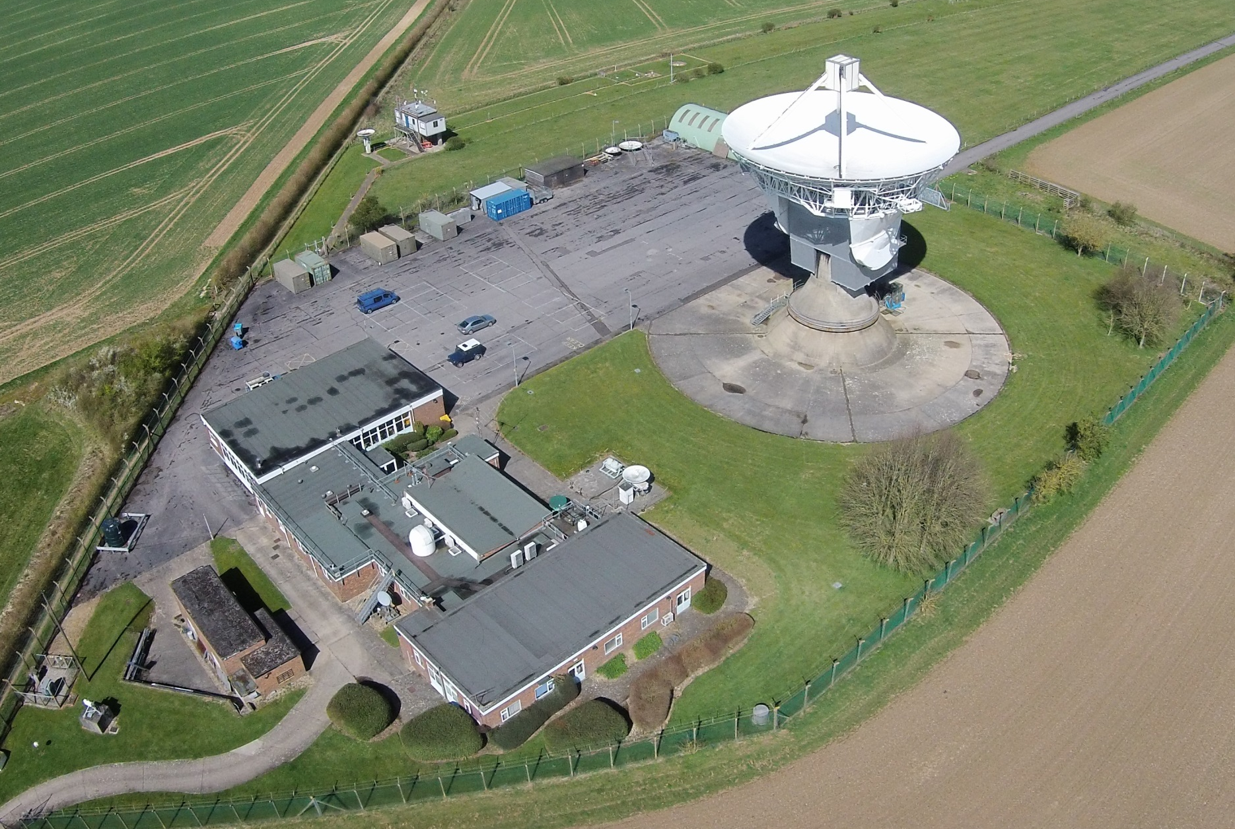

Slide 5
CL2 Tracking Involvement
Platform Development with Acuitas AG
Control system design
System Integrator
Provision of real-time software
Customer specials
Long Experience with Control System Design & Electro-Optical Auto-Trackers

Slide 6
Acuitas Tracking Platforms Acuitas AG Alpendorf SZ Switzerland www.acuitas.ch

Slide 7
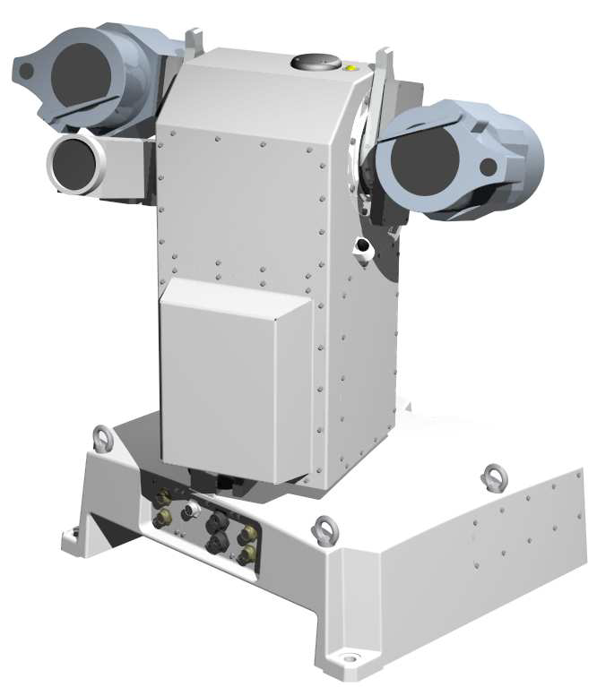
Platform Features
High rate, precision platform for target tracking.
Direct drives
Support for multiple sensors (COTS)
Optical cameras
IR cameras
Radar
Permanent, Semi-portable or portable deployable onto pre-prepared plinths.
Self calibrating.
Auto-track capability

Slide 8
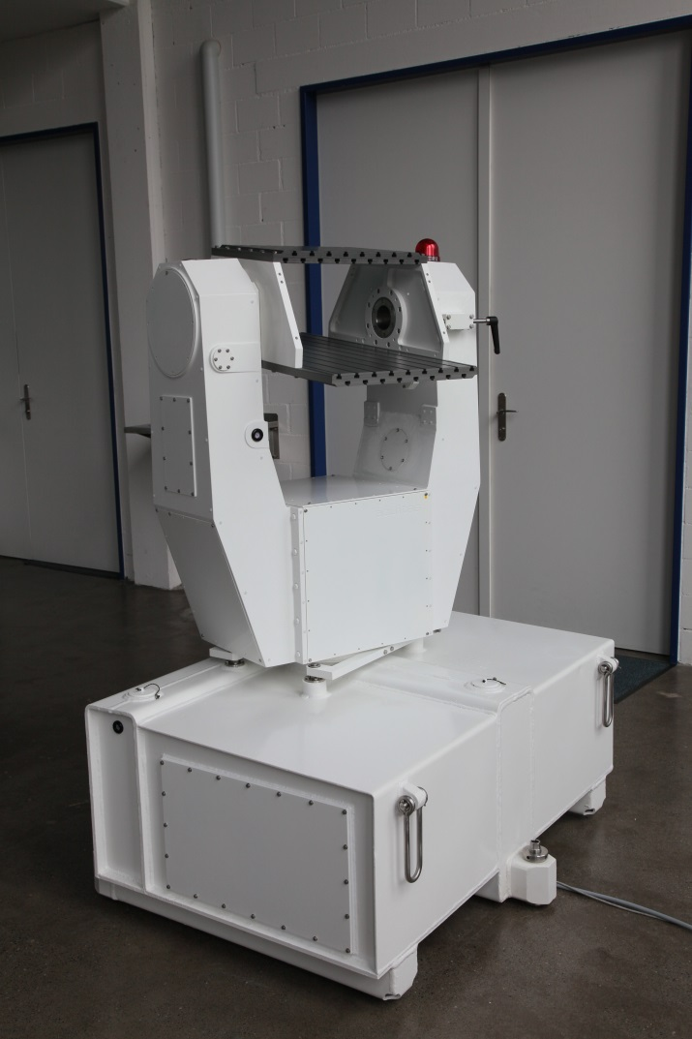
USP U42
Rate: > 100 deg/s
Acceleration: > 100 deg/s²
Bandwidth: > 15 Hz
Resolution: < 0.04 arc-sec
Update rate: 1 kHz
T42 Accuracy: 3 to 5 arc-sec
System Acc’y: < 20 arc-sec

Slide 9
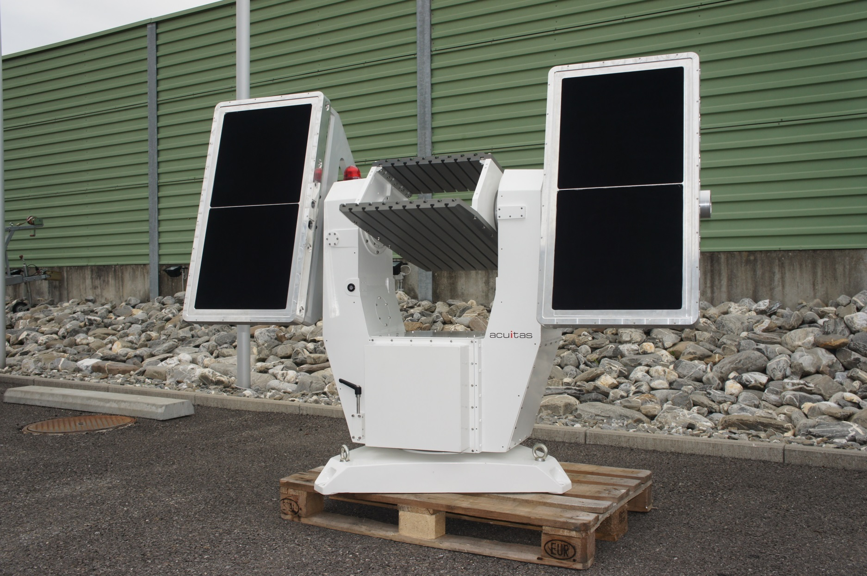
USP U42

Slide 10
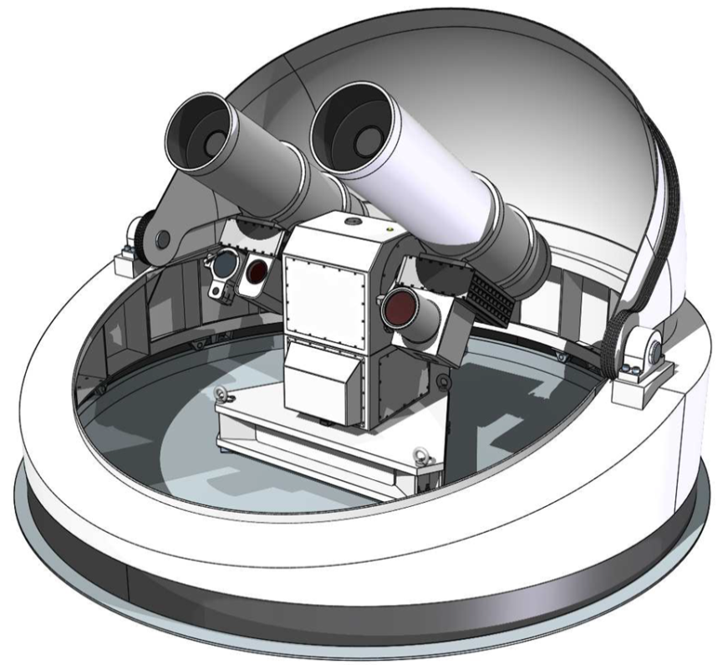
USP T33 Performance
Rate: > 120 deg/s
Acceleration: > 120 deg/s²
Bandwidth: > 15 Hz
Resolution: < 0.04 arc-sec
Update rate: 1 kHz
T33 Accuracy: 3 to 5 arc-sec
System Acc’y: < 20 arc-sec

Slide 11
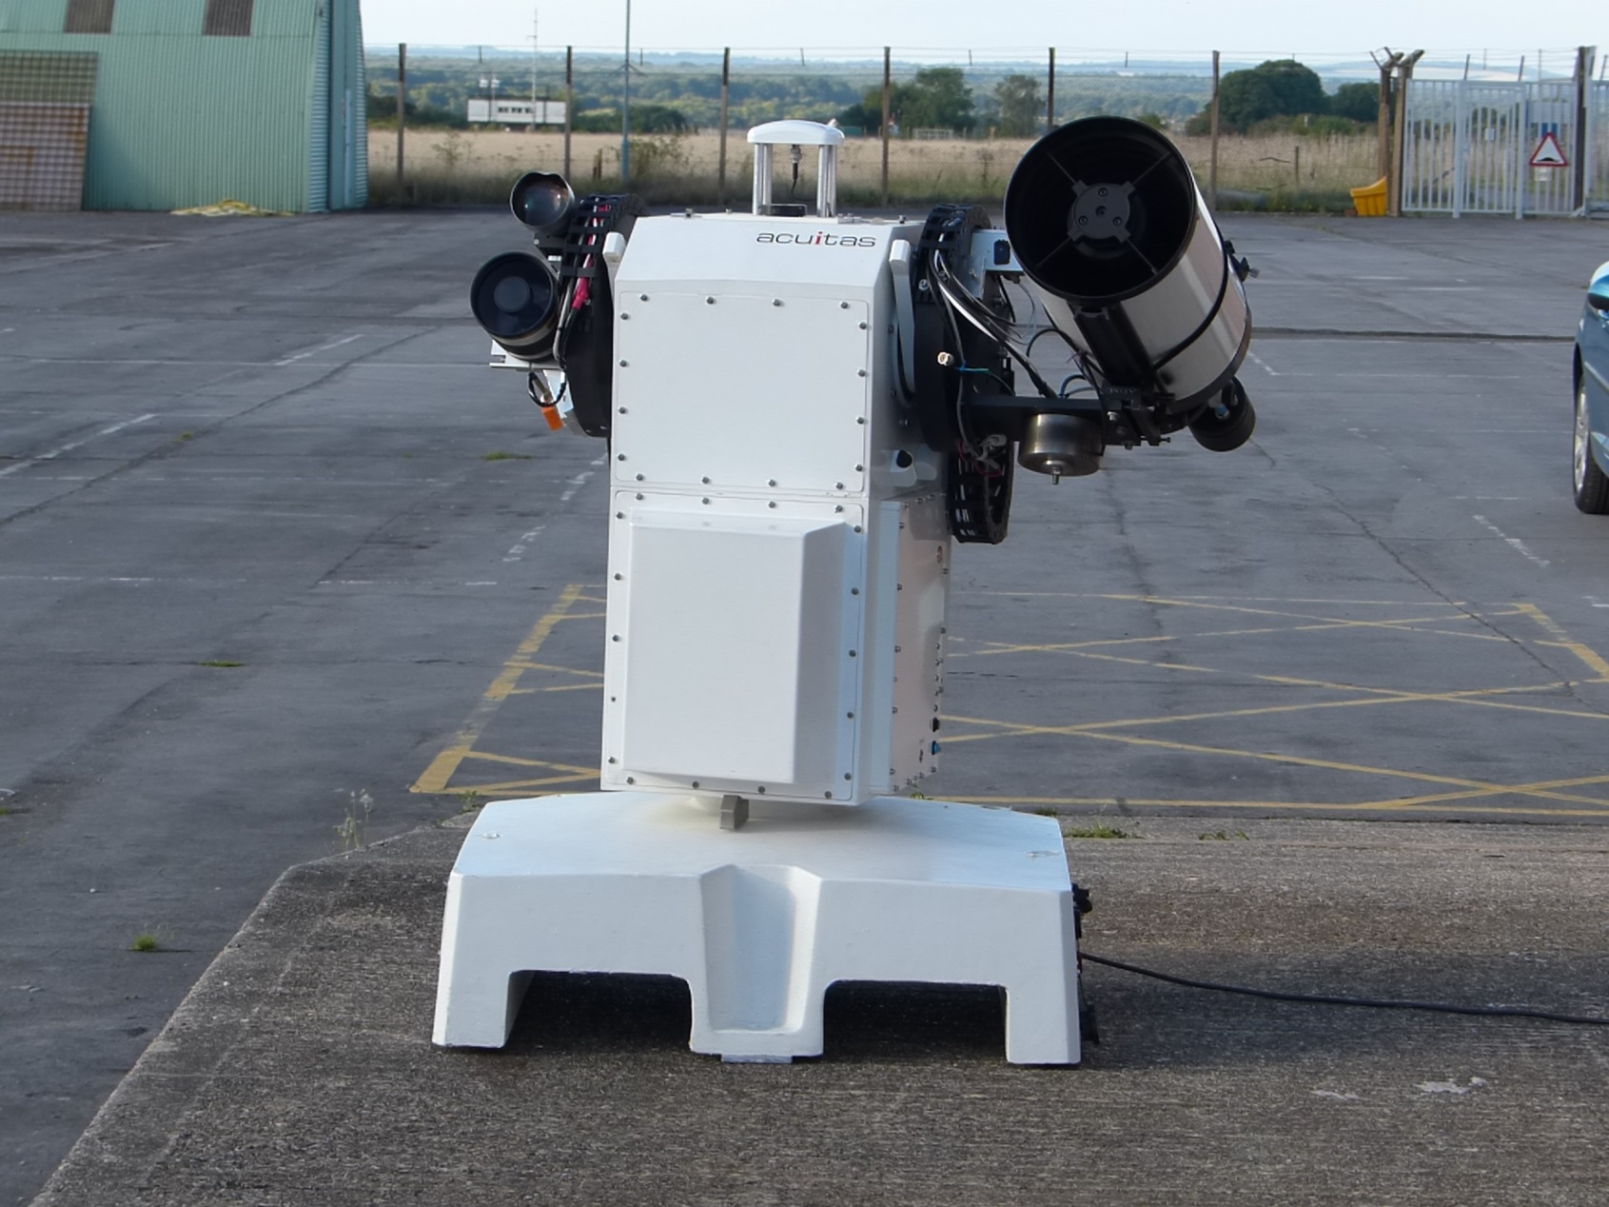
Development Platform (COATS)

Slide 12
COATS with 8” Telescope
Three sensors:
7 to 0.78 deg FOV, 75 mm
0.5 deg FOV, 100 mm
0.24 deg FOV 205 mm
Richey-Chretien 8” telescope
With filter wheel
(720 760 800 850 950 1000 nm LP filters)

Slide 13
Sensor Networking

Slide 14
Sensor Networking
CL2 Developed
Real-time Client-Server protocol (MEP)
Chilbolton 25 m Radar Antenna server (Gandalf)
Client for COATS
Client for SGF at Herstmonceux (under development with the SGF)
Demonstrated operation between COATS & Chilbolton radar (CASTR)
7th Match 2016

Slide 15
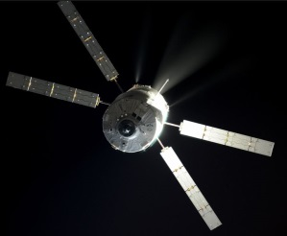
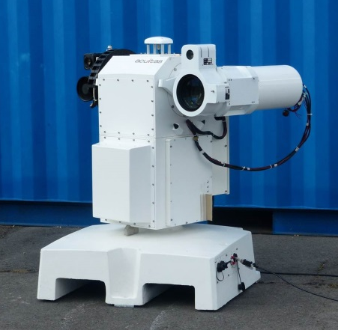
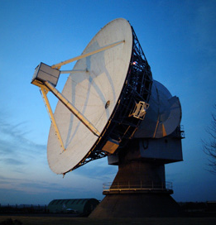
Radar Cueing/Slaving
25 m Antenna Server (Gandalf) accepts inputs from multiple sensors using MEP

Slide 16
Network Development
Client
MEP
Gandalf

Slide 17
Network Development
Client
MEP
Gandalf
MEP
Client

Slide 18
Network Development
Gandalf #2
Client
MEP
MEP
Gandalf
MEP
Client

Slide 19
Network Development
Gandalf #2
MEP
Client
MEP
MEP
Gandalf
MEP
Client

Slide 20
Network Development
Gandalf #2
MEP
Client
MEP
MEP
MEP
Gandalf
MEP
Client
Client

Slide 21
GEO & MEO Observations

Slide 22
GEO & MEO Observations
Results of observations with CL2 Observation And Tracking System (COATS):
18th to 20th July 2016
15th August 2016
28th & 29th November 2016

Slide 23
Selected GEOs & MEOs
GEOs
Skynet 6
Astra 16
Inmarsat 3
LUCH 1
SES 1
Hylas 2
MEOs / IGSO
Galileo 8
GPS 9
Bediou 4
GLONASS 9

Slide 24
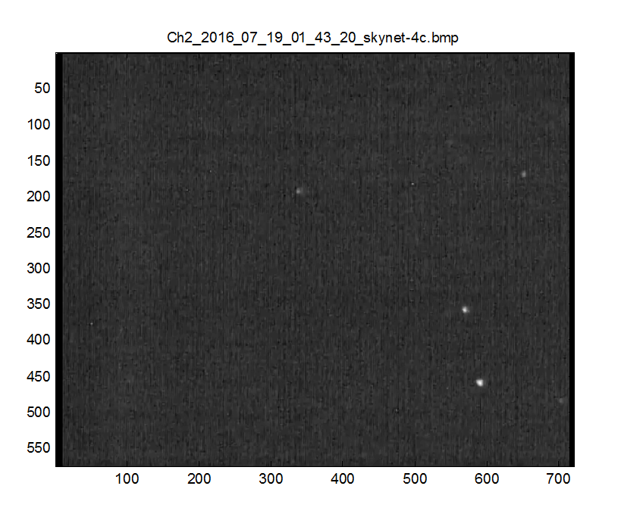
Skynet 4C

Slide 25
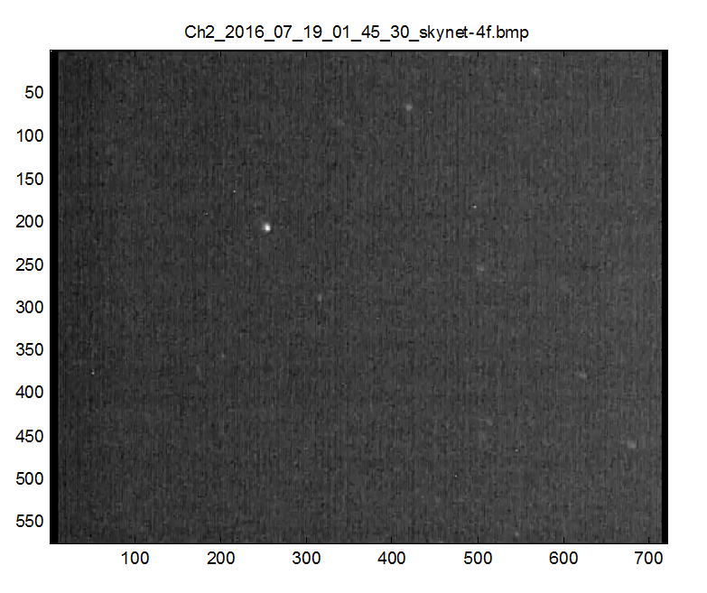
Skynet 4E & 4F
Notes:
Separation ~ 50km

Slide 26
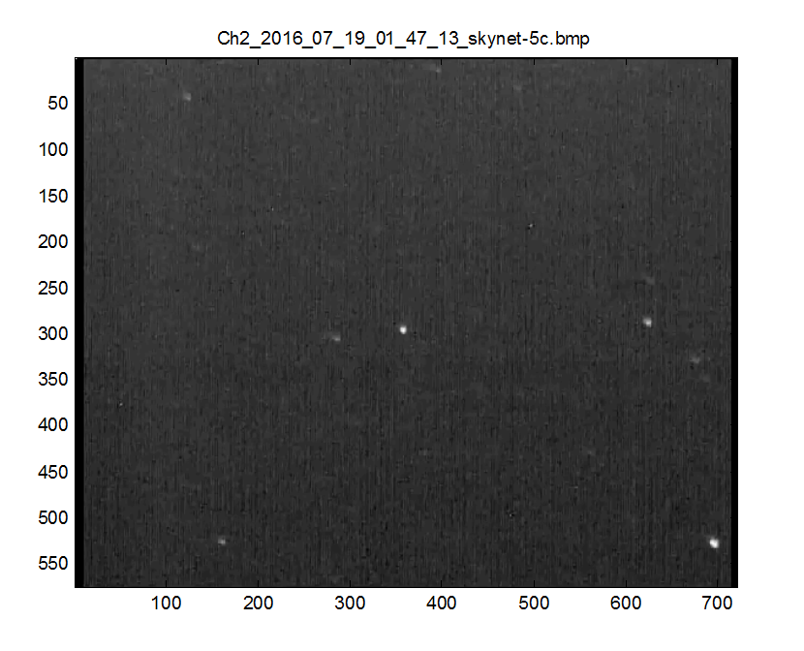
Skynet 5C

Slide 27
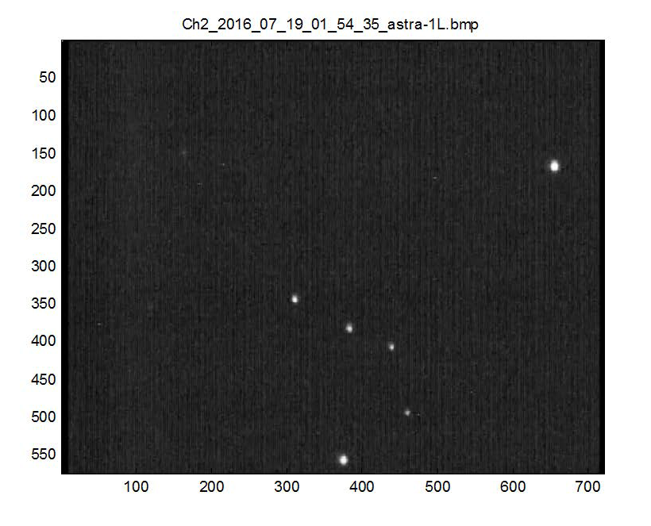
Astra 1KN, 1L, 1M, 1N: 19.2° E

Slide 28
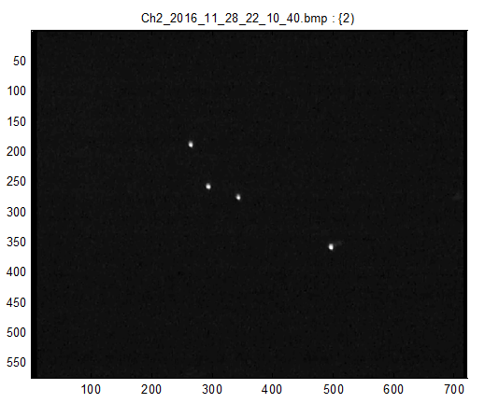
Astra 1KN, 1L, 1M, 1N: 19.2° E

Slide 29
Astra Sequence

Slide 30
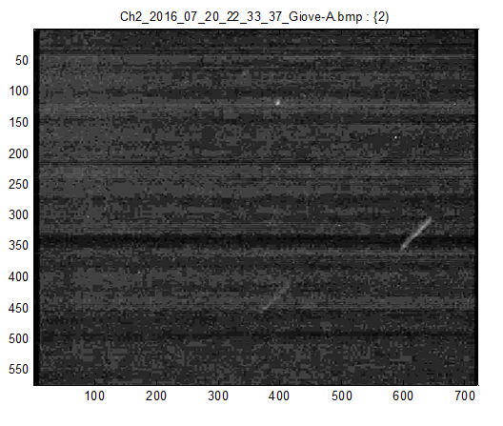
Giove A

Slide 31
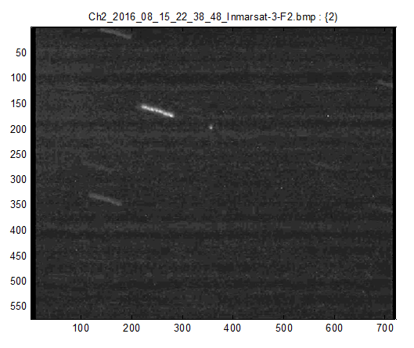
Inmarsat 3-F2

Slide 32
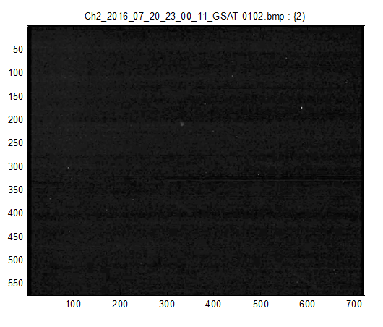
Galileo FM2

Slide 33
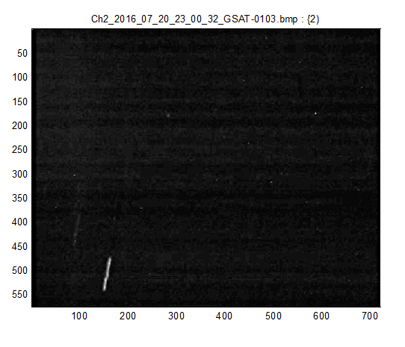
Galileo FM3

Slide 34
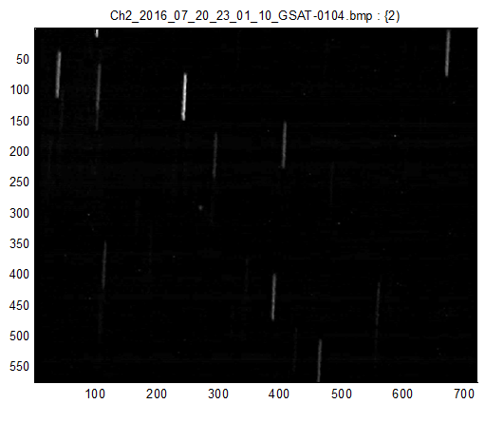
Galileo FM4

Slide 35
In Summary
Networking of Sensors demonstrated
GEO & MEO observations possible with
8” aperture telescope
Sensitive camera
Favourable phase angles
Favourable position of the Moon

Slide 36
Thank you

